Slide 1
Professional Vue.js Development
Vue 3 · Composition API · Vite · Pinia · Vitest
Version 2.2 · © 2026 Chris Minnick · WatzThis?
Notes:
TIMING: Day 1, 8:30. Have this slide up while people arrive.
DO: Before class starts, confirm every student can run `node -v` and sees 20.19+ or 22.12+. Vite 8 will refuse to start on anything older, and fixing Node versions mid-lab costs far more time than doing it now.
DO: Put the repo URL somewhere visible (chat or whiteboard): https://github.com/watzthisco/pro-vue — the solutions folder has a finished version of every lab, so nobody gets permanently stuck.
SAY: Welcome to Professional Vue.js Development. Over the next three days we'll go from "what is Vue?" to a working, tested, routed, store-backed single-page app built on the current Vue 3 toolchain.

Slide 2
Introduction and Vue Quickstart
DAY 1
Who we are, what Vue is, and your first Vite project
Professional Vue.js Development
2
Notes:
TIMING: About 60 minutes for this part, including Labs 01 and 02.
SAY: We'll start with introductions and the schedule, then look at what Vue is and why it's designed the way it is, and finish by scaffolding a real Vite project you'll keep building on for the rest of the course.

Slide 3
Introduction
DAY 1
Objectives
Who am I?
Who are you?
Daily schedule
Course schedule and syllabus
Professional Vue.js Development
3
Notes:
SAY: Before we touch any code, let's get to know each other and set expectations for how the days will run.
TIP: Keep this part brisk (10-15 minutes total). The introductions on slide 5 are where you learn what this group needs; take notes on JavaScript levels so you know how much of the optional JavaScript review appendix to use.

Slide 4
About Me
Chris Minnick — author, trainer, developer
Teaching programming since 2000
Teaching AI since 2023
Author of over 25 books and numerous courses on programming and AI
JavaScript All-in-One For Dummies, ReactJS Foundations, Coding with AI For Dummies, and more
Founder of WatzThis? — books, courseware and training
Professional Vue.js Development
4
Notes:
SAY: A minute or two about yourself. The point isn't the resume; it's to tell the class you write and teach this material for a living, so questions that go beyond the slides are welcome.
TIP: Mention that you'll be live-coding demos and that mistakes during demos are part of the lesson: reading error messages out loud is one of the most useful things students can watch.

Slide 5
Introductions
What's your name?
What do you do?
JavaScript level: beginner, intermediate, or advanced?
What do you want to know at the end of this course?
What do you like to do for fun?
Favorite food?
Professional Vue.js Development
5
Notes:
DO: Go around the room (or the call). Ask everyone to answer every question.
DO: Write down each person's JavaScript level and their "what do you want to know" answer. Use them to decide:
- How much of the JavaScript review appendix (slides 262-307) to use, and when.
- Which topics deserve extra time (people often ask about testing, state management, or migrating from Vue 2).
TIP: If someone mentions a Vue 2 codebase, promise to call out "what changed from Vue 2" as we go. The slides flag those differences throughout.

Slide 6
Daily Schedule (CT)
Morning
8:30 – 10:30 session
10:30 – 10:45 break
10:45 – 12:00 session
12:00 – 1:00 lunch
Afternoon
1:00 – 2:00 session
2:00 – 2:15 break
2:15 – 3:15 session
3:15 – 3:30 break
3:30 – 4:30 session
Professional Vue.js Development
6
Notes:
SAY: This is a rough plan. We'll take breaks at natural stopping points, which may shift by a few minutes depending on where we are in a lab.
DO: Adjust the times and time zone on this slide for your class before you start. (The original said "CMT"; if you're teaching on Central Time, CT is the usual abbreviation.)
TIP: Labs are where most of the learning happens. If a lab is running long, it's usually better to shorten the next lecture than to cut the lab off.

Slide 7
The Big Picture
Topics covered in this course
Modern JavaScript, the DOM, and async/await
Node.js, npm, Vite and build tooling
Vue templates, directives, forms and styling
Composition API, reactivity and lifecycle hooks
Components, props, slots and composables
Pinia state management, Vue Router and APIs
Debugging with browser and Vue DevTools
ESLint, TDD, Vitest and Vue Test Utils
Transitions and animations
Professional Vue.js Development
7
Notes:
SAY: Day 1 is the foundation: the tooling every modern front-end project runs on, and your first components. Day 2 is core Vue: templates, directives, reactivity, events, lifecycle, forms. Day 3 is building real applications: components in depth, composables, Pinia, routing, talking to an API, and testing.
SAY: The whole time we'll be building one app, a clone of Medium called Conduit, so each lab adds a feature to something real rather than a throwaway exercise.
TIP: If this is a shorter class, say so here and tell students which parts you'll cover lightly (usually the Node/npm/tooling material and the JavaScript review).

Slide 8
What's New in JavaScript (aka ECMAScript)?
ES2015 (ES6) — the big one
Arrow functions
Classes
let and const
Iterators and generators
Modules (import / export)
Promises
A new version every year
ES2020 ?. and ??
ES2021 replaceAll, logical assignment
ES2022 top-level await, class fields, Array.at
ES2023 toSorted, findLast
ES2024 Object.groupBy, Promise.withResolvers
ES2025 iterator helpers, new Set methods
Professional Vue.js Development
8
Notes:
KEY POINT: Vue code is modern JavaScript. Almost every Vue file uses arrow functions, destructuring, modules and async/await, so students who are shaky on these will struggle with the Vue syntax for reasons that have nothing to do with Vue.
SAY: ES2015 was the huge release that turned JavaScript into the language we use now. Since then, a smaller version comes out every June, named for the year.
SAY: You'll see optional chaining (`?.`) and nullish coalescing (`??`) constantly in Vue code. For example, `article.author?.username ?? 'anonymous'`.
DO: Based on the introductions, decide now whether to teach parts of the JavaScript review appendix (slides 262-307) before Day 2. A good trigger: if more than one person rated themselves a JavaScript beginner, do the arrow function, destructuring, modules and promises slides at the end of Day 1.

Slide 9
What is Vue.js?
A progressive, incrementally adoptable, reactive front-end JavaScript framework.
Progressive — start with a <script> tag on one page; grow into a full single-page app with routing, state and a build step
Incrementally adoptable — use as much or as little as you need
Reactive — change the data, and Vue updates the page for you
Framework — opinionated about templates and components, flexible about everything else
Professional Vue.js Development
9
Notes:
KEY POINT: The thing that makes Vue different from other front-end frameworks is its philosophy of incremental adoption.
SAY: You don't have to buy into an entire ecosystem to start using Vue. You can drop it into an existing page with a script tag and enhance one widget. As your needs grow, the same Vue scales up to a full build with single-file components, routing, a store and tests. The official tools for each of those layers come from the Vue team, so they fit together.
ASK: Who here is adding Vue to an existing app, and who is starting something new? Both are common, and Vue handles both well.

Slide 10
What is Reactivity?
The way an application changes the view in response to changes in its state.
const count = ref(0) // state
count.value++ // change the state...
<p>{{ count }}</p> <!-- ...and the view updates itself -->
You never write "find the element and update its text"
Vue tracks which parts of the page read which state
When state changes, only the affected parts re-render
Professional Vue.js Development
10
Notes:
SAY: "Reactive" in front-end development means the page changes in response to changes in data. Every modern view library does this; the differences are in how.
SAY: Think of a spreadsheet. If cell C1 is =A1+B1 and you change A1, C1 updates by itself. You declared the relationship once, and the spreadsheet maintains it. Vue does the same thing for your page: the template declares how the page depends on state, and Vue keeps the page in sync.
KEY POINT: In Vue, reactivity is automatic and fine-grained. Vue records which state each component reads while rendering. When that state changes, Vue re-renders only those components. In React, by contrast, you call a setter function and React re-renders the component and its children.
TRANSITION: Next, a bit of history on where Vue came from.

Slide 11
History of Vue.js
Created by Evan You after working at Google with AngularJS
"I figured, what if I could just extract the part that I really liked about Angular and build something really lightweight."
Vue was first released in February 2014
Vue 3 shipped in September 2020 and became the default in 2022
Vue 2 reached end of life on 31 December 2023
Vue 3.6, with the opt-in Vapor Mode compiler, is in release-candidate testing (fall 2026)
Professional Vue.js Development
11
Notes:
SAY: Evan You liked AngularJS's templates and data binding, but found the framework heavy. Vue started as "the good parts, lightweight".
KEY POINT: Vue 2 is end of life. It gets no security fixes unless you pay for extended support. Everything in this course is Vue 3. If students maintain a Vue 2 app, the "Vue 2" notes on many slides will help them migrate.
IF ASKED: What is Vapor Mode? It's an alternative compilation strategy, opt-in per component, that compiles templates to direct DOM operations instead of a virtual DOM. Your component code stays the same; it's a performance option. As of fall 2026, Vue 3.6 is still a release candidate, so we're using Vue 3.5 in class. Check the Vue blog for the current status.

Slide 12
What Makes Vue Different?
Incrementally adoptable
Use it with just a <script> include, or with modern tooling
Combines the best features of React and Angular
More built in than React (templates, transitions, scoped CSS)
Less complex than Angular
Small: about 34 KB gzipped for the runtime plus reactivity
Unused features are tree-shaken out of your bundle
Independent: not created by a giant corporation
Governed by an independent core team, funded by its users and sponsors
Professional Vue.js Development
12
Notes:
SAY: Vue sits between React and Angular. Like Angular, it has templates, directives and official solutions for routing and state. Like React, it's small, component-focused, and stays out of your way.
SAY: "Tree-shaken" means the build removes code you never import. If you never use <Transition>, its code never reaches your users.
IF ASKED: Is Vue used in big companies? Yes. Vue is widely used in production (GitLab, Alibaba, Nintendo and many others have publicly used it). The independent governance means no single company can change its direction.

Slide 13
Comparison of Framework File Sizes
Framework (historical versions) | Size
Angular 2 + Rx | 766 KB
Angular 2 | 566 KB
Ember 1.13.8 | 486 KB
Ember 2.2.0 | 435 KB
Angular 1.4.5 | 143 KB
React 0.14.5 + React DOM + Redux | 139 KB
React 0.14.5 + React DOM | 133 KB
React 16.2.0 + React DOM | 97.5 KB
Vue 2.4.2 | 58.8 KB
Inferno 1.2.2 | 48 KB
Preact 7.2.0 | 16 KB
Historical comparison of minified builds from the Vue 2 era. Current Vue 3: about 34 KB gzipped (runtime + reactivity).
Professional Vue.js Development
13
Notes:
SAY: This is a historical snapshot, and the versions are old, but the shape of it still holds: Vue has always been one of the smaller full-featured frameworks. Preact and Inferno are smaller because they do much less.
KEY POINT: Bundle size matters most on mobile and slow networks. More important than the framework's size is what you add on top, and Vite's tree-shaking keeps unused framework features out of your bundle.
IF ASKED: Current numbers? Measure your own app's build. `npm run build` prints the size of every chunk, gzipped, at the end. That's the number that matters.

Slide 14
Vue vs. React and Angular
All three now favour function-based, composable components: Vue's Composition API, React's hooks, Angular's signals.
Vue and Angular
Two-way data binding with v-model
Data changes update the view
Input in the view updates the data
Built-in directives
v-for, v-if, v-on, v-bind, v-model
HTML-based templates
React
One-way data flow
Events call functions that update state
When state changes, the component re-renders
Mostly plain JavaScript
JSX; map() instead of v-for
Everything is a function
Professional Vue.js Development
14
Notes:
SAY: Vue and Angular give you two-way binding: bind an input to a variable and the two stay in sync in both directions. React is one-way: you write an onChange handler that calls a setter.
SAY: Under the hood, Vue's v-model is a shortcut for exactly what React makes you write by hand: bind the value, listen for input. We'll see that on the forms slides.
SAY: Vue and Angular give you directives, special attributes like v-if and v-for. React uses plain JavaScript expressions inside JSX instead.
KEY POINT: The big convergence: all three frameworks moved toward the same idea, putting related logic together in functions you can extract and reuse. If you know React hooks, Vue's Composition API will feel familiar, minus the rules about dependency arrays.

Slide 15
Vue.js Hello World
DEMO
Files: demos/hello-world.html
<script src="https://unpkg.com/vue@3.5.43/dist/vue.global.js"></script>
<div id="app"></div>
<script>
const { createApp, ref } = Vue
createApp({
template: '<div>{{ message }}</div>',
setup() {
const message = ref('Hello Vue!')
return { message }
}
}).mount('#app')
</script>
No build step: open the file in a browser
Vue 2 wrote new Vue({ el: '#app', data: { ... } })
Professional Vue.js Development
15
Notes:
DEMO: Open demos/hello-world.html directly in the browser (double-click it, or drag it into a browser window). No server needed.
DO: Open DevTools > Console and type `Vue.version` to show that the global build loaded.
DO: Change the message in the file, reload, and show the update. Then point out the three moving parts:
1. The script tag loads Vue's global build, which puts a `Vue` object on window.
2. `createApp()` creates an application from a root component.
3. `.mount('#app')` tells Vue where on the page to render it.
SAY: `setup()` is where Composition API state lives. `ref('Hello Vue!')` creates a reactive value. Whatever setup returns is available to the template.
KEY POINT: This is "progressive" in action: one script tag, no tooling. Later today we'll do the same thing with Vite and single-file components, which is how real projects are built.
IF ASKED: Why `template:` as a string? The global build includes the template compiler, so it can compile templates in the browser. In a Vite project, templates are compiled at build time and the compiler isn't shipped to users.

Slide 16
Virtual DOM
Vue renders your component to a lightweight JavaScript copy of the DOM (the virtual DOM)
When state changes, it renders a new copy and diffs it against the old one
Only the differences are applied to the real browser DOM
In the diagram, only the changed img node is patched
Professional Vue.js Development
16
Notes:
SAY: The browser's DOM is slow to touch, mostly because every change can trigger layout and repaint. A virtual DOM is a plain JavaScript tree that describes what the page should look like. Creating and comparing these objects is cheap.
SAY: Walk through the diagram: on the left is the new virtual DOM after a state change; on the right is the current real DOM. The library diffs the two, sees that only the img node is different (highlighted), and patches just that node.
KEY POINT: You never touch the virtual DOM directly. You change state; Vue figures out the minimum set of DOM updates.
TRANSITION: Vue's virtual DOM has a few tricks other frameworks don't, which is the next slide.

Slide 17
What Makes Vue's Virtual DOM Different?
Compiler-informed: templates are compiled ahead of time, so Vue knows which parts can never change
Static content is hoisted and skipped during diffing
Dynamic nodes are flagged so the diff checks only those
Tracks dependencies automatically
Knows exactly which components need to re-render
Avoids re-rendering components whose state hasn't changed
Can be rendered at runtime or precompiled at build time
Professional Vue.js Development
17
Notes:
KEY POINT: Vue combines a virtual DOM with a compiler. Because templates are more constrained than arbitrary JSX, Vue's compiler can analyze them and mark which nodes are static and which are dynamic. At runtime, Vue skips everything static.
SAY: The second advantage is dependency tracking. When a component renders, Vue records which reactive values it read. Later, when one of those values changes, Vue re-renders exactly the components that read it, and no others. In React you often reach for memo() or useMemo() to get the same effect; in Vue it's the default.
IF ASKED: Is the virtual DOM going away? Vapor Mode (Vue 3.6, still a release candidate) is an opt-in way to compile components without a virtual DOM. The regular virtual DOM mode isn't going anywhere, and the two can be mixed.

Slide 18
Vue Versions
1.0 — improved template syntax, v-for, hot reloading, scoped CSS
2.0 — virtual DOM, JSX support, server-side rendering
3.0 — Composition API, Teleport, Fragments, Proxy reactivity
3.2 — <script setup>, v-memo, custom-element build
3.3 — generic components, better TypeScript for defineProps
3.4 — faster parser, stable defineModel
3.5 — reactive props destructure, lazy hydration, lower memory use
3.6 — Vapor Mode (release candidate as of fall 2026)
Professional Vue.js Development
18
Notes:
SAY: You don't need to memorize this. The reason it's here: when you search for Vue answers, check the date and version. A Stack Overflow answer from 2019 is almost certainly Vue 2 and may not work.
KEY POINT: This course uses Vue 3.5 with `<script setup>`. If you see `export default { data() {...} }` in an example, that's the Options API. It still works in Vue 3 but isn't what we'll write.
TIP: Ask students to run `npm ls vue` in their project later today to see exactly which version they have.

Slide 19
What Vue 3 Changed
Reactivity rebuilt on Proxy
Added and deleted properties are now tracked; Vue.set is gone
The Composition API, and <script setup> on top of it
Fragments: a component may have more than one root element
Teleport: render part of a component elsewhere in the DOM (modals!)
Multiple app instances, each isolated — there is no global Vue
First-class TypeScript support
Removed: filters, $on / $off / $once, old functional component syntax
Professional Vue.js Development
19
Notes:
SAY: These are the changes you'll feel most if you've used Vue 2.
- Proxy reactivity: Vue 2 couldn't see when you added a new property to an object or set an array item by index, so you had to call Vue.set. Vue 3 wraps your data in a JavaScript Proxy, which intercepts every read and write, so those caveats are gone.
- The Composition API lets you organize code by feature instead of by option type, and reuse logic with plain functions called composables. That replaces mixins.
- Teleport is great for modals and tooltips: the component logic stays where it is, but the markup renders under <body>.
- Removed features: filters became methods or computed properties; the event-bus pattern ($on/$off) is replaced by stores or provide/inject.
IF ASKED: Is the Options API deprecated? No. It's fully supported in Vue 3. The Composition API is what new code and the docs default to, and it's what we'll use.

Slide 20
Vue QuickStart
DAY 1
Objectives
Scaffold a project with create-vue
Understand what Vite gives you
Run, build and test a Vue app
Professional Vue.js Development
20
Notes:
TIMING: About 45 minutes including Labs 01 and 02.
SAY: Now let's get you set up with an editor and a real project. By the end of this module every one of you should have the Conduit project running locally with hot reloading.

Slide 21
Code Editors and IDEs
Visual Studio Code with the Vue - Official extension (used in this course)
JetBrains WebStorm / IntelliJ IDEA
Zed
Sublime Text
Neovim / Emacs
Any editor with a Volar (Vue language server) client will give you Vue syntax highlighting, type checking and go-to-definition.
Professional Vue.js Development
21
Notes:
SAY: You can use any editor you like. We'll use VS Code because it's free, popular, and has first-class support from the Vue team through the Vue - Official extension.
KEY POINT: "Volar" is the name of the Vue language server. Vue - Official in VS Code, WebStorm's built-in Vue support, and the Neovim/Zed plugins all use it, so you get the same features everywhere.
WATCH FOR: Students with the old Vetur extension installed. Vetur was for Vue 2 and is deprecated. Running Vetur and Vue - Official together produces duplicate or contradictory errors. Have them disable Vetur.

Slide 22
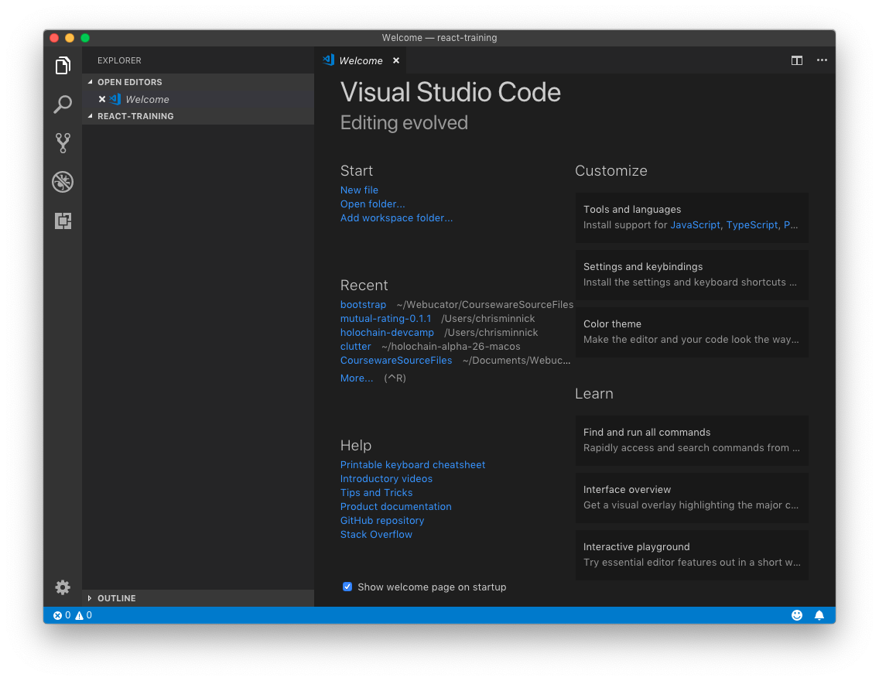
Installing and Configuring VS Code
LAB 01
15 min
Install VS Code and the extensions we use all week.
Install Visual Studio Code
Install the Vue - Official and ESLint extensions
Disable Vetur if you have it
Create a vue-training folder and open it in VS Code
Professional Vue.js Development
22
Notes:
TIMING: 15 minutes. Students who already have VS Code can skip straight to the extensions.
LAB TIPS:
- If you're on locked-down machines, VS Code and Node may need to be pre-installed. Check before class.
- Students using another editor can skip this lab; nothing else in the course depends on VS Code.
WATCH FOR: Vetur. If a student sees duplicate errors in .vue files later, the cause is almost always Vetur and Vue - Official both running.
TRANSITION: While people finish, introduce Vite on the next slide.

Slide 23
Vite
The build tool behind the current Vue tooling (created by Evan You)
Development: serves your source as native ES modules
No bundling step, so startup and reloads stay fast as the app grows
Hot module replacement (HMR) that keeps component state
Production: bundles, tree-shakes and minifies with Rolldown
Vite 8 (March 2026) replaced esbuild + Rollup with Rolldown and Oxc, written in Rust
Framework-agnostic: Vue support comes from @vitejs/plugin-vue
Vue CLI, which used webpack, reached end of life at the end of 2023
Professional Vue.js Development
23
Notes:
SAY: Vite (French for "fast", pronounced "veet") is the build tool for Vue projects today. It does two jobs:
1. In development, it's a dev server. Instead of bundling your whole app before showing anything, it serves each file to the browser as an ES module when the browser asks for it. Startup is nearly instant no matter how large the app gets.
2. For production, it bundles everything into optimized files.
KEY POINT: Hot module replacement means when you save a component, Vite swaps in just that module, and the page updates without a full reload and without losing state. You'll see this in Lab 02.
BACKGROUND: Before Vite 8, Vite used esbuild for dev-time transforms and Rollup for production builds. Vite 8 (released March 12, 2026) replaced both with Rolldown, a Rust bundler, plus the Oxc compiler toolchain. You'll still see esbuild and Rollup in older articles and in Vite 7 projects. Your Vite config mostly doesn't care which is used.
IF ASKED: What about Vue CLI? It was webpack-based, and it's in maintenance mode and end of life. If you have a Vue CLI project, the migration to Vite is mostly moving index.html to the root and replacing vue.config.js with vite.config.js.

Slide 24
Using create-vue
Scaffold a project — nothing to install globally
npm create vue@latest conduit
Then, in the new directory:
npm install
npm run dev # start the dev server on :5173
npm run build # production build into dist/
npm run preview # serve the production build
The prompts let you add TypeScript, Router, Pinia, Vitest, ESLint and Prettier up front
Professional Vue.js Development
24
Notes:
SAY: `npm create vue@latest` downloads the official scaffolding tool, create-vue, runs it, and throws it away. There's nothing to install globally and nothing to keep up to date.
SAY: Walk through the scripts: dev runs the dev server; build creates production files in dist/; preview serves the dist folder locally so you can test the production build before you deploy it.
KEY POINT: In Lab 02 we'll say yes only to Vitest, ESLint and Prettier. We'll add Vue Router and Pinia by hand later so you can see exactly what each one contributes.
WATCH FOR: If `npm create vue@latest` fails with a syntax error or an engine warning, the student's Node.js is too old. Vite 8 needs Node 20.19+ or 22.12+.

Slide 25
Get Started with Vite
LAB 02
30 min
Scaffold the Conduit project with create-vue and see hot module replacement work.
Run npm create vue@latest conduit
Say Yes to Vitest, Linter and Prettier only
npm install, then npm run dev
Open http://localhost:5173 and edit App.vue — watch HMR
Find index.html (in the project root) and vite.config.js
Professional Vue.js Development
25
Notes:
TIMING: 30 minutes, including the Vite and create-vue lecture.
LAB TIPS:
- The prompts: TypeScript No, JSX No, Router No, Pinia No, Vitest Yes, E2E No, Linter Yes, Prettier Yes. Don't install experimental features. Don't skip the example code.
- Have students keep `npm run dev` running in its own terminal tab for the rest of the day. Many "my changes don't show up" problems are a stopped dev server.
COMMON PROBLEMS:
- Node too old: create-vue or Vite errors out. Fix: install the current LTS of Node.js.
- Port 5173 in use: Vite picks the next free port and prints it. Use the URL Vite prints.
- Corporate proxy or firewall blocking registry.npmjs.org: npm install hangs or 403s. Check `npm config get registry` and the proxy settings.
DEBRIEF: Point out that index.html lives in the project root, not public/. It's the entry point, and it loads /src/main.js with a type="module" script tag. That's Vite's design: the HTML file is the start of the module graph.

Slide 26
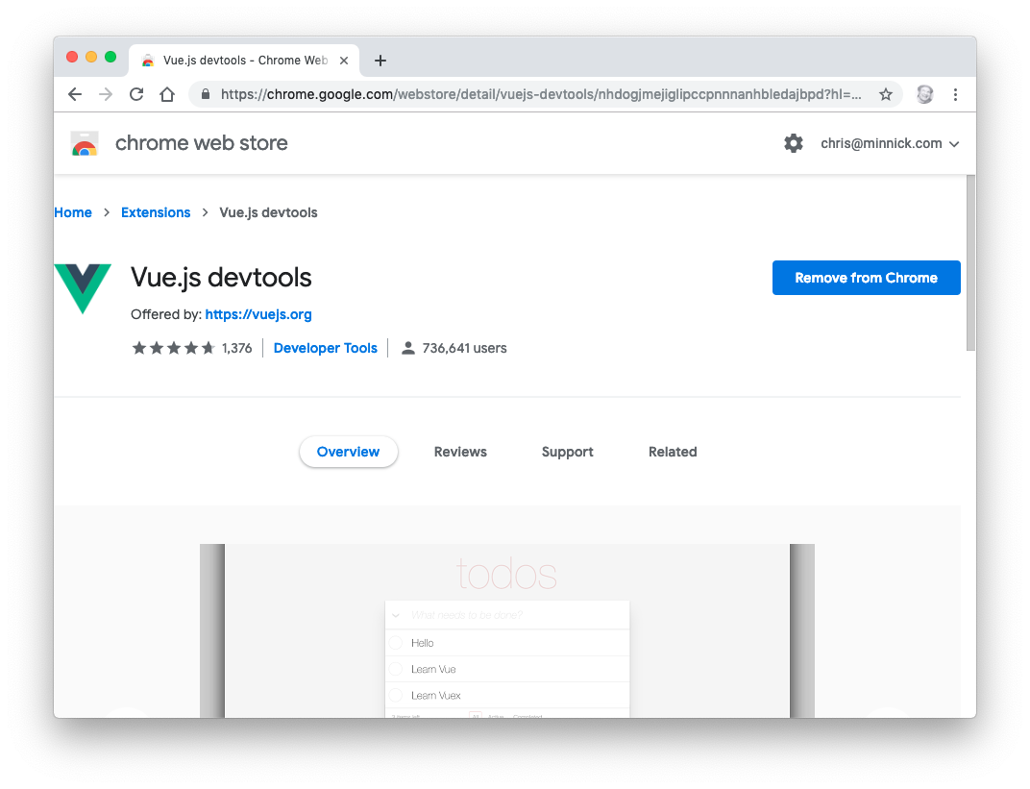
Installing and Using the Vue DevTools
Browser extension for Chrome, Edge and Firefox
devtools.vuejs.org
Or in-page, with no extension: vite-plugin-vue-devtools
Inspect the component tree, props and state
Watch Pinia stores and router state
Timeline of events and performance
Professional Vue.js Development
26
Notes:
SAY: Once you have a Vue project, you'll want Vue DevTools. It adds a Vue panel to the browser's developer tools where you can see your component tree, select a component, and inspect or even edit its props and state live.
DEMO: With your Conduit project running, open the browser DevTools, find the Vue tab, select the App component and expand its children. Then show the in-page option: create-vue can add vite-plugin-vue-devtools, which puts a small Vue logo at the bottom of the page that opens the same tools without installing an extension.
TIP: Students in locked-down corporate browsers often can't install extensions. The Vite plugin is the workaround: `npm install -D vite-plugin-vue-devtools`, then add `vueDevTools()` to the plugins array in vite.config.js.
WATCH FOR: The extension's icon stays grey on pages that aren't using Vue or are a production build. That's normal.

Slide 27
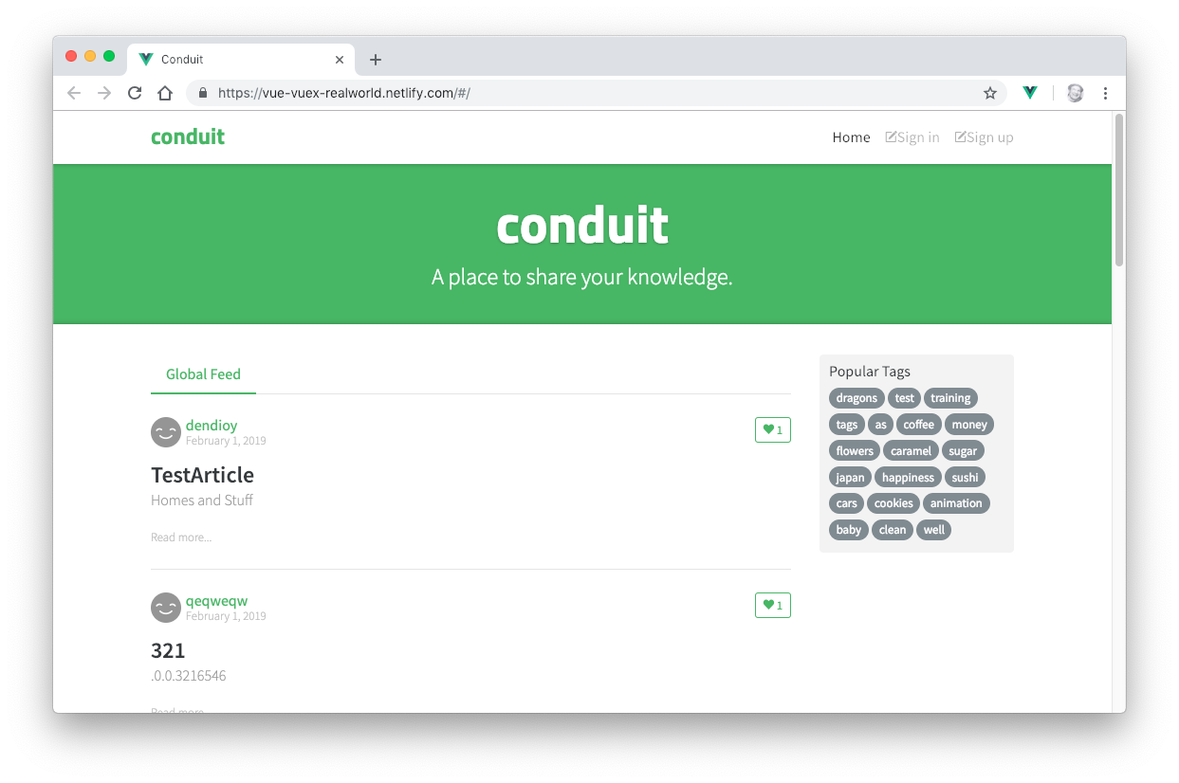
Our Real-World Project: Conduit
An open-source Medium.com clone — the RealWorld example app
We'll build it step by step with:
Components, props, slots and events
A real REST API
Authentication
Routing and Pinia state management
Unit tests
Professional Vue.js Development
27
Notes:
SAY: In this class we're building a real-world application based on Conduit, an open-source clone of Medium.com. The RealWorld project publishes the same app spec and API for dozens of front-end and back-end frameworks, so there's a real API to talk to.
DO: Before the next lab, show a running instance. The lab guide links to https://vue3-realworld-example-app-mutoe.vercel.app. Click around: the global feed, tags, an article page, sign in and sign up. Tell students that by the end of Day 3 their app will do most of this.
NOTE: The earlier version of these notes pointed at conduit.watzthis.com; use whichever instance is working on the day and make sure the URL in the lab guide matches.

Slide 28
Single-File Components
<script setup>
import { ref } from 'vue'
const count = ref(0)
</script>
<template>
<button @click="count++">Clicked {{ count }} times</button>
</template>
<style scoped>
button { font-weight: bold; }
</style>
<script setup> — the logic, using the Composition API
<template> — the markup
<style scoped> — CSS that applies to this component only
One file, one component, named after the file. Compiled at build time, so the format costs nothing at runtime.
Professional Vue.js Development
28
Notes:
KEY POINT: A Vue single-file component (SFC) is a .vue file with up to three blocks: script, template, style. Everything about one piece of UI lives in one file.
SAY: Walk through the example:
- In <script setup>, `ref(0)` creates reactive state. Anything declared at the top level is automatically available to the template.
- In the template, `@click="count++"` listens for clicks, and `{{ count }}` displays the value. When count changes, the button re-renders.
- `scoped` on the style tag means these styles only apply to this component's elements. Vue does this by adding a unique data attribute to the elements and the CSS selectors.
ASK: What's the component's name? Answer: whatever the file is called. If this is Counter.vue, you use it as <Counter />.
SAY: Browsers can't read .vue files. The Vite plugin compiles each SFC to a plain JavaScript module at build time (or on request during dev).

Slide 29
Your First Component
LAB 03
30 min
Create TheHeader.vue, a static Bootstrap navbar, and use it in App.vue.
Components are reusable modules composed into user interfaces
Vue components are single-file components: template, script and style
We write them with <script setup>
Every top-level binding is available to the template
Importing a child component is its registration
Add Bootstrap 5 to index.html
Professional Vue.js Development
29
Notes:
TIMING: Labs 03 and 04 together take about 60 minutes.
SAY: Although you can use Vue with a script tag, as we just did, real projects are built from components. In this lab you'll write your first one: the page header.
LAB TIPS:
- Remind students to include the .vue extension in imports: './components/TheHeader.vue'. Vite won't resolve extensionless .vue imports.
- Bootstrap's CSS link goes in index.html in the project root. Bootstrap 5 has no jQuery dependency.
COMMON PROBLEMS:
- Check the lab guide: one step shows `import TheHeader from './components/PageHeader.vue'`, but the file students create is TheHeader.vue. Tell students to import './components/TheHeader.vue'.
- A blank page usually means an import error. Have students open the browser console, where Vite shows the exact file and line.
- ESLint's vue/multi-word-component-names rule complains about single-word names like Header.vue. That's why we use TheHeader, HomeContent and TheFooter.

Slide 30
Create More Components
LAB 04
30 min
Build static HomeContent and TheFooter components so App.vue is composed of three parts.
Replace the welcome components in App.vue with <TheHeader />, <HomeContent /> and <TheFooter />
Write the static HTML for the home page from the screenshot
banner, global feed, popular tags sidebar
Write the static footer
Try it yourself before looking at the solution in the lab guide
Professional Vue.js Development
30
Notes:
SAY: In this lab you'll get more practice creating components before we dive into what's happening behind the scenes with the tooling.
LAB TIPS:
- Encourage students to try writing the HomeContent markup from the screenshot before copying the solution. It's good practice in breaking a design into elements.
- It's fine if it's ugly at this point. Styling comes in Lab 12.
WATCH FOR: Students forgetting to remove the HelloWorld and TheWelcome imports from App.vue. ESLint will flag the unused imports.
DEBRIEF: Ask: how many components does the page have now? (App, TheHeader, HomeContent, TheFooter.) Draw the tree on the whiteboard. You'll keep extending this tree all week.

Slide 31
Testing Vue
LAB 05
20 min
Write your first component tests with Vitest and Vue Test Utils.
Create tests/components/Header.spec.js
mount() the component and assert that it exists
Check the test section in vite.config.js (jsdom environment)
Copy the spec for HomeContent and TheFooter
Run npm run test, then try watch mode
Professional Vue.js Development
31
Notes:
TIMING: 20 minutes, right after lunch.
SAY: We'll write tests from the very beginning, so testing is a habit rather than an afterthought. These first tests are simple smoke tests: does the component mount without throwing? We'll go much deeper into Vitest on Day 3.
LAB TIPS:
- `@/` in imports is an alias for src, configured in vite.config.js by create-vue.
- If jsdom isn't installed: `npm install --save-dev jsdom`.
- Make sure the `include` pattern in the test config matches where students put their files (tests/**/*.spec.js).
COMMON PROBLEMS:
- "document is not defined": the test environment isn't set to jsdom.
- No tests found: the include pattern doesn't match the file name or folder.
DEBRIEF: Show that Vitest's watch mode re-runs only the tests related to the file you saved. That fast feedback is the whole point of using Vite's test runner.

Slide 32
Node.js
DAY 1
Objectives
Install Node
Test Node and get started using npm
Understand why front-end tooling runs on Node
Professional Vue.js Development
32
Notes:
TIMING: About 40 minutes, including Lab 06.
SAY: Behind modern JavaScript development is Node.js. It runs the scripts we use for linting, testing, previewing and building applications. You don't need to become a Node developer to use Vue, but understanding what Node is and how npm works will make the tooling much less mysterious.
TIP: If the class is experienced with Node, move quickly through slides 33-45 and spend the time on the labs.

Slide 33
What is Node.js?
A JavaScript runtime outside the browser
Built on Google Chrome's V8 JavaScript engine
Open source
Event-driven and non-blocking: it never sits and waits for I/O
Single-threaded, yet handles thousands of concurrent connections with little overhead
Used on the server, and for development automation
Every tool in this course — Vite, ESLint, Vitest, npm — is a Node program
Professional Vue.js Development
33
Notes:
SAY: Node started its life as a way to run JavaScript on the server. It has also become the platform for almost all front-end development tooling.
SAY: Node takes the V8 engine from Chrome and adds things browsers don't have, like access to the file system, networking and processes, and removes things only browsers have, like the DOM and window.
KEY POINT: "Non-blocking" is the big idea. When Node asks for a file or a network response, it doesn't wait. It registers a callback, keeps running other code, and handles the result when it arrives. That's how one thread can serve thousands of connections.
ASK: Has anyone written a Node script before? If several have, move faster through the next few slides.

Slide 34
How is Node.js Different?
JavaScript is single-threaded
A Node application has one event loop, and gets the benefit of concurrency through asynchronous operations
Can handle thousands of concurrent connections with minimal overhead
No buffering
Node streams data in chunks instead of loading it all into memory
Non-blocking
Node doesn't wait for data to be returned from APIs
It's possible to write blocking code in Node.js (readFileSync), but it's discouraged in servers
Professional Vue.js Development
34
Notes:
SAY: Traditional servers like Apache historically used a thread per request. Each thread costs memory, and most of the time those threads are just waiting for a database or a disk.
SAY: Node uses one thread and an event loop. Instead of waiting, it hands off the slow work (file reads, network calls) to the operating system and moves on. When the work finishes, a callback is queued and the event loop runs it.
SAY: The analogy: a restaurant where one waiter takes everyone's orders and hands them to the kitchen, rather than one waiter per table who stands at the kitchen door until the food is ready.
WATCH FOR: The phrase "no buffering" can be misleading. Node does use buffers internally; the point is that it streams data in chunks rather than waiting to accumulate the whole thing.

Slide 35
The Event Loop
Problem: JavaScript is single-threaded
The event loop lets Node.js perform non-blocking I/O
Offloads operations to the system kernel when possible
Node starts the event loop when it starts your program
Each turn of the loop runs through six phases
Between turns, Node checks whether anything is still pending, and exits if nothing is
Professional Vue.js Development
35
Notes:
SAY: The event loop is a loop that runs for the life of your program. Each time around it checks queues of callbacks that are ready to run: timers that have expired, I/O that has completed, and so on.
SAY: That's why a Node script that only does `console.log('hi')` exits immediately (there's nothing pending), but a script that starts a server keeps running (the server is waiting for connections, so there's always something pending).
KEY POINT: The same idea applies in the browser. A long-running synchronous loop blocks everything, including clicks and rendering. That's why we use async/await for anything slow.

Slide 36
Recap: How is Node.js Different?
JavaScript is single-threaded
A Node application has one event loop, and gets the benefit of concurrency through asynchronous operations
Can handle thousands of concurrent connections with minimal overhead
No buffering
Node streams data in chunks instead of loading it all into memory
Non-blocking
Node doesn't wait for data to be returned from APIs
It's possible to write blocking code in Node.js (readFileSync), but it's discouraged in servers
Professional Vue.js Development
36
Notes:
NOTE: This slide repeats slide 34 on purpose, as a recap before the event loop phases. If you're short on time, skip it.
ASK: Now that you've seen the event loop, how does a single thread handle thousands of connections? (Answer: it never waits; slow work is handed to the OS, and the loop runs the callbacks as results come back.)

Slide 37
Event Loop Phases
timers — runs setTimeout() and setInterval() callbacks
pending callbacks — I/O callbacks deferred from the previous turn
idle, prepare — internal use only
poll — retrieve new I/O events; run their callbacks
check — run setImmediate() callbacks
close callbacks — e.g. socket.on('close', ...)
Promise callbacks (microtasks) run between each callback, before the loop moves on.
Professional Vue.js Development
37
Notes:
SAY: You won't need these phases day to day, but they explain some surprising ordering.
SAY: The one most people trip on: `setTimeout(fn, 0)` vs `setImmediate(fn)`. From the main module the order isn't guaranteed; inside an I/O callback, setImmediate always runs first, because check comes right after poll.
KEY POINT: Promise callbacks (`.then`, and the code after `await`) are microtasks. They run as soon as the current callback finishes, before the event loop moves to the next callback or phase. That's why `Promise.resolve().then(...)` runs before `setTimeout(..., 0)`.
DEMO (optional): In the Node REPL:
setTimeout(() => console.log('timeout'), 0); Promise.resolve().then(() => console.log('promise')); console.log('sync')
Output: sync, promise, timeout.
NOTE: Older docs call phase 2 "I/O callbacks". The current Node docs call it "pending callbacks".

Slide 38
Event Loop
network and disk
setImmediate
poll
timers
"close" events
Professional Vue.js Development
38
Notes:
SAY: Here's the loop visually. Trace one turn: timers, then pending I/O callbacks (network and disk), then poll for new events, then setImmediate callbacks in the check phase, then close events, then back around to timers.
SAY: If nothing is left in any queue and nothing is pending (no open server, no timers), Node exits.
TRANSITION: Node's event-driven style shows up in its APIs too. The most basic example is EventEmitter.

Slide 39
EventEmitter
Node is event driven
EventEmitter is a class that lets you listen for named events and run code when they occur
A very loose way of coupling different parts of your application
import { EventEmitter } from 'node:events'
const ee = new EventEmitter()
ee.on('someEvent', (who) => {
console.log(`event has occurred: ${who}`)
})
ee.emit('someEvent', 'Ada')
Professional Vue.js Development
39
Notes:
SAY: An EventEmitter is a publish/subscribe object. `on()` subscribes a listener to a named event; `emit()` fires the event and calls every listener synchronously, passing along any extra arguments.
SAY: Much of Node is built on it: HTTP servers emit 'request', streams emit 'data' and 'end', processes emit 'exit'.
DEMO: demos/node-basics/event-emitter.js. Run `node event-emitter.js` from that folder.
KEY POINT: Vue components emit events in a very similar way, with `emit('name', payload)` in the child and `@name` in the parent. We'll see that on Day 2.
NOTE: The original slide used `require("events")`. It's updated to ES module syntax to match the rest of the course; both work.

Slide 40
A Simple Node.js Example
import http from 'node:http'
const hostname = '127.0.0.1'
const port = 3000
const server = http.createServer((req, res) => {
res.statusCode = 200
res.setHeader('Content-Type', 'text/plain')
res.end('Hello World\n')
})
server.listen(port, hostname, () => {
console.log(`Server running at http://${hostname}:${port}/`)
})
Professional Vue.js Development
40
Notes:
SAY: This is a complete web server. `createServer` takes a callback that runs once per request; `listen` starts the server and calls its callback once it's ready.
SAY: Notice the event-driven style: we don't loop waiting for requests. We hand Node a function, and Node calls it whenever a request arrives.
DEMO: demos/node-basics/server.js. Run `node server.js`, open http://127.0.0.1:3000, then press Ctrl+C to stop it. Point out that the program keeps running until you stop it, because the server keeps the event loop busy.
KEY POINT: `node:http` is the built-in module. The `node:` prefix makes it clear it's built in and can't be shadowed by an npm package with the same name. Students will write this exact server in Lab 08.

Slide 41
Modules Overview
Node originally used CommonJS for loading modules
Original name was ServerJS
A way to import dependencies outside the browser
module.exports — encapsulates code into a module
require() — imports a module into JavaScript code
Today Node also supports standard ES Modules (import / export), which is what Vite projects use
Professional Vue.js Development
41
Notes:
SAY: JavaScript didn't have a module system until ES2015, so Node invented one: CommonJS. You'll still see it in older Node code and many npm packages: `const x = require('x')` and `module.exports = ...`.
KEY POINT: Browsers don't understand require(). Modern code, including everything in a Vite project, uses ES modules: import and export. Node supports both, which is what the next three slides are about.

Slide 42
CommonJS Example
circle.js
exports.area = function (r) {
return Math.PI * r * r
}
foo.js
const circle = require('./circle.js')
console.log('Area of circle: ' + circle.area(4))
Professional Vue.js Development
42
Notes:
SAY: circle.js adds a function to its exports object. foo.js requires the file and gets that object back.
SAY: require() is synchronous: it reads, runs and returns the module immediately. That works on a server reading from local disk, but it's one reason it was never adopted by browsers.
TRANSITION: Here's the same pair of files written as ES modules.

Slide 43
ES Modules: import and export
JavaScript's standard module format. This example exports and imports a function by name.
circle.js
export function area(r) {
return Math.PI * r * r
}
foo.js
import { area } from './circle.js'
console.log('Area of circle: ' + area(4))
Professional Vue.js Development
43
Notes:
SAY: ES modules are the standard JavaScript module system. Named exports are imported with braces using the exported name. A module can also have one default export, imported without braces: `import App from './App.vue'`.
KEY POINT: Imports are static: they're at the top level and can be analyzed without running the code. That's what makes tree-shaking possible, because the bundler can see exactly which exports are used.
SAY: This rewrites the CommonJS circle example. To run it in Node, configure Node as shown on the next slide.

Slide 44
ES Modules in Node.js
Node.js supports both CommonJS and ES Modules
To run the previous example, add to package.json:
{ "type": "module" }
Node now treats .js files in this package as ES Modules
Run the entry file with node foo.js
Alternative: use .mjs files (and matching imports)
Use .cjs for CommonJS files in an ES Module package
Include extensions in relative imports: ./circle.js
Professional Vue.js Development
44
Notes:
SAY: Put package.json beside foo.js and circle.js. The nearest package.json above a .js file controls how Node interprets it. Add the type field to the existing JSON; don't replace the whole file.
SAY: Alternatively rename both files to .mjs and update the import to ./circle.mjs. The .mjs and .cjs extensions select ES modules or CommonJS regardless of the type field.
KEY POINT: Native Node ES modules require file extensions in relative imports. Bundlers like Vite are more forgiving for .js files, but we'll still write .vue extensions in every import.
SAY: create-vue projects already have "type": "module" in package.json, which is why vite.config.js and eslint.config.js can use import.

Slide 45
Front-end Node
Node has become an essential part of front-end development. It runs:
Package managers (npm, pnpm, yarn)
Dev servers and build tools (Vite)
Test runners (Vitest, Playwright)
Linters and formatters (ESLint, Prettier)
CSS tools (PostCSS, Sass)
Headless browsers for testing (Playwright, Puppeteer)
…and much more
Professional Vue.js Development
45
Notes:
SAY: Even if your app never runs on a Node server, your development workflow runs on Node. Every `npm run` command you type in this course launches a Node program.
NOTE: The original slide listed PhantomJS, a headless browser that was abandoned in 2018. Playwright and Puppeteer are the current equivalents.
TRANSITION: Time to get hands-on with Node and npm.

Slide 46
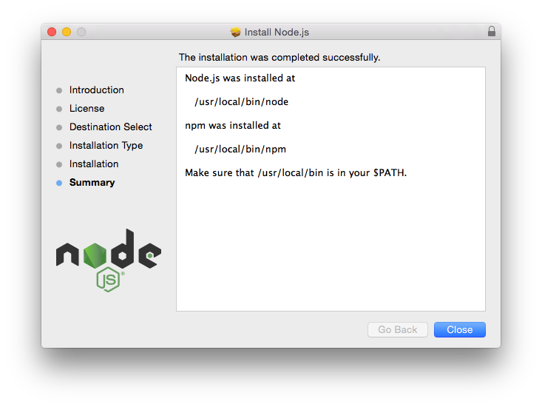
Getting Started with Node.js and npm
LAB 06
25 min
Explore Node in the REPL, run a script from a file, and learn the core npm commands.
Check your version: node -v
Explore the REPL: expressions, process.version, process.platform
Write javascript.js and run it with node
Read a name from process.argv
Part 2: npm -v, npm ls, npm outdated, npm help
Professional Vue.js Development
46
Notes:
TIMING: About 25 minutes.
LAB TIPS:
- Students work in labs/lab06 from the course repo.
- To exit the REPL: Ctrl+D (Mac/Linux), Ctrl+Z then Enter (Windows), or Ctrl+C twice anywhere.
- The `??` in `process.argv[2] ?? 'World'` is nullish coalescing: use the default only when the value is null or undefined.
COMMON PROBLEMS:
- 'node' is not recognized: Node isn't on the PATH. On Windows, closing and reopening the terminal after installing usually fixes it.
- Permission errors on `npm update -g`: don't use sudo. Recommend a Node version manager (nvm, fnm, or Volta).
DEBRIEF: Ask: what's the difference between the REPL and running a file? When would you use each?

Slide 47
Tooling
DAY 1
npm, package.json, linting, transpiling and bundling
Professional Vue.js Development
47
Notes:
TIMING: About 75 minutes for this part, including Labs 07-09.
SAY: For the next few labs, we'll work in separate folders outside the Conduit project, so we can see each fundamental tool on its own before it's hidden inside a create-vue project.

Slide 48
Why Have Tooling?
Front-end web development is complex. Modern tooling helps you achieve four software-development best practices:
Version control — every change tracked (git)
Automation — linting, testing and building run with one command
Reproducible builds — the same inputs produce the same output on every machine (lockfiles)
Test-driven development — fast, automatic feedback
Professional Vue.js Development
48
Notes:
SAY: Each tool we'll look at serves one of these goals.
- Version control: git, plus a .gitignore that keeps node_modules and dist out of the repo.
- Automation: npm scripts, so `npm run lint` or `npm test` does the same thing for everyone.
- Reproducible builds: package.json plus package-lock.json, so a new developer or a CI server gets exactly the same dependency versions.
- TDD: Vitest in watch mode re-running tests on every save.
ASK: Who has had "it works on my machine" problems? Most of them come from missing automation or non-reproducible dependencies.

Slide 49
npm
Installs, publishes and manages Node packages
Bundled and installed with Node
Installs packages from the npm registry (npmjs.com)
Runs project scripts: npm run dev, npm test
npx runs a package's command without installing it globally
Professional Vue.js Development
49
Notes:
SAY: npm is three things: a command-line tool, a public registry of over two million packages, and the website for browsing that registry.
KEY POINT: npm ships with Node. To update npm, the normal approach is to install a newer Node, rather than updating npm on its own.
SAY: `npm create vue@latest`, which we used earlier, is shorthand for running the create-vue package with npx.

Slide 50
Other Package Managers
npm ships with Node.js and is the default
yarn — created by Facebook; offers a Plug'n'Play install mode
pnpm — hard-links packages from a global store, so disk use stays flat
Strict by default: a package can only import what it declares
bun — a JavaScript runtime with a very fast built-in installer
All four read package.json. They differ mainly in their lockfile and how they lay out node_modules.
Professional Vue.js Development
50
Notes:
SAY: You'll run into these in the wild. pnpm in particular is popular for monorepos and is what Vue's own repository uses.
KEY POINT: Pick one per project and stick with it. The lockfile tells you which: package-lock.json (npm), yarn.lock, pnpm-lock.yaml, or bun.lock. Mixing them causes confusing version differences.
SAY: In this course we use npm because it's already installed everywhere.

Slide 51
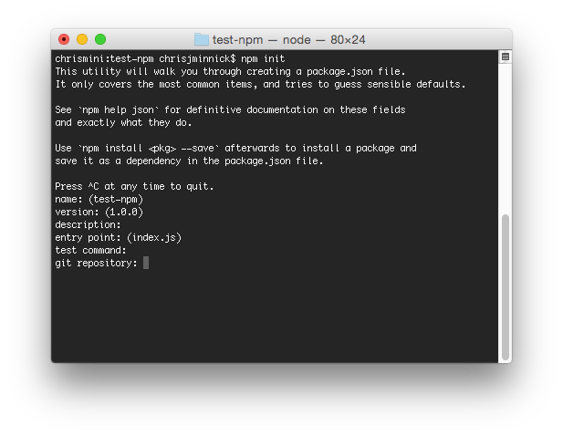
Initialize npm
LAB 07
20 min
Create a package.json with npm init and automate a tiny build with npm scripts.
npm init in labs/lab07
Look at package.json; run npm install to create package-lock.json
Run scripts with npm run and npm run test
Add a build script and a prebuild script that runs your tests first
Professional Vue.js Development
51
Notes:
SAY: npm stores information about your project, and the packages it uses, in package.json. `npm init` creates one by asking you a few questions.
LAB TIPS:
- `npm init -y` accepts all the defaults if students want to skip the questions.
- Git Bash on Windows sometimes hangs after the last npm init question. Ctrl+C is safe; package.json has already been written.
KEY POINT: pre and post scripts: if you define prebuild, npm runs it automatically before build. Lab 09 uses this to run the linter before the tests.
DEBRIEF: Ask why the build fails when the test script exits with 1. (npm stops at the first script that exits with a non-zero code. That's exactly what you want in CI.)

Slide 52
node_modules
Two ways to install npm packages: locally or globally
Local packages go into the node_modules directory of your project
Always run npm install from the folder that holds package.json — the root of your project
npm update updates local packages within their allowed ranges
npm outdated shows which packages have newer versions
Never commit node_modules. It's rebuilt from package.json and the lockfile.
Professional Vue.js Development
52
Notes:
SAY: node_modules is often huge: hundreds of packages, because each dependency has its own dependencies. That's normal.
KEY POINT: node_modules is disposable. When something is mysteriously broken, deleting node_modules and running `npm install` (or `npm ci`) is a legitimate fix. Make sure it's in .gitignore; create-vue does this for you.
WATCH FOR: Students running `npm install` in the wrong folder. That creates a stray package.json and node_modules somewhere unexpected, and then "cannot find module" errors in the real project.
NOTE: Old versions of npm created very deep nested folders that broke Windows' path length limit. Modern npm flattens node_modules, so that's rarely an issue now.

Slide 53
package.json and Semantic Versioning
Manages locally installed npm packages
Documents the packages your project depends on, and the version ranges it can use
With the lockfile, makes your build reproducible
Versions use semver: MAJOR.MINOR.PATCH — e.g. 3.5.13
Range operators:
~3.5.13 — patch updates only: 3.5.x
^3.5.13 — minor and patch updates: 3.x.x (npm's default)
* — any version (avoid)
Professional Vue.js Development
53
Notes:
SAY: Semantic versioning: MAJOR changes can break your code; MINOR adds features without breaking anything; PATCH fixes bugs.
SAY: The range operators in package.json:
- `~3.5.13` allows patch updates only: 3.5.x.
- `^3.5.13` allows minor and patch updates: 3.x.x. This is npm's default.
- `*` allows any version. Never use it.
KEY POINT: The lockfile (package-lock.json) records the exact version that was installed. package.json says what's allowed; the lockfile says what you actually got. Commit both.
ASK: If package.json says "vue": "^3.5.0" and Vue 4.0 comes out, will npm install it? (No. The caret never crosses a major version.)

Slide 54
npm install
Downloads and installs a package
npm install vue # dependencies (the default)
npm install -D vitest # devDependencies
npm install -E vue@3.5.13 # exact version, no range
npm install -g pnpm # global, not in the project
npm ci # clean install from lockfile (CI)
dependencies: needed by your app at runtime
devDependencies: only needed to build and test it
Professional Vue.js Development
54
Notes:
SAY: Plain `npm install` with no package name installs everything listed in package.json. With a name, it installs that package and adds it to package.json.
KEY POINT: The dependencies vs devDependencies split matters for libraries and servers. For a Vite front-end app, everything ends up bundled anyway, but by convention build and test tools (vite, vitest, eslint) go in devDependencies and runtime libraries (vue, pinia, vue-router, axios) go in dependencies.
SAY: `npm ci` deletes node_modules and installs exactly what's in the lockfile, failing if package.json and the lockfile disagree. That's what you want on a build server.
NOTE: `--save-optional` (optionalDependencies) still exists but is rarely used in front-end projects, so it's dropped from the slide.

Slide 55
package.json Fields
Every npm package contains this file. It holds metadata about the project:
Identifier metadata
name
version
license
description
Functional metadata
type ("module")
main / exports (entry point)
repository
scripts
dependencies
devDependencies
engines
Professional Vue.js Development
55
Notes:
DO: Open the Conduit project's package.json and walk through it live. That makes this slide concrete.
SAY: Point out:
- `"private": true`, which stops you accidentally publishing your app to npm.
- `"type": "module"`, which makes .js files ES modules.
- The scripts create-vue wrote: dev, build, preview, test:unit, lint, format.
- `engines`, which documents the Node version the project needs.

Slide 56
Making a Web Server
LAB 08
20 min
Write and run a Node HTTP server using ES module syntax.
npm init in labs/lab08, with type module
Create server.js using node:http
Run it with node server.js
Visit http://127.0.0.1:3000
Change the response to return a full HTML page
Professional Vue.js Development
56
Notes:
SAY: This is the server from slide 40. Writing it yourself makes the event-driven model concrete: your callback runs once for each request.
LAB TIPS:
- The template literal in console.log uses backticks, not single quotes. That's the most common typo in this lab.
- To return HTML, change the Content-Type header to text/html.
COMMON PROBLEMS:
- "Cannot use import statement outside a module": "type": "module" is missing from package.json.
- EADDRINUSE: something is already on port 3000, often their own server from a previous run. Stop it with Ctrl+C or change the port.
DEBRIEF: Ask why the program doesn't exit like the scripts in Lab 06. (The listening server keeps the event loop alive.)

Slide 57
Code-along: Set Up Your Own Tooling
DEMO
Files: demos/Vue-Starter
How a Vue app with single-file components works, starting from an empty directory.
Only three dependencies: vue, vite, @vitejs/plugin-vue
npm init -y
npm install vue
npm install -D vite @vitejs/plugin-vue
Add index.html, vite.config.js, src/main.js, src/App.vue
Add "dev": "vite" and "build": "vite build" scripts
Professional Vue.js Development
57
Notes:
DEMO: Build demos/Vue-Starter from scratch in an empty folder, or open the finished version and walk through it:
1. `npm init -y`, then install vue, vite and @vitejs/plugin-vue. Add "type": "module" to package.json.
2. index.html in the root, with <div id="app"> and <script type="module" src="/src/main.js">.
3. vite.config.js exporting defineConfig({ plugins: [vue()] }).
4. src/main.js: createApp(App).mount('#app').
5. src/App.vue with a ref and a template.
6. `npx vite` (or npm run dev).
KEY POINT: create-vue generated all of this plus linting and testing. Seeing the minimum makes it clear what each piece does, and that there's no magic.
NOTE: The old notes linked to a freeCodeCamp article that used webpack. That approach is obsolete; the Vite version above is the current equivalent.

Slide 58
Static Code Analysis
DAY 1
Objectives
Learn about lint tools
Use ESLint
Configure ESLint with a flat config
Manual testing with a local dev server
Professional Vue.js Development
58
Notes:
TIMING: About 20 minutes including Lab 09.
SAY: Static code analysis means examining code without running it. Linters catch bugs (an undefined variable, an unused import, a == that should be ===) and enforce consistent style, before the code ever reaches a browser.

Slide 59
Lint Tools
ESLint — the standard. Pluggable and "agenda free": it doesn't push a particular style
Flat config (eslint.config.js) since version 9
Biome — linter and formatter in one, written in Rust
oxlint — a very fast linter, also Rust; often run alongside ESLint
Prettier — a formatter, not a linter: it's about layout, not correctness
JSLint and JSHint came first, and are now rarely used.
Professional Vue.js Development
59
Notes:
SAY: Linting tools look at your code for errors and bad practices.
BACKGROUND: The first JavaScript linter was JSLint, created by Douglas Crockford. It flagged many style choices Crockford disliked, with little configuration. JSHint was created to give more control. ESLint came next and won because everything is a pluggable rule, with plugins for Vue, React, TypeScript, accessibility and more.
KEY POINT: Linters and formatters do different jobs. Prettier decides where line breaks and quotes go; ESLint finds problems. create-vue sets them up to work together, with Prettier owning formatting and ESLint's style rules turned off where they'd conflict.
SAY: The Rust-based tools (Biome, oxlint) are much faster, which matters in very large codebases. oxlint comes from the same Oxc project that Vite 8 now uses for transforms.

Slide 60
Configuring ESLint
Two ways:
Configuration comments — embed config in a JS file
/* eslint eqeqeq: "off", curly: "error" */
Configuration files — eslint.config.js, the "flat config" format
Flat config became the default in ESLint 9
It exports an array; each entry applies to the files it matches
.eslintrc.* and .eslintignore were removed in ESLint 10 (Feb 2026)
Professional Vue.js Development
60
Notes:
SAY: Configuration comments are useful for one-off exceptions. The most common is `// eslint-disable-next-line no-console` on a line where you really do want console.log.
KEY POINT: If students find ESLint tutorials online, most still show the old .eslintrc format. It doesn't work in ESLint 10. Look for "flat config" or eslint.config.js.
SAY: Flat config is just a JavaScript module exporting an array of config objects. ESLint applies every object whose `files` pattern matches the file being linted, in order, so later entries override earlier ones. That's simpler to reason about than the old cascading .eslintrc files.

Slide 61
ESLint: What Can Be Configured?
languageOptions
ecmaVersion, sourceType, and the parser to use
globals — the predefined variables the code can rely on
files / ignores
Which paths this configuration object applies to
plugins
Imported objects now, not strings resolved by name
rules
Turn rules on at different levels, with options
Professional Vue.js Development
61
Notes:
SAY: Each object in the flat config array can have these keys.
- languageOptions tells the parser what JavaScript to expect. `globals` stops ESLint from reporting `window` or `document` as undefined in browser code; the `globals` package provides ready-made sets like globals.browser and globals.node.
- files and ignores pick which files an object applies to. An object containing only `ignores` works like the old .eslintignore.
- plugins are imported with a normal import statement, so there's no more guessing about package names.
- rules is where you turn individual checks on or off.
DO: Open the Conduit project's eslint.config.js and show the real thing: the Vue plugin's recommended config, the Prettier compatibility config, and the files and ignores entries.

Slide 62
ESLint Rules
Three levels:
"off" or 0 — rule not applied
"warn" or 1 — reported, but doesn't fail the run
"error" or 2 — reported, and ESLint exits with an error code
// eslint.config.js
export default [
{
files: ['**/*.js'],
rules: {
eqeqeq: 'off',
curly: 'error',
quotes: ['error', 'double'],
},
},
]
Professional Vue.js Development
62
Notes:
SAY: A rule's value is either a level, or an array of the level followed by options. `quotes: ['error', 'double']` means "require double quotes, and treat violations as errors".
KEY POINT: The difference between warn and error matters in automation. ESLint's exit code is non-zero only for errors, so an error will fail a CI build or an npm script chain, and a warning won't. In Lab 09 we'll set no-console to warn so console.log is flagged but doesn't block the build.
TIP: `npx eslint --fix .` automatically fixes many rule violations, like quotes and semicolons.

Slide 63
Automate Linting
LAB 09
20 min
Install ESLint, write a flat config, and run the linter automatically before your tests.
npm install --save-dev eslint @eslint/js globals
Write an eslint.config.js flat config
Create an npm script called lint
Fix the errors (or tune the rules) until only warnings remain
Make prebuild run lint before test
Professional Vue.js Development
63
Notes:
TIMING: About 20 minutes.
LAB TIPS:
- Students work in labs/lab09, which contains a javascript.js file with deliberate problems.
- Make sure package.json has "type": "module" (or students name the config eslint.config.mjs). Otherwise `import` in the config fails.
- The lint script is simply "eslint ." There's no --ext flag in ESLint 10; the `files` pattern in the config decides what gets linted.
COMMON PROBLEMS:
- linebreak-style errors on every line for Windows users: set it to 'windows', or turn it off.
- "No files matching the pattern": the `files` glob doesn't match. Check for typos in '**/*.js'.
DEBRIEF: Show the result: `npm run build` now lints, then tests, then builds, and stops at the first failure. That's the automation and reproducibility from the "Why have tooling?" slide.

Slide 64
Transpilers
Not all browsers support the same JavaScript and CSS features
Check support at caniuse.com
Transpilers convert modern code to a form older browsers accept
In a Vite project this happens at build time
Vite 8 uses Oxc for JavaScript and TypeScript, and Lightning CSS for CSS
The default target is "baseline widely available" browsers
Set build.target in vite.config.js to support older browsers
Professional Vue.js Development
64
Notes:
SAY: A transpiler is a compiler that translates one version of a language into another, for example modern JavaScript into older JavaScript. Also TypeScript into JavaScript, or JSX into function calls.
SAY: Today, evergreen browsers support almost all modern JavaScript, so transpiling matters less than it did in 2016. The main jobs now are stripping TypeScript types, compiling .vue files, and handling the newest syntax.
DO: Open caniuse.com and look up something students care about, such as "optional chaining" or "CSS nesting", to show the support tables.
IF ASKED: What about really old browsers? Vite's official @vitejs/plugin-legacy generates a second, transpiled and polyfilled bundle for browsers without native ES module support.
NOTE: This slide used to say esbuild handles the syntax. That was true through Vite 7. Vite 8 (March 2026) uses Oxc for transforms and Rolldown for bundling.

Slide 65
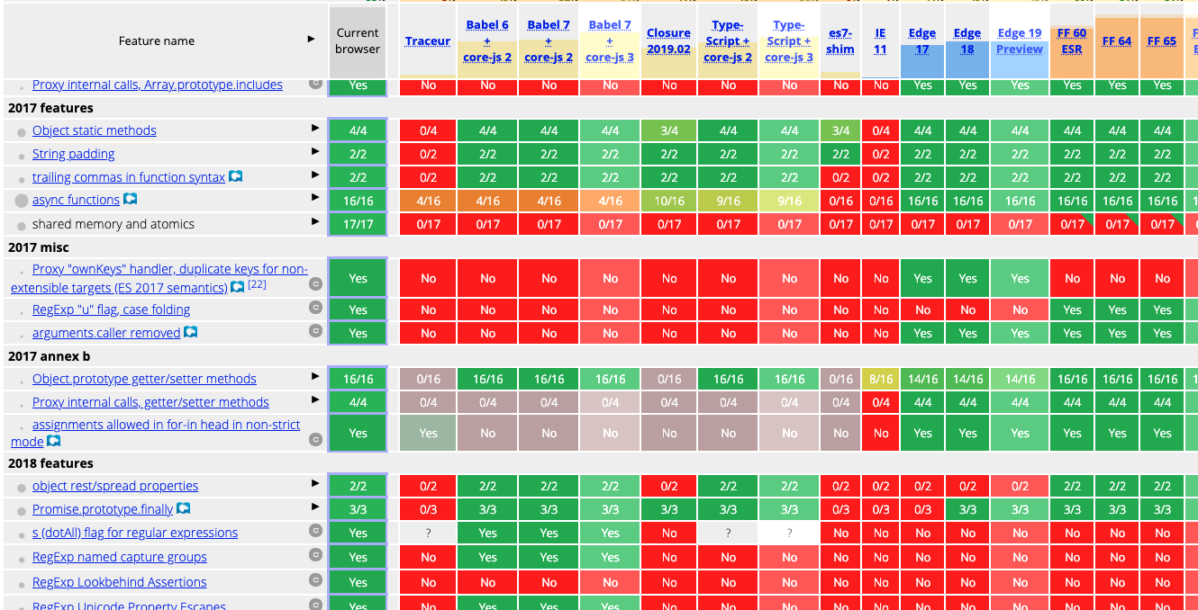
Browser Compatibility Tables
Feature-by-feature support across browsers and versions (compat-table.github.io)
Professional Vue.js Development
65
Notes:
SAY: This compatibility table, originally by kangax, shows every JavaScript feature against every browser and transpiler. Green is supported, red is not.
SAY: The point to make: support used to be very patchy, which is why every project needed Babel. Today the modern browser columns are almost entirely green, which is why Vite defaults to only light transformation.
TIP: For day-to-day questions, caniuse.com and the browser compatibility table at the bottom of every MDN reference page are easier to read.

Slide 66
Babel, esbuild, and Oxc
Babel — the original JavaScript transpiler
Plugin-based; the reference implementation for proposed syntax
esbuild — written in Go, roughly 100× faster than Babel
Vite used it for dev-time transforms through Vite 7
Oxc — Rust compiler toolchain (parser, transformer, minifier)
What Vite 8 uses for transforms
You rarely configure any of these directly in a Vite project.
Professional Vue.js Development
66
Notes:
SAY: Babel is still widely used, especially in older webpack projects and React Native, and it's where new JavaScript proposals usually get their first implementation.
SAY: esbuild showed that rewriting tooling in a compiled language could make it dramatically faster. Vite adopted it early. Oxc continues that trend in Rust, and Vite 8 uses it together with the Rolldown bundler.
KEY POINT: In a Vite project you configure Vite, and Vite configures the transformer. Students only need to know these names so they recognize them in error messages and articles.
WATCH FOR: Old Vue CLI projects have a babel.config.js. In a Vite project it does nothing unless a plugin explicitly uses Babel. (The demos/Vue-Starter folder still has an old .babelrc.js; it's unused and can be deleted.)

Slide 67
Transpiling Example
ES2015
ES5
let myFunc = () => {
let myVar = {
myProp,
}
}
"use strict";
var myFunc = function myFunc() {
var myVar = {
myProp: myProp
};
};
Professional Vue.js Development
67
Notes:
SAY: Here's what a transpiler does to some ES2015 code when targeting ES5:
- `let` becomes `var`. (The transpiler also checks that this doesn't change behavior, renaming variables if needed.)
- The arrow function becomes a function expression. It even gets a name, myFunc, so it shows up properly in stack traces.
- The shorthand property `{ myProp }` becomes `{ myProp: myProp }`.
- "use strict" is added, because ES modules are always strict.
DEMO (optional): Paste the left side into the Babel REPL at babeljs.io/repl with the ES5 preset to show this live.

Slide 68
Bundlers
A bundler resolves your import graph and writes deployable files.
webpack — the long-time incumbent; configured with loaders and plugins
Rollup — what Vite used for production builds through Vite 7
Rolldown — Rust, Rollup-compatible; Vite 8's single bundler
esbuild — fast Go bundler; Vite 7 used it to pre-bundle dependencies
In development, Vite doesn't bundle your source code at all.
Professional Vue.js Development
68
Notes:
SAY: Why bundle at all? A large app can have thousands of modules. Loading each over its own HTTP request in production would be slow, so bundlers combine them into a few optimized files, remove unused code (tree-shaking), split the code into chunks that load on demand, and minify it.
KEY POINT: Vite's trick is to skip bundling in development, where serving native ES modules is fast enough, and bundle only for production.
SAY: Before Vite 8, that meant two different tools (esbuild in dev, Rollup in prod), which occasionally behaved differently. Rolldown replaces both, so dev and production now go through the same engine.

Slide 69
How Vite Works
In development
Serves your source over HTTP as native ES modules
Transforms each file only when the browser asks for it
Pre-bundles dependencies once, then caches them
In production (vite build)
Bundles with Rolldown: tree-shaking, code-splitting, minification
Each lazily imported route becomes its own chunk
Plugins extend both pipelines — @vitejs/plugin-vue compiles SFCs
Professional Vue.js Development
69
Notes:
SAY: When you open the dev server URL, the browser requests index.html, which has a script type="module" tag pointing at /src/main.js. Main.js imports App.vue, so the browser requests App.vue, and Vite compiles it to JavaScript on the fly and sends it back. And so on down the import tree.
SAY: Dependencies in node_modules get special treatment. A package like lodash-es can be hundreds of tiny files, so Vite pre-bundles each dependency into one file the first time you run the dev server, and caches it in node_modules/.vite.
DEMO: In the Conduit project, open DevTools > Network, reload, and filter by JS. Show App.vue, TheHeader.vue etc. being requested individually. Then run `npm run build` and show the few hashed files in dist/assets.
WATCH FOR: If dependencies behave strangely after an install or upgrade, delete node_modules/.vite (or run `npx vite --force`) to rebuild the pre-bundle cache.

Slide 70
The Document Object Model
DAY 1
Objectives
Understand how the DOM works
Select DOM nodes
Manipulate the DOM with JavaScript
See how libraries and frameworks change that work
Professional Vue.js Development
70
Notes:
TIMING: About 15 minutes. This is a review for most developers; move faster if the group is experienced.
SAY: Vue's job is to manage the DOM for you. To appreciate what it's doing, and to debug it when something goes wrong, you need a clear picture of what the DOM is.

Slide 71
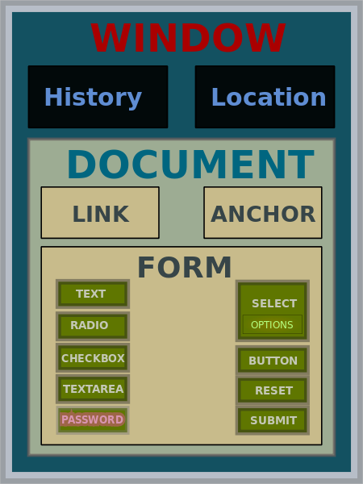
What is the DOM?
The browser's JavaScript API for HTML documents
Represents elements as a tree of objects
Objects in the tree can be found, read and changed with methods
Change the tree, and the browser re-renders the page
Image: JohnManuel, GFDL / CC BY-SA 3.0, via Wikimedia Commons
Professional Vue.js Development
71
Notes:
SAY: When the browser loads HTML, it parses it into a tree of objects in memory: the Document Object Model. The window object is at the top; the document is inside it; and inside the document are the html, head and body elements and everything nested in them.
KEY POINT: The DOM is not the HTML source. It's a live object model. JavaScript (and browser extensions, and Vue) can change it after the page loads, and DevTools' Elements panel shows the DOM, not the original source.
DEMO: Open DevTools on any page, select an element in the Elements panel, then type `$0` in the console. That's a reference to the selected DOM node. Try `$0.textContent = 'Hello'`.

Slide 72
Understanding Nodes
DOM interfaces that inherit from Node:
Document
Element
CharacterData
Text
Comment
DocumentType
Every Node also inherits from EventTarget, so every node can receive events.
Professional Vue.js Development
72
Notes:
SAY: Everything in the DOM tree is a node, but there are different kinds. Elements are the tags. Text nodes hold the text between tags, including whitespace. Comments are nodes too.
SAY: This matters in Vue in one place you'll see this week: a component with a v-if that's false renders a comment node as a placeholder. If you inspect the DOM and see `<!--v-if-->`, that's what it is.

Slide 73
EventTarget
An interface implemented by objects that can receive events (event targets)
Examples:
Element
Document
Window
Event targets let you register handlers:
button.addEventListener('click', (event) => {
console.log('clicked', event.target)
})
Professional Vue.js Development
73
Notes:
SAY: Anything that can have an event listener attached implements EventTarget. That's every element, the document, and the window, plus non-DOM things like XMLHttpRequest and WebSocket.
KEY POINT: Vue's @click is a thin layer over addEventListener. Vue adds the listener when the element is created and removes it when the element is destroyed, so you don't leak listeners.

Slide 74
DOM Events
Things that happen in the DOM. A few common ones:
Mouse and pointer
click, dblclick
mousedown, mouseup
mouseenter, mouseleave
mouseover, mouseout
mousemove, wheel
Keyboard and input
keydown, keyup
beforeinput, input
compositionstart, compositionend
select
Focus, page and media
focus, blur
focusin, focusout
load, error, abort
resize, scroll
Professional Vue.js Development
74
Notes:
SAY: This is a sample of the events elements can receive. You'll use click, input, submit, keydown and the focus events most often in Vue.
TIP: mouseenter/mouseleave don't bubble and fire only for the element itself; mouseover/mouseout bubble and fire again for each child. That difference causes a lot of flickering-hover bugs.
SAY: For text inputs, listen to `input` (fires on every change) rather than `keyup` (misses paste and autocomplete). Vue's v-model uses `input` for exactly this reason.
NOTE: The original slide listed `unload`. It's deprecated and browsers are removing it; use `pagehide` or `visibilitychange` instead.

Slide 75
Other Events
Many interfaces implement or inherit events
Forms: submit, reset, change
Network and storage: online, offline, storage
Media: play, pause, ended
Page lifecycle: DOMContentLoaded, visibilitychange, pagehide
Full reference: developer.mozilla.org/en-US/docs/Web/Events
Professional Vue.js Development
75
Notes:
SAY: There are hundreds of event types. MDN's event reference is the place to look them up. Each entry says which interface fires it, whether it bubbles, and whether it can be cancelled with preventDefault().
KEY POINT: `submit` on a form is the one we'll use most. Listen for submit on the form, not click on the button, so pressing Enter works too.

Slide 76
Element
The interface for elements in a document. It inherits properties and methods from Node and EventTarget.
Common properties
innerHTML, textContent
attributes
classList
id
tagName
Common methods
querySelector(), querySelectorAll()
addEventListener()
setAttribute(), getAttribute()
closest(), remove()
getElementById() (on document)
Professional Vue.js Development
76
Notes:
SAY: These are the properties and methods you'll reach for most when working with the DOM directly.
KEY POINT: innerHTML parses a string as HTML. That's an XSS risk if the string comes from users. textContent sets plain text and is safe. Vue's {{ }} interpolation uses the safe text approach; v-html uses innerHTML, which is why the docs warn about it.
NOTE: getElementById is a method of document, not of individual elements, so it's listed with document here.

Slide 77
Manipulating HTML with the DOM
You can get and set properties of HTML elements with JavaScript through the DOM.
<!-- starting HTML -->
<p id="favoriteMovie">The Matrix</p>
<script>
document.getElementById('favoriteMovie')
.textContent = 'The Godfather'
</script>
<!-- the DOM, and the page, now contain -->
<p id="favoriteMovie">The Godfather</p>
Professional Vue.js Development
77
Notes:
SAY: This is the imperative way: find the element, then change it. Each step is an instruction you write.
SAY: For one element, this is fine. Now imagine keeping a list of 100 items in sync with an array that changes: finding the right element, inserting, removing, reordering. That bookkeeping is what frameworks automate.
NOTE: The original slide called getElementById without `document.`, which would throw. Fixed here, and changed to textContent since we're setting plain text.
TRANSITION: Let's compare the same task in plain DOM code, jQuery, React and Vue.

Slide 78
Manipulating HTML with the DOM
<ol id="favoriteSongs">
<li class="song"></li>
<li class="song"></li>
<li class="song"></li>
</ol>
<script>
const mySongs =
document.querySelectorAll('#favoriteSongs .song')
mySongs[0].textContent = 'My New Favorite Song'
</script>
Professional Vue.js Development
78
Notes:
SAY: querySelectorAll takes any CSS selector and returns a NodeList of matches. Here we update the first song.
ASK: What happens if the array of songs changes and we need four list items? (We have to create an li, set its text and class, and append it ourselves. The HTML and the data drift apart unless we keep them in sync by hand.)

Slide 79
Manipulating HTML with jQuery
<ol id="favoriteSongs">
<li class="song"></li>
<li class="song"></li>
<li class="song"></li>
</ol>
<script>
$('#favoriteSongs .song').first()
.text('My New Favorite Song')
</script>
Professional Vue.js Development
79
Notes:
SAY: jQuery made DOM code shorter and smoothed over browser differences that were huge in 2006. But it's the same imperative model: you still find elements and change them, step by step.
SAY: Today, querySelectorAll, classList and fetch cover most of what jQuery was used for, so new projects rarely include it.

Slide 80
Manipulating HTML with React
<div id="favoriteSongs"></div>
function FavoriteSongs({ songs }) {
return (
<ol>
{songs.map((song) => (
<li key={song.id} className="song">{song.title}</li>
))}
</ol>
)
}
createRoot(document.getElementById('favoriteSongs'))
.render(<FavoriteSongs songs={songs} />)
Professional Vue.js Development
80
Notes:
KEY POINT: This is the declarative model. You don't say "change the first li". You describe what the list should look like for any array of songs, and React works out the DOM updates.
SAY: In React, the template is JSX: JavaScript with HTML-like syntax. Lists are made with array.map(), and each item needs a key so React can track it.
NOTE: The original slide rendered a single song prop. Updated to map over an array so it compares directly with the Vue version on the next slide.

Slide 81
Manipulating HTML with Vue.js
<div id="favoriteSongs">
<ol>
<li v-for="song in songs" :key="song.title">
{{ song.title }}
</li>
</ol>
</div>
import { createApp, ref } from 'vue'
createApp({
setup() {
const songs = ref([
{ title: 'Walk This Way' },
{ title: 'Give It Away' },
{ title: 'My Way' },
])
return { songs }
},
}).mount('#favoriteSongs')
Professional Vue.js Development
81
Notes:
SAY: Vue is declarative too, but the template stays HTML. v-for repeats the li once per song; :key gives each one an identity; {{ song.title }} outputs the text.
ASK: What do we have to do to add a fourth song to the page? (Push to the array: songs.value.push({ title: 'New Song' }). Vue updates the list.)
DEMO (optional): Paste this into a copy of demos/hello-world.html (using the template in the HTML instead of a template string) and push a song from the console.
KEY POINT: Compare the four approaches: DOM and jQuery are imperative (do this, then this); React and Vue are declarative (here's what it should look like). The declarative approach is why frameworks scale to large UIs.

Slide 82
Debugging JavaScript
DAY 1
Browser DevTools and Vue DevTools
Professional Vue.js Development
82
Notes:
TIMING: About 25 minutes including Lab 10. This is the last module of Day 1.
SAY: You'll spend a lot of your development time in the browser's developer tools. Let's make sure everyone knows their way around them, and then add the Vue-specific tools on top.

Slide 83
Browser Development Tools
Every modern browser has them: Chrome, Edge, Firefox, Safari
Open with F12, Ctrl+Shift+I (Windows/Linux) or Cmd+Option+I (macOS)
The panels you'll use most:
Elements — the live DOM and CSS
Console — logs, errors, and a JavaScript REPL
Sources — breakpoints and step-through debugging
Network — every request, its timing and its response
Professional Vue.js Development
83
Notes:
SAY: Chrome and Edge share the same Chromium DevTools; Firefox and Safari have their own, with the same core panels. We'll use Chrome or Edge in class because the Vue DevTools extension supports them well.
DEMO: Quick tour on the Conduit dev server:
1. Elements: select an element, edit a CSS value live.
2. Console: show an error message link that jumps to the source.
3. Sources: open src/components/TheHeader.vue (Vite serves the original files, so they're easy to find) and set a breakpoint.
4. Network: reload and show the module requests.
TIP: The `debugger;` statement in your code pauses execution there whenever DevTools is open. It's often faster than finding the line in Sources.

Slide 84
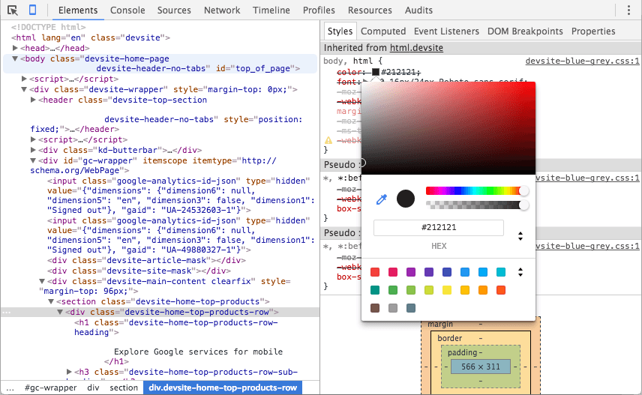
Installing and Using the Vue DevTools
Install from devtools.vuejs.org
Or add vite-plugin-vue-devtools for an in-page version
Adds Vue panels alongside the browser's own
Component tree, props and state
Pinia stores and routes
Events timeline
Professional Vue.js Development
84
Notes:
SAY: This is the second time we've seen Vue DevTools. Now we'll use them for real in Lab 10.
DEMO: Select a component in the Vue panel, then go to the Console and type `$vm`. That's the selected component instance. In the component tree, hover over a component to highlight it on the page.
WATCH FOR: If the Vue tab doesn't appear, close and reopen DevTools, or reload the page with DevTools open. Extensions also need permission for localhost pages in some browsers.

Slide 85
Manual In-Browser Testing and Debugging
LAB 10
20 min
Get comfortable inspecting, changing and stepping through your app in the browser.
Run the Conduit dev server
Install Vue DevTools (extension or Vite plugin)
Elements: edit styles live; hide an element
Console: change document.body.innerHTML
Sources: set a breakpoint in a .vue file and reload
Vue tab: inspect a component's props and state
Professional Vue.js Development
85
Notes:
TIMING: About 20 minutes; the last lab of Day 1.
LAB TIPS:
- The lab refers to src/components/Header.vue in one step. Students named theirs TheHeader.vue; any component works.
- Breakpoints in .vue files: Vite provides source maps, so the code shown is the original SFC, not the compiled output.
COMMON PROBLEMS:
- Can't install extensions (corporate policy): use vite-plugin-vue-devtools instead.
- Nothing happens at the breakpoint: the line doesn't run on page load. Pick a line in <script setup>, which runs every time the component is created.
DEBRIEF: End of Day 1. Recap: Node and npm, Vite, linting, testing, and three components. Tomorrow starts with a review quiz (quiz/day1.txt), then core Vue features.

Slide 86
Getting Started With Vue.js
DAY 2
Core features: templates, directives, reactivity, events and lifecycle
Professional Vue.js Development
86
Notes:
TIMING: Day 2 starts with Review 1 (Labs 01-10, quiz/day1.txt) from 8:30 to 9:00, then this part.
SAY: Yesterday was about the tooling and project structure. Today is the heart of Vue: how templates work, how reactivity works, and how components handle events and data over their lifetime. Seven labs, all building on Conduit.

Slide 87
Basic Vue.js Features
DAY 2
Composition API, <script setup>, template syntax and directives
Professional Vue.js Development
87
Notes:
TIMING: 9:00-9:45: this lecture block (through slide 109), then Lab 11.
SAY: We'll start with the two ways to write Vue components, then how an app is created, then template syntax and directives.

Slide 88
Options API vs. Composition API
Both are fully supported. This course uses the Composition API with <script setup>, which is what current Vue code and documentation use.
Options API
Code grouped by option: data, computed, methods, watch
A single feature is spread across several options
Reuse means mixins
Composition API
Code grouped by feature
Reuse means composables — ordinary functions
Better type inference and IDE support
Professional Vue.js Development
88
Notes:
SAY: The Options API is how Vue 2 components were written: one object with a data function, a computed object, a methods object, and so on. It's easy to learn, but in a large component, one feature (say, search) ends up split across data, computed, watch and methods, mixed with every other feature.
SAY: The Composition API puts everything for one feature together, and when you want to reuse that feature you move it into a function, called a composable. We'll write one on Day 3.
DO: If anyone works on a Vue 2 or Options API codebase, show a side-by-side on the whiteboard:
Options: data() { return { count: 0 } }, methods: { inc() { this.count++ } }
Composition: const count = ref(0); function inc() { count.value++ }
KEY POINT: No `this` in the Composition API. That's one of the biggest differences, and it removes a whole class of bugs.

Slide 89
Creating and Mounting an App
import { createApp } from 'vue'
import { createPinia } from 'pinia'
import App from './App.vue'
import router from './router'
const app = createApp(App) // an isolated application instance
app.use(createPinia()) // plugins are installed per app
app.use(router)
app.mount('#app') // where to render
There's no global Vue object, so two apps on the same page never share plugins, components or configuration.
Professional Vue.js Development
89
Notes:
SAY: This is a typical main.js. createApp takes the root component; you install plugins with app.use(); then mount() renders the root component into the element matching the selector.
KEY POINT: mount() should be last. Plugins and global components registered after mounting won't be available to the first render.
SAY: In Vue 2, plugins were installed globally with Vue.use(), which leaked between apps and between tests. In Vue 3 everything is per app.
SAY: Your Conduit main.js is simpler right now: just createApp(App).mount('#app'). We'll add Pinia in Lab 20 and the router in Lab 21.
NOTE: The original notes described a root instance created with `new Vue`. That's Vue 2; the description is updated.

Slide 90
<script setup>
<script setup>
import { computed, ref } from 'vue'
import ArticleList from './ArticleList.vue'
const count = ref(0) // state
const doubled = computed(() => count.value * 2) // derived state
function increment() { // behavior
count.value++
}
</script>
Every top-level binding is available to the template — variables, functions and imports
No export default, no components object, no this
Professional Vue.js Development
90
Notes:
SAY: <script setup> is compile-time syntax. The SFC compiler turns this block into the setup() function of a normal component, and makes everything declared at the top level available to the template. That's why you don't return anything.
KEY POINT: Imported components are usable in the template immediately. Importing ArticleList is all it takes to use <ArticleList /> below.
ASK: In the template, would you write {{ count.value }} or {{ count }}? (Just {{ count }}. Refs are unwrapped automatically in templates. In script you need .value.)
SAY: The code inside <script setup> runs once each time a component instance is created, which makes it the equivalent of the old created hook.

Slide 91
ref and computed
ref(value) wraps any value in a reactive container
Read and write it as .value in script
Vue unwraps it for you in the template
computed(getter) derives a cached, read-only value
Re-evaluates only when something it read has changed
reactive(object) makes an object reactive without .value
Objects only, and it doesn't survive destructuring
Reach for ref by default.
Professional Vue.js Development
91
Notes:
SAY: Why does ref need .value? JavaScript can't intercept reads and writes of a plain variable. Vue can only track a value if it's a property of an object. So ref wraps your value in an object with a value property, and Vue watches that property.
SAY: computed() takes a function. Vue runs it, remembers which refs it read, and caches the result. The next time you read it, you get the cached value, unless one of those refs has changed.
KEY POINT: reactive() is fine for objects, but has two traps: you can't put a primitive in it, and destructuring it breaks reactivity. ref has neither problem, which is why the Vue docs now recommend ref as the default. We'll see the destructuring trap on slide 131.

Slide 92
Compiler Macros
Available only at the top level of <script setup>. They're not imported — the compiler handles them.
defineProps({ ... }) — declare the props
defineEmits(['change']) — declare the events
defineModel() — a writable v-model ref (3.4+)
defineExpose({ ... }) — expose members to a parent's template ref
defineOptions({ ... }) — set component options such as name
withDefaults() — default values for TypeScript-declared props
Professional Vue.js Development
92
Notes:
SAY: Compiler macros look like functions, but they're instructions to the SFC compiler. At build time, the compiler reads them and turns them into the component's props, emits and so on. They don't exist at runtime.
KEY POINT: Because they're handled by the compiler, you must not import them. `import { defineProps } from 'vue'` produces a warning. And they only work at the top level of <script setup>, not inside functions.
DEMO: demos/compiler-macros/macro-demos. Run `npm install` then `npm run dev`. Walk through src/components/MacroCounter.vue, which uses every macro with TypeScript:
- withDefaults(defineProps<Props>(), { count: 0 }) for typed props with defaults,
- defineEmits with a typed event signature,
- defineModel<boolean>,
- defineOptions to set the component name and inheritAttrs,
- defineExpose to let App.vue call focusInput() through a template ref.
In App.vue, show the template ref and onMounted calling counter.value?.focusInput().
TIP: If students don't use TypeScript, mention that the same macros work in plain JavaScript with the runtime object syntax: defineProps({ title: String }).

Slide 93
App-level Configuration
app.component('BaseButton', BaseButton) // global component
app.directive('focus', vFocus) // custom directive
app.use(plugin) // install a plugin
app.provide('apiUrl', API_URL) // for every descendant
app.config.errorHandler = (err) => {} // app-wide errors
app.mount('#app') // render it
Vue 2 set all of these on the global Vue; Vue 3 scopes them to the app instance.
Professional Vue.js Development
93
Notes:
SAY: The app object returned by createApp is where app-wide configuration lives.
- app.component registers a component everywhere, without importing it. Use sparingly; slide 170 explains why.
- app.directive registers a custom directive, like v-focus.
- app.provide makes a value available to any component via inject(). It's how plugins like the router expose themselves to components.
- app.config.errorHandler is a single place to catch errors thrown in any component: perfect for sending errors to a logging service.
KEY POINT: Each of these returns the app, so they can be chained: createApp(App).use(pinia).use(router).mount('#app').

Slide 94
Vue Template Syntax
DAY 2
Interpolation, expressions and directives
Professional Vue.js Development
94
Notes:
SAY: Templates are where Vue looks most different from plain JavaScript. They're valid HTML with a few additions: double-curly interpolation, and attributes starting with v-, :, @ or #.
NOTE: This divider used to show a <script setup> snippet that wasn't about templates; it's been removed to keep the focus on template syntax.

Slide 95
Vue Templates
Vue compiles templates into render functions that produce virtual DOM
In a Vite project, at build time; with the global build, in the browser
Templates are usually written in HTML
You can also write render functions in JSX, or in JavaScript with h()
<template>
<h1>{{ title }}</h1>
</template>
Professional Vue.js Development
95
Notes:
SAY: A template is not HTML that Vue fills in with string replacement. The compiler turns it into a JavaScript render function that creates virtual DOM nodes. That's how Vue can optimize it: it knows the structure in advance.
SAY: Render functions and JSX are an escape hatch for unusual cases, like component libraries that generate markup dynamically. You won't need them for application code.
DEMO (optional): Paste a small template into the Vue SFC Playground (play.vuejs.org) and open the JS tab to show the compiled render function.

Slide 96
Using HTML in Templates
Mustache syntax (double curly braces) for text interpolation
<div>{{ customerName }}</div>
Interpolation always outputs plain text — HTML is escaped
To output HTML, use the v-html directive
<p>{{ info }}</p> <!-- shows the tags as text -->
<p v-html="info"></p> <!-- renders info as HTML -->
Only use v-html with trusted content: it's an XSS risk.
Professional Vue.js Development
96
Notes:
SAY: Interpolation always escapes HTML. If info is '<b>hi</b>', the user sees the angle brackets on screen. That's a security feature: user-entered content can't inject markup.
SAY: v-html sets innerHTML instead. Use it for HTML you trust, such as content from your own CMS that you've sanitized, never for anything a user typed.
DEMO: demos/output-raw-html/index.html. Open it in the browser. The first line shows the HTML tags as text; the second renders red text. Then open js/index.js and point out the security comment.

Slide 97
Using JavaScript in Templates
Vue supports any single JavaScript expression inside templates and bindings.
<p>{{ count + 1 }}</p>
<p>{{ ok ? 'YES' : 'NO' }}</p>
<p>{{ message.split('').reverse().join('') }}</p>
<div :id="'list-' + id"></div>
Expressions only: no statements (let, if, loops)
Keep them short — move logic into a computed property
Professional Vue.js Development
97
Notes:
SAY: Anything that produces a value works in a template: math, ternaries, method calls, template literals. Statements don't: `{{ if (ok) { ... } }}` won't compile; use v-if or a ternary instead.
KEY POINT: If an expression gets long, it belongs in a computed property, where it has a name, is cached, and can be tested.
NOTE: The original slide had `{{ counter++ }}`, which modifies state during rendering and triggers an infinite update loop warning, and `{{ loggedIn ? <LogOut /> : <LogIn /> }}`, which is JSX and won't compile in a Vue template. Both were replaced. To switch between components, use v-if/v-else or <component :is="...">.

Slide 98
Vue.js Directives
Special attributes that take a JavaScript expression as their value
Prefixed with v- followed by the directive name
<div v-if="test">The test is true</div>
When the value of the expression changes, Vue updates the DOM
Professional Vue.js Development
98
Notes:
SAY: Directives are how templates express behavior: conditionals, loops, bindings and events. The value is a JavaScript expression evaluated against the component's state.
SAY: Over the next few slides: directive arguments (the part after a colon), modifiers (the parts after dots), and the built-in directives. Then shorthands, which you'll see far more often than the long forms.

Slide 99
Directive Arguments
Some directives take an argument, written after a colon
<button v-on:click="doSomething">Click Me</button>
<a v-bind:href="url">Link</a>
v-on:click — the argument is the event name
v-bind:href — the argument is the attribute name
Arguments can be dynamic: v-bind:[attrName]="value"
Professional Vue.js Development
99
Notes:
SAY: The argument tells the directive what to act on. For v-on it's the event; for v-bind it's the attribute or prop.
SAY: Dynamic arguments, in square brackets, are evaluated as expressions. They're rare in application code but handy in reusable components.
TRANSITION: The full anatomy of a directive is `v-name:argument.modifier="expression"`. Next: modifiers.

Slide 100
Directive Modifiers
Modifiers change how a directive is bound
They follow a . after the argument
<form v-on:submit.prevent="doSomething">...</form>
.prevent calls event.preventDefault() before calling doSomething, so the browser doesn't submit and reload the page
Modifiers can be chained: @click.stop.prevent
Professional Vue.js Development
100
Notes:
SAY: Without .prevent, submitting a form makes the browser navigate, which reloads your single-page app and loses all its state. In plain JavaScript you'd call event.preventDefault() in the handler. The modifier keeps that DOM detail out of your function.
KEY POINT: Anatomy recap: v-on (directive) : submit (argument) .prevent (modifier) = "doSomething" (expression).
SAY: We'll see the full list of event modifiers on slide 137, and v-model's modifiers (.trim, .number, .lazy) in the forms section.

Slide 101
Vue.js Built-in Directives
Most used
v-bind — bind attributes to data
v-if / v-else-if / v-else — conditional rendering
v-for — loop over arrays and objects
v-on — event handling
v-model — two-way binding for inputs
Also built in
v-show — toggle display
v-html, v-text — set content
v-slot — named and scoped slots
v-once, v-memo — skip re-rendering
v-pre, v-cloak — compilation control
Professional Vue.js Development
101
Notes:
SAY: The left column is what you'll use every day. The right column comes up occasionally.
- v-once renders an element once and then treats it as static. v-memo skips re-rendering unless listed values change; it's a performance tool for huge lists.
- v-pre skips compilation for an element, handy for showing literal {{ }} in documentation.
- v-cloak hides un-compiled templates when you use Vue from a CDN, to avoid a flash of {{ }} on page load.

Slide 102
Custom Directives
Components are the main way to reuse code
Sometimes you need low-level DOM access on plain elements
<script setup>
// in <script setup>, vFocus is usable as v-focus
const vFocus = {
mounted: (el) => el.focus(),
}
</script>
<template>
<input v-focus />
</template>
Hook names match the component lifecycle: Vue 2's inserted is now mounted
Professional Vue.js Development
102
Notes:
SAY: A custom directive is an object with lifecycle hooks that receive the DOM element. Use one when you need to do something directly to an element, like focusing it, measuring it, or attaching a third-party library.
SAY: The naming convention does the registration: any camelCase variable starting with v in <script setup> becomes a directive. vFocus becomes v-focus.
SAY: To use a directive across the app, register it with app.directive('focus', vFocus) in main.js.
IF ASKED: The available hooks are created, beforeMount, mounted, beforeUpdate, updated, beforeUnmount and unmounted. Each receives (el, binding), where binding.value is the expression's value.

Slide 103
Loops and Lists
Use v-for to render a list of items from an array or object.
<ul>
<li v-for="song in songs" :key="song.id">
{{ song.title }}
</li>
</ul>
const songs = ref([
{ id: 1, title: 'Hotel California' },
{ id: 2, title: 'April in Paris' },
])
Professional Vue.js Development
103
Notes:
SAY: v-for uses `item in items` syntax, and creates one element per item. Inside the loop, `song` is available to that element and everything inside it.
SAY: You can also get the index: v-for="(song, index) in songs".
ASK: What happens on the page if we call songs.value.push({ id: 3, title: 'Rocket Man' })? (A new li appears. Vue 3 tracks all array mutations.)
TRANSITION: The :key attribute is important enough to get its own slide.

Slide 104
Using key
Always provide a key with v-for
<li v-for="song in songs" :key="song.id">
{{ song.title }}
</li>
The key gives each element a stable identity, so Vue can reuse, move and remove the right DOM nodes
Use a stable, unique id — not the array index
The key goes on the element that carries v-for, including a <template v-for> (Vue 2 didn't allow that)
Professional Vue.js Development
104
Notes:
SAY: Without keys, when the array changes, Vue patches elements in place by position. That's fast, but if elements have internal state (an input's text, a component's state, a running transition), the state stays at the old position while the data moves, and you see the wrong state on the wrong item.
KEY POINT: Why not the index? If you delete item 0, every item's index shifts by one. Vue thinks item 1 is now item 0, and so on. That's the same bug as no key at all.
DEMO (optional, two minutes): Render a list where each item has an <input>. Type into the first input, then remove the first item. With :key="index", the typed text jumps to the next item. With :key="item.id", it disappears with its item.
WATCH FOR: ESLint's vue/require-v-for-key rule will flag a missing key. Students will hit it in Lab 11.

Slide 105
Using v-for
Renders a list based on an array, an object, or a number range
<li v-for="(song, index) in songs" :key="song.id">
{{ index }}: {{ song.title }}
</li>
<li v-for="(value, key) in person" :key="key">
{{ key }}: {{ value }}
</li>
<span v-for="n in 5" :key="n">{{ n }}</span>
Often used with HTML lists, table rows, and repeated components
v-for can repeat a <template> to output several elements per item
Professional Vue.js Development
105
Notes:
SAY: Three forms:
- Arrays: optionally with the index as a second variable.
- Objects: the first variable is the value, the second is the key (and a third is the index).
- Numbers: `n in 5` counts from 1 to 5.
KEY POINT: When you need several elements per item without a wrapper element, put v-for on a <template>. The template tag itself doesn't render.

Slide 106
v-for with Arrays
Template
Result
Hotel California
April in Paris
<ul id="favorite-songs">
<li v-for="song in songs" :key="song.title">
{{ song.title }}
</li>
</ul>
State
const songs = ref([
{ title: 'Hotel California' },
{ title: 'April in Paris' },
])
Professional Vue.js Development
106
Notes:
SAY: Each object in the array becomes one li. The template reads song.title from each.
ASK: How would you show the songs in reverse alphabetical order without changing the original array? (A computed property: computed(() => [...songs.value].sort(...).reverse()). Don't sort in the template; sort() mutates the array.)
NOTE: The original slide used Options-API style data and omitted the key; both updated.

Slide 107
v-for with Objects
With an object, v-for iterates over the object's properties.
Template
Result
firstName: Joe
lastName: Smith
<ul>
<li v-for="(value, key) in person" :key="key">
{{ key }}: {{ value }}
</li>
</ul>
State
const person = ref({
firstName: 'Joe',
lastName: 'Smith',
})
Professional Vue.js Development
107
Notes:
SAY: The first variable is the property's value, the second is its name. Order follows Object.keys(), which is insertion order for string keys.
SAY: This is handy for rendering things like a details panel from an object, but most lists you render will be arrays.
NOTE: The original slide's result said "Joe Doe", but the data says Smith. Fixed, and the key is now shown too.

Slide 108
Conditional Rendering
Use v-if, v-else-if and v-else:
<h1 v-if="thing === true">It is so</h1>
<h1 v-else-if="thing === undefined">We don't know</h1>
<h1 v-else>It is not so</h1>
v-else-if and v-else must immediately follow a v-if or v-else-if element
Put v-if on a <template> to toggle several elements at once
Avoid v-if and v-for on the same element — wrap one in a <template>
Professional Vue.js Development
108
Notes:
SAY: v-if adds and removes elements from the DOM entirely. When the condition is false, the element doesn't exist; when it becomes true, Vue creates it (and any components inside it run their setup and mounted hooks).
WATCH FOR: v-if with v-for on the same element. In Vue 3, v-if is evaluated first, so it can't see the loop variable. That's the opposite of Vue 2. Filter the list with a computed property instead, or wrap with <template v-for> and put v-if on the inner element.

Slide 109
v-if vs. v-show
<p v-if="loggedIn">Welcome back!</p>
<p v-show="menuOpen">Menu</p>
v-if
Adds and removes the element
Lazy: nothing renders until true
Child components are created and destroyed
Higher toggle cost
Works with v-else and <template>
v-show
Always renders; toggles CSS display
Element and children stay alive
Higher initial render cost
Cheap to toggle
No v-else; not on <template>
Professional Vue.js Development
109
Notes:
SAY: Both hide things, but differently. v-if removes the element from the DOM. v-show keeps it and sets display: none.
KEY POINT: Rule of thumb: use v-show for things that toggle often (menus, tabs, accordions), and v-if for things that rarely change or that shouldn't exist at all when hidden (content for logged-in users, expensive components).
SAY: With v-show, child components keep their state while hidden, because they're never destroyed. With v-if, they're recreated from scratch each time.

Slide 110
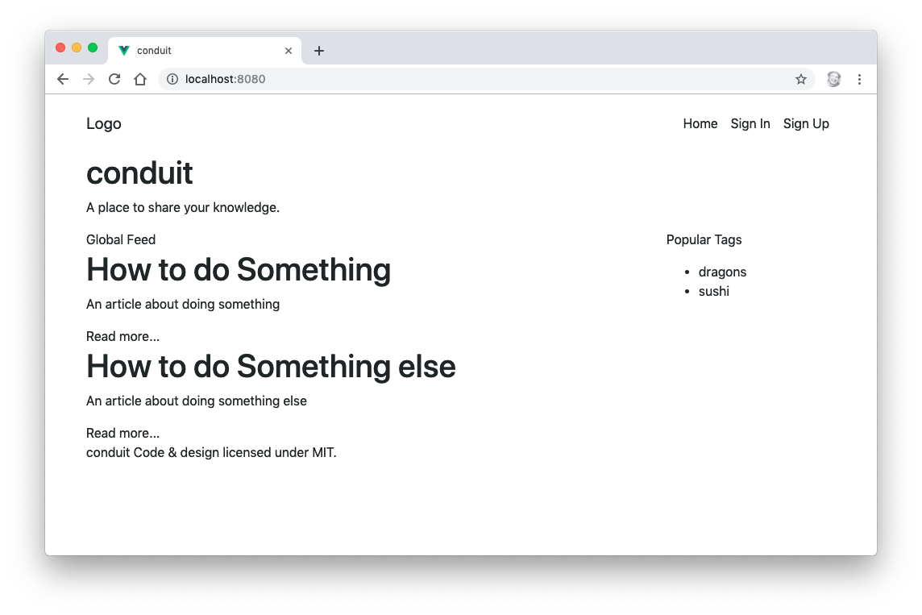
Static Vue View
LAB 11
45 min
Render the article list from JSON with v-for, v-if and props.
Create GlobalFeed, ArticleList and ArticlePreview
Load articles.json into a ref
Use v-if for the empty state and v-for (with :key) for the list
Pass each article to ArticlePreview as a prop with defineProps
Add tests for the new components
Professional Vue.js Development
110
Notes:
TIMING: 45 minutes.
SAY: The first step in building a Vue UI is a static version: the right components, rendering hard-coded data. Once the structure is right, we'll add interactivity and a real API.
LAB TIPS:
- Copy articles.json from labs/lab11 into src/json.
- The component tree is now App > HomeContent > GlobalFeed > ArticleList > ArticlePreview (many). Draw it on the board.
- Remind students: in the template it's articles.length; in script it's articles.value.
COMMON PROBLEMS:
- Missing .vue extension in an import.
- defineProps imported from vue (it shouldn't be).
- vue/require-v-for-key lint error: they forgot :key.
- A tests failure for ArticlePreview: it requires an article prop, so the test has to pass one with mount(ArticlePreview, { props: { article: {...} } }).
DEBRIEF: Ask how data gets from ArticleList to each ArticlePreview. (Props: :article="article".) Props are covered in depth on Day 3.

Slide 111
Binding HTML Classes
:class can take an object to toggle classes on and off
<div :class="{ active: isActive, 'text-danger': hasError }"></div>
…or an array to apply a list of classes
<div :class="[baseClass, { active: isActive }]"></div>
Vue merges these with any static class attribute on the element
Professional Vue.js Development
111
Notes:
SAY: Object syntax: each key is a class name; the class is applied when the value is truthy. Class names with dashes need quotes.
SAY: Array syntax: each entry is a class name (or an object). Useful when class names come from variables.
KEY POINT: A static class="btn" and a bound :class can be on the same element; Vue combines them. That's exactly what Lab 14 does: class="btn btn-sm" plus :class="{ 'btn-primary': favorited }".

Slide 112
Adding Styles Conditionally
Bind a computed property or a ref to the class to change styles based on conditions.
<div :class="[{ active: isActive }, errorClass]"></div>
const isActive = ref(true)
const hasError = ref(false)
const errorClass = computed(() =>
hasError.value ? 'text-danger' : ''
)
Professional Vue.js Development
112
Notes:
SAY: When the logic gets more complex than a simple flag, move it to a computed property. The template stays readable, and the logic has a name.
SAY: A common pattern is a computed property that returns a whole class object: const classes = computed(() => ({ active: isActive.value, 'text-danger': hasError.value })), then :class="classes".

Slide 113
Binding Styles
Inline object syntax for :style (camelCase or quoted kebab-case keys)
<div :style="{
color: activeColor,
fontSize: fontSize + 'px'
}"></div>
Bind to a style object to keep the template cleaner
<div :style="styleObject"></div>
const styleObject = reactive({
color: 'red',
fontSize: '13px',
})
Professional Vue.js Development
113
Notes:
SAY: :style works like :class, but with CSS properties. Property names can be camelCase (fontSize) or quoted kebab-case ('font-size'). Vue adds vendor prefixes when needed.
KEY POINT: Prefer classes for anything static or reusable. Use :style for values that are truly dynamic, like a computed width, a user-chosen color, or a font size. Lab 15 does exactly that, binding the article font size with :style.

Slide 114
Outputting Raw HTML
DEMO
Files: demos/output-raw-html
Open index.html in a browser — no build step
Compare {{ rawHtml }} with v-html="rawHtml"
Look at the ref in js/index.js
v-html sets innerHTML. Never use it with user-supplied content.
Professional Vue.js Development
114
Notes:
DEMO: Open demos/output-raw-html/index.html in the browser.
1. Point out the two paragraphs: the mustache version shows the literal <span style="color:red"> markup; the v-html version shows red text.
2. Open js/index.js and show the single ref holding the HTML string.
3. In DevTools Elements, show that the second span contains a real child element, while the first contains a text node.
ASK: Why doesn't Vue render HTML from {{ }} by default? (Security. If the string came from a user, rendering it as HTML would let them inject scripts: cross-site scripting.)
TIP: If you need to show user content with formatting, render Markdown with a library and sanitize the output (for example, DOMPurify) before using v-html.

Slide 115
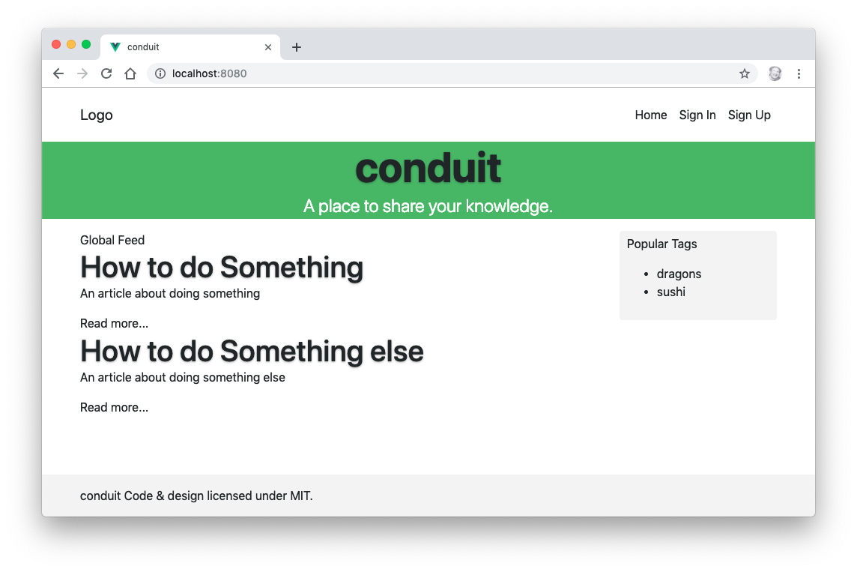
Styling Vue Components
LAB 12
25 min
Style HomeContent and TheFooter with scoped CSS.
Add a <style scoped> block to HomeContent
Style the banner, sidebar and feed toggle
Add scoped styles to TheFooter
Inspect the result in DevTools — find the data-v-… attributes
Professional Vue.js Development
115
Notes:
TIMING: 25 minutes.
SAY: Scoped styles let each component carry its own CSS without leaking into the rest of the app.
DEBRIEF: Have students inspect an element in HomeContent in DevTools. They'll see an attribute like data-v-7ba5bd90 on each element, and selectors like .banner[data-v-7ba5bd90] in the Styles pane. That's how Vue scopes CSS: unique attributes, not shadow DOM.
WATCH FOR: Scoped styles don't reach into child components' elements, except the child's root element. To style inside a child, use :deep(.selector) in the parent's scoped CSS.

Slide 116
Computed Properties
DAY 2
import { computed, ref } from 'vue'
const firstName = ref('Ada')
const lastName = ref('Lovelace')
const fullName = computed(() => `${firstName.value} ${lastName.value}`)
Professional Vue.js Development
116
Notes:
TIMING: 11:30-11:45 lecture, then Lab 13 until lunch.
SAY: Here's the whole idea in four lines. fullName is derived from two refs. Change either name, and fullName updates. Read fullName ten times without changing anything, and the function runs once.

Slide 117
Computed Properties
Useful for logic too complex to sit in a template
Created by calling computed() with a getter function
const message = ref('Hi There')
const reversedMessage = computed(() =>
message.value.split('').reverse().join('')
)
computed() returns a read-only ref
reversedMessage.value in script
{{ reversedMessage }} in the template
Professional Vue.js Development
117
Notes:
SAY: Compare this to the template expression on slide 97: same logic, but now it has a name, it's cached, and the template is just {{ reversedMessage }}.
KEY POINT: Vue tracks dependencies automatically. You never list them, unlike React's useMemo dependency array. Whatever reactive values the getter reads become its dependencies, every time it runs.
ASK: If message changes, when does the getter run? (Not immediately. The computed is marked dirty and runs the next time something reads it. Computed properties are lazy.)

Slide 118
Benefits of Computed Properties
Cached: unlike a function call in the template, a computed property doesn't re-run unless a reactive value it read has changed
Declarative: often a cleaner alternative to a watcher
Readable and testable: the logic has a name
A getter should have no side effects. Don't mutate state, make requests or touch the DOM inside one.
Professional Vue.js Development
118
Notes:
SAY: You could get the same output with a function, {{ reverseMessage() }}. The difference: a function in the template runs on every re-render of the component, even if message didn't change. A computed property only re-runs when its inputs change.
SAY: Computed vs watch: if you want a value derived from other values, use computed. If you want to do something (call an API, write to localStorage) when a value changes, use watch.
WATCH FOR: Side effects in a computed getter, like pushing to an array or calling fetch. They'll run at unpredictable times (or not at all, if nothing reads the computed), and can cause infinite update loops.

Slide 119
Filtering and Sorting a List with a Computed Property
DEMO
Files: demos/filter-with-computed-property
Open index.html in a browser
Type in the box to filter by name or age
Click a column heading to sort; click again to reverse
Read js/index.js: one computed property, filterIt, does both
Professional Vue.js Development
119
Notes:
DEMO: Open demos/filter-with-computed-property/index.html.
1. Type "a" to filter, then "2" to filter by age. Click Name and Age to sort; click again to reverse.
2. Open js/index.js. Walk through filterIt:
- it reads searchDetails, people, reverse and sortKey, so it re-runs when any of them changes;
- it filters, then copies the array with [...matches] before sorting, because sort() mutates in place;
- sortBy() only changes sortKey and reverse; it doesn't touch the list. The computed does the rest.
3. Add console.log('filtering') at the top of the computed. Show that it logs once per keystroke, not once per render.
KEY POINT: This is the exact pattern students build in Lab 17 for the Conduit article filter, and extract into a composable in Lab 19.

Slide 120
Using Setters in Computed Properties
Computed properties are getter-only by default
Pass an object with get and set when you need to write to one
const fullName = computed({
get: () => `${firstName.value} ${lastName.value}`,
set: (newValue) => {
const names = newValue.split(' ')
firstName.value = names[0]
lastName.value = names.at(-1)
},
})
fullName.value = 'Grace Hopper' // calls set()
Professional Vue.js Development
120
Notes:
SAY: A writable computed lets you assign to a derived value, and the setter decides how to update the underlying state. Here, assigning a full name splits it and updates both refs; then the getter recomputes from them.
SAY: The most common real use is with v-model: binding an input to a computed with get/set, for example to format or validate as the user types, or to bind v-model to a store value.
KEY POINT: The setter should update the source refs, never the computed itself.

Slide 121
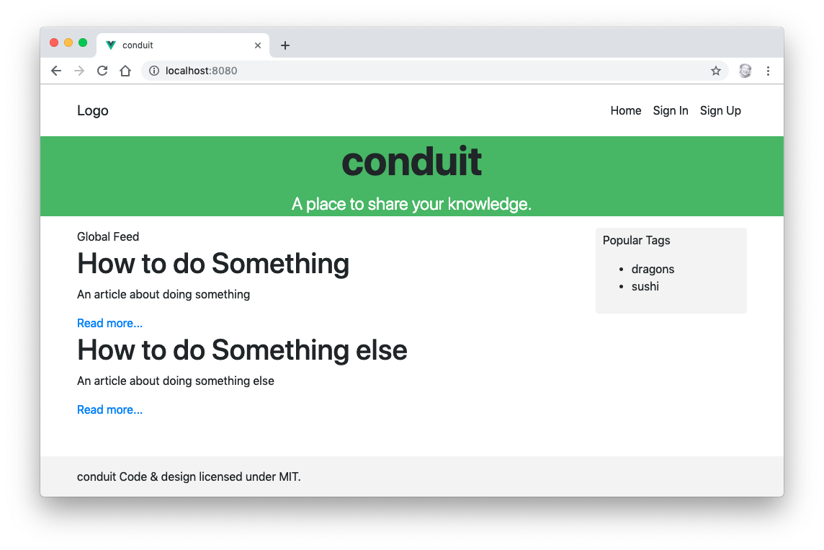
Computed Properties
LAB 13
15 min
Use a computed property to build each article's link.
In ArticlePreview, capture the return value of defineProps
Create an articleLink computed property from props.article.slug
Bind the "Read more..." link with :href (or :to later)
Challenge: format the article's createdAt date
Professional Vue.js Development
121
Notes:
TIMING: 15 minutes, before lunch.
LAB TIPS:
- In the template, write article; in script, write props.article. Students need const props = defineProps(...) to read props in script.
- For the date challenge: new Date(props.article.createdAt).toLocaleDateString(), inside a computed.
WATCH FOR: Destructuring props, e.g. const { article } = defineProps(...). In Vue 3.5+, destructured props are reactive when used in the template or in computed()/watch() getters, but passing them into plain functions loses reactivity. To keep it simple, stick with props.article in this course.

Slide 122
Reactive State
DAY 2
A ref is the default choice: reactive() can't hold a primitive, and loses reactivity if you destructure it.
import { reactive, ref } from 'vue'
const count = ref(0) // any value; use .value
const user = reactive({ name: '' }) // objects only; no .value
Professional Vue.js Development
122
Notes:
TIMING: After lunch, 1:00-1:20 lecture, then Lab 14.
SAY: Welcome back. This section is about how Vue tracks state: refs, reactive objects, data binding, and a few traps to avoid.

Slide 123
ref and reactive
State lives in refs, declared at the top of <script setup>
When a ref changes, every component that read it re-renders
Vue 3 tracks state with a Proxy, so properties added or deleted after creation are reactive too
Vue.set and vm.$set existed only to work around that limit in Vue 2, and were removed
Professional Vue.js Development
123
Notes:
SAY: Here's what happens when a component renders: Vue sets "the current component" as the active effect, runs the render function, and every ref or reactive property that gets read registers that component as a subscriber. When one of those values changes, Vue schedules a re-render for its subscribers.
KEY POINT: Updates are batched. If you change five refs in the same function, the component re-renders once, on the next tick, not five times. To wait for the DOM to update, use `await nextTick()`.
IF ASKED: Is a ref holding an object deeply reactive? Yes. ref(obj) wraps the object in reactive() internally, so nested properties are tracked. Use shallowRef if you deliberately want only .value reassignment tracked, for example with large immutable data.

Slide 124
Vue.js Data Binding
v-bind (shorthand :) binds an attribute or prop to a reactive value — one-way
Vue keeps the attribute up to date with the value
v-model creates two-way binding between an input and a ref
<img :src="imageSrc" :alt="caption"> <!-- state → DOM -->
<input v-model="searchText"> <!-- state ↔ DOM -->
Professional Vue.js Development
124
Notes:
SAY: One-way binding: the value flows from your state into the DOM. If the user could change the element, your state wouldn't know.
SAY: Two-way binding: also flows back. When the user types, v-model updates the ref.
KEY POINT: Components use one-way data flow for props: parent to child only. v-model on a component is two-way by convention, implemented with a prop plus an event. We'll see that on Day 3.

Slide 125
v-bind directive
<!-- bind an attribute -->
<img v-bind:src="imageSrc">
<!-- dynamic attribute name -->
<button v-bind:[key]="value"></button>
<!-- inline string concatenation -->
<img v-bind:src="'/path/to/images/' + filename">
<!-- bind several attributes from an object -->
<input v-bind="{ id: fieldId, placeholder: hint }">
<!-- same-name shorthand (Vue 3.4+): :id="id" -->
<div :id></div>
Professional Vue.js Development
125
Notes:
SAY: v-bind binds an attribute to an expression. Walk through the examples:
- A simple binding.
- A dynamic attribute name in square brackets.
- Any expression, including string concatenation (a template literal works too).
- v-bind with no argument and an object binds all its keys as attributes. Useful for passing a bag of props through.
- Since Vue 3.4, if the attribute and the variable have the same name, you can leave off the value: :id is the same as :id="id".
KEY POINT: Without v-bind, the attribute value is a literal string. src="imageSrc" sets the src to the text "imageSrc".

Slide 126
Value Binding
v-model gives checkboxes, radio buttons and select options a value
Use v-bind to make that value dynamic, or something other than a string
<!-- toggle is 'yes' or 'no' instead of true / false -->
<input type="checkbox" v-model="toggle"
true-value="yes" false-value="no">
<!-- pick is set to the value of the variable a -->
<input type="radio" v-model="pick" :value="a">
<!-- selected is set to the object, not a string -->
<select v-model="selected">
<option :value="{ id: 1 }">One</option>
</select>
Professional Vue.js Development
126
Notes:
SAY: By default, a checkbox's v-model is true or false, and a radio or option's value is the string in its value attribute.
SAY: true-value and false-value change what a checkbox writes. Binding :value lets a radio or option set a number, an object, or any other value, which is handy when the choice is a record from your data rather than a string.
TRANSITION: We'll see all of these in action in the forms demos later today.

Slide 127
2-way Binding
DAY 2
v-model, arrays, and the reactivity caveats that remain
Professional Vue.js Development
127
Notes:
SAY: v-model is the Vue feature people coming from React notice first. Let's look at how it works and the few places reactivity can still surprise you.

Slide 128
v-model directive
Creates two-way data binding on <input>, <textarea> and <select> elements
<input v-model="message">
<p>Message is: {{ message }}</p>
Picks the right property and event for each element type
text and textarea: value + input
checkbox and radio: checked + change
select: value + change
v-model ignores the initial value, checked or selected attributes — your state is the source of truth
Professional Vue.js Development
128
Notes:
SAY: Type in the input and the paragraph updates instantly; change message in code and the input updates.
KEY POINT: The state is always the source of truth. If you write <input v-model="name" value="Bob">, the "Bob" is ignored. Set the initial value in the ref: const name = ref('Bob').
SAY: v-model also handles details like IME composition for Chinese and Japanese input, where it waits for the composition to finish before updating.

Slide 129
Working with Arrays
Every array mutation is reactive, because Vue 3 observes the array through a Proxy:
push, pop, shift, unshift, splice, sort, reverse
items[0] = value — assignment by index
items.length = 0
Vue 2 couldn't detect the last two, and needed Vue.set and splice as workarounds
Replacing the array wholesale is still often clearer:
items.value = items.value.filter((item) => !item.done)
Professional Vue.js Development
129
Notes:
SAY: If you used Vue 2, forget everything you learned about array caveats. In Vue 3 you can mutate arrays any way you like.
SAY: Non-mutating methods (filter, map, slice, concat, toSorted) return a new array. Assign the result back to the ref: items.value = items.value.filter(...). Vue is efficient about re-rendering a replaced array, especially with good keys.
WATCH FOR: Calling sort() or reverse() on a prop or a store array inside a computed or template. Those methods mutate in place. Use toSorted()/toReversed() or copy first with [...arr].

Slide 130
Reactivity Caveats
Proxy-based reactivity is deep and covers add and delete, but a few things still break tracking:
Destructuring a reactive() object copies the values out
Use toRefs(), or a ref, instead
Replacing a reactive() object wholesale drops the old proxy
Reassigning a ref without .value inside <script setup>
Passing props.x to a function passes the current value, not a live reference
Map, Set, Date and class instances are supported, but a plain object is usually the simpler choice.
Professional Vue.js Development
130
Notes:
SAY: Each of these has the same root cause: Vue can only track reads and writes that go through a ref or a reactive proxy. As soon as you have a plain copy of a value, Vue can't see it.
- `const { count } = state` copies the number out of the proxy. count is now just 0.
- `let state = reactive({...}); state = reactive({...})` makes a new proxy, but the template and watchers are still subscribed to the old one. With ref you'd write state.value = {...}, which works.
- `count = 5` instead of `count.value = 5` replaces the ref with a number. (const prevents this, which is one reason to always declare refs with const.)
- A function receiving props.title gets a string. If you need it to stay live, pass a getter: () => props.title, or toRef(props, 'title').
TRANSITION: The next slide shows the destructuring fix.

Slide 131
Destructuring and Reactivity
const state = reactive({ count: 0 })
const { count } = state // a plain 0: not reactive
const { count } = toRefs(state) // a ref: still live
count.value++ // updates state.count too
The same rule applies to Pinia stores, which is why you destructure them through storeToRefs().
Professional Vue.js Development
131
Notes:
SAY: toRefs() converts each property of a reactive object into a ref that points back at the original object. Reading or writing count.value reads or writes state.count.
KEY POINT: This is the rule you'll meet again on Day 3: a Pinia store is a reactive object, so `const { articles } = store` breaks, and `const { articles } = storeToRefs(store)` works.
TIP: Composables return plain objects of refs for exactly this reason: so the caller can destructure them freely.

Slide 132
v-bind Shorthand
<!-- full syntax -->
<a v-bind:href="url"> ... </a>
<!-- shorthand -->
<a :href="url"> ... </a>
<!-- shorthand with a dynamic argument -->
<a :[key]="url"> ... </a>
<!-- same-name shorthand (3.4+) -->
<a :href> ... </a>
In real Vue code you'll almost always see :.
Professional Vue.js Development
132
Notes:
SAY: The colon is just shorthand for v-bind:. They compile to the same thing. The style guide recommends using the shorthand consistently.
SAY: Combined with the event shorthand @ (coming up on slide 138) and the slot shorthand # (slide 182), these are the three symbols to recognize in Vue templates.

Slide 133
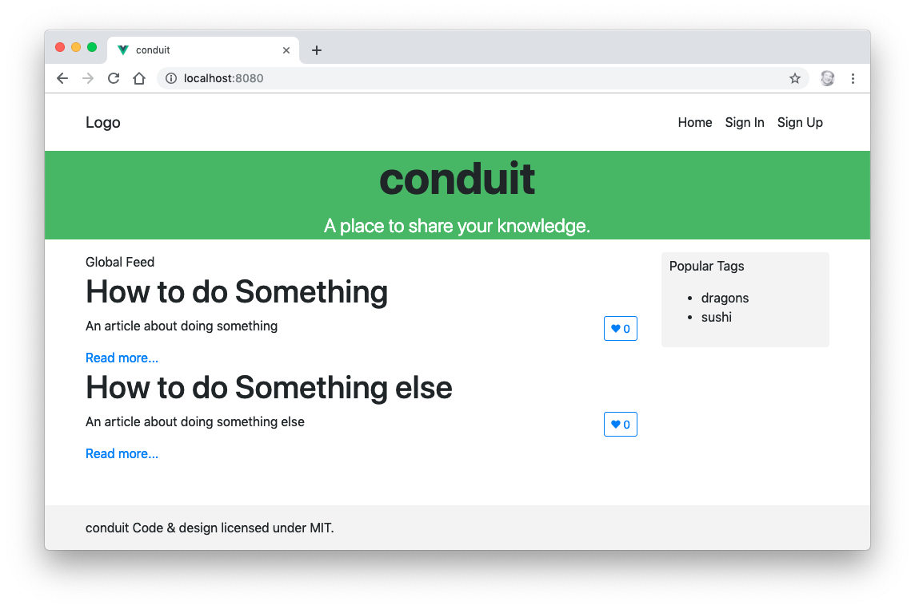
Methods and State
LAB 14
40 min
Add a favorite button to each article, toggled by a function that updates a ref.
Add a favorited ref to ArticlePreview
Write toggleFavorite() — no methods object needed
Add a button with @click="toggleFavorite"
Switch its style with :class (btn-primary / btn-outline-primary)
Challenge: add a favorites count
Professional Vue.js Development
133
Notes:
TIMING: 40 minutes.
SAY: This lab combines three things from this morning: refs for state, a function to change state, and class binding to show the state.
KEY POINT: Each ArticlePreview gets its own favorited ref, because <script setup> runs separately for each instance. That's what the data() function was for in the Options API.
LAB TIPS:
- toggleFavorite must use .value: favorited.value = !favorited.value.
- Bootstrap 5 uses float-end, not Bootstrap 4's float-right.
COMMON PROBLEMS:
- @click="toggleFavorite()" and @click="toggleFavorite" both work. The first is an inline call; the second passes the event to the function.
- Forgetting .value in script, so the button never changes.

Slide 134
Event Handling
The v-on directive (shorthand @) attaches an event listener
<button @click="counter += 1">Add 1</button>
<p>The button has been clicked {{ counter }} times.</p>
import { ref } from 'vue'
const counter = ref(0)
Vue removes the listener for you when the element is destroyed
Professional Vue.js Development
134
Notes:
SAY: v-on:click, or @click, listens for clicks. The value can be a statement to run, or a function to call.
SAY: Notice there's no .value in the template: counter += 1 works because refs are unwrapped in templates, for assignments too.
KEY POINT: You never call addEventListener or removeEventListener. Vue handles both, so there are no listener leaks.

Slide 135
Inline Event Handling
Use small bits of JavaScript directly in the value of v-on.
<button @click="count++">Add 1</button>
<button @click="say('hi')">Say hi</button>
<!-- pass the native event with $event -->
<button @click="warn('Not yet', $event)">Submit</button>
<!-- or use an inline arrow function -->
<button @click="(event) => warn('Not yet', event)">Submit</button>
Professional Vue.js Development
135
Notes:
SAY: An inline handler is any JavaScript statement. It's ideal for a one-liner like count++ or calling a function with arguments.
SAY: When you call a function with your own arguments, you lose the automatic event argument. $event is a special variable that holds the native DOM event in inline handlers, so you can pass it along. An inline arrow function does the same thing.
KEY POINT: If the handler is more than one short statement, move it into a function in <script setup>. That's the next slide.
NOTE: This slide previously had no example.

Slide 136
Event Handling with Methods
Declare a function in <script setup> and use it with v-on.
const name = ref('Vue.js')
function greet(event) {
alert(`Hello ${name.value}!`)
if (event) {
alert(event.target.tagName)
}
}
<button @click="greet">Greet</button>
When you pass the function by name, Vue calls it with the native event
Professional Vue.js Development
136
Notes:
SAY: @click="greet" passes a reference to the function. Vue calls it with the DOM event as the first argument. Here, event.target.tagName shows "BUTTON".
SAY: @click="greet()" would call it with no arguments, so event would be undefined. That's why the function checks if (event).
KEY POINT: In the Options API these went in a methods object and used this. In <script setup> they're plain functions, and state is reached through refs, not this.

Slide 137
Event Modifiers
v-on modifiers handle common DOM event details for you:
.stop — event.stopPropagation()
.prevent — event.preventDefault()
.self — only if event.target is the element itself
.capture — listen in the capture phase (outer handlers run first)
.once — run the handler at most once
.passive — tell the browser you won't call preventDefault() (smoother scrolling)
<form @submit.prevent="onSubmit">…</form>
<input @keyup.enter="search">
Professional Vue.js Development
137
Notes:
SAY: Modifiers keep your handler focused on what to do, not on DOM plumbing.
- .stop: the click doesn't bubble to parent elements. Useful for a delete button inside a clickable card.
- .prevent: no default browser action. Most common on form submit and on links handled by JavaScript.
- .self: ignore events that bubbled from children. Good for closing a modal when clicking the backdrop but not the dialog.
- .capture: handle the event on the way down rather than on the way up.
- .once: the listener removes itself after the first call.
- .passive: for scroll and touch listeners; lets the browser scroll without waiting for your handler.
SAY: There are also key modifiers (.enter, .esc, .tab, .up, .down) and system modifiers (.ctrl, .shift, .alt, .meta), plus .exact.
WATCH FOR: Don't combine .passive and .prevent; the browser ignores preventDefault in a passive listener.

Slide 138
v-on Shorthand
<!-- full syntax -->
<a v-on:click="doSomething"> ... </a>
<!-- shorthand -->
<a @click="doSomething"> ... </a>
<!-- shorthand with a dynamic event name -->
<a @[event]="doSomething"> ... </a>
Professional Vue.js Development
138
Notes:
SAY: @ is shorthand for v-on:. Like the colon for v-bind, it's what you'll see in almost all Vue code.
SAY: Dynamic event names in square brackets are rare, but useful in generic wrapper components.

Slide 139
Listening to Child Component Events
Child components declare and emit events
<!-- BlogPost.vue -->
<script setup>
const emit = defineEmits(['enlarge-text'])
</script>
<template>
<button @click="emit('enlarge-text')">Enlarge text</button>
</template>
Parent components listen for them
<BlogPost @enlarge-text="postFontSize += 0.1" />
An undeclared listener falls through to the child's root element as a native attribute, so always declare your events.
Professional Vue.js Development
139
Notes:
KEY POINT: This is the "events flow up" half of "props down, events up". A child can't change its parent's state directly. Instead it emits an event, and the parent decides what to do.
SAY: defineEmits declares which events the component can emit, and returns the emit function. Calling emit('enlarge-text') notifies any parent listening with @enlarge-text.
SAY: Declaring events matters more in Vue 3. If the parent listens for an event the child didn't declare, Vue treats @enlarge-text as a native listener on the child's root element. With a click event, that can make the handler fire twice.
SAY: Event names: declare and emit in kebab-case or camelCase; listen with @enlarge-text in templates. Vue normalizes between the two.

Slide 140
Emitting a Value With an Event
emit takes extra arguments: the event's payload
const emit = defineEmits(['enlarge-text'])
<button @click="emit('enlarge-text', 0.1)">Enlarge text</button>
The parent receives them as handler arguments
<BlogPost @enlarge-text="postFontSize += $event" />
<BlogPost @enlarge-text="(n) => (postFontSize += n)" />
<BlogPost @enlarge-text="enlarge" /> <!-- function enlarge(n) -->
Vue 2's $on / $off / $once "event bus" was removed in Vue 3. Use a store or provide/inject instead.
Professional Vue.js Development
140
Notes:
SAY: Now the child decides how much to enlarge the text by, and passes it along. In an inline handler, the first payload argument is available as $event. With a function reference, the payload arrives as the function's arguments.
KEY POINT: Component events don't bubble. Only the direct parent can listen. If a deeply nested component needs to talk to a distant one, that's a sign you need shared state: a Pinia store, coming on Day 3.

Slide 141
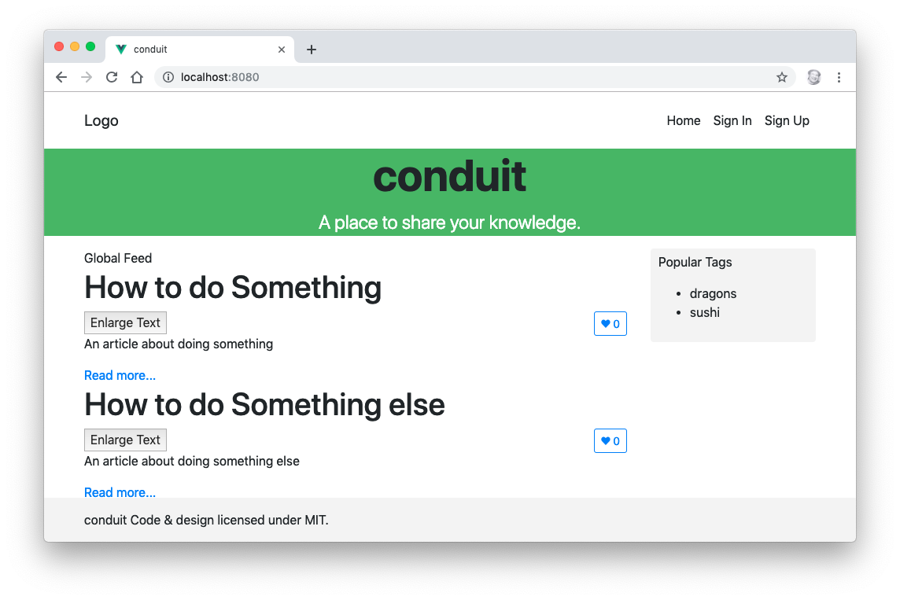
Events
LAB 15
40 min
Let each article preview ask its parent to change the font size of the whole list.
Add an articleFontSize ref to ArticleList
Bind it with :style on each ArticlePreview
Declare enlarge-text with defineEmits in ArticlePreview
Emit it from an "Enlarge Text" button
Listen with @enlarge-text in ArticleList; add "Shrink Text"
Professional Vue.js Development
141
Notes:
TIMING: 40 minutes.
SAY: State lives in the parent (ArticleList); the child (ArticlePreview) only asks for a change. That's props down, events up.
LAB TIPS:
- The style binding is :style="{ fontSize: articleFontSize + 'em' }".
- For Shrink Text, emit a second event, or emit enlarge-text with a negative payload. Discuss which is cleaner.
COMMON PROBLEMS:
- Using $emit in <script setup>: it's not available there. Use the emit function returned by defineEmits. ($emit does work in the template.)
- The challenge (only the description grows): move the :style binding inside ArticlePreview onto the description element, and pass the size as a prop.

Slide 142
Watchers
A general way to react to state changes with side effects
Most useful for asynchronous or expensive work in response to changing data
import { ref, watch } from 'vue'
const question = ref('')
const answer = ref('Ask me a question!')
watch(question, async (newQuestion, oldQuestion) => {
if (!newQuestion.endsWith('?')) return
answer.value = 'Thinking...'
answer.value = await getAnswer(newQuestion)
})
Professional Vue.js Development
142
Notes:
TIMING: 3:30 block: watchers and lifecycle, then Lab 16.
SAY: A watcher runs a callback whenever its source changes. Here, whenever the question changes and ends with a question mark, it fetches an answer.
KEY POINT: computed is for deriving a value; watch is for doing something: calling an API, writing to localStorage, updating the document title, logging.
SAY: The source can be a ref, a reactive object, a getter function, or an array of these. To watch a property of a reactive object or a prop, use a getter: watch(() => props.id, ...).
IF ASKED: What about race conditions, if an older request finishes after a newer one? The callback receives a third argument, onCleanup (or call onWatcherCleanup() in 3.5+), to cancel the previous request.

Slide 143
watch and watchEffect
watch(source, callback)
Explicit about what it tracks; gives you the new and old value
Lazy: doesn't run until the source changes (unless { immediate: true })
watchEffect(callback)
Tracks whatever the callback reads, automatically; runs once immediately
watchEffect(() => {
document.title = `${count.value} new posts`
})
Both return a stop function and stop automatically when the component unmounts. Reach for computed() first — a watcher is for side effects.
Professional Vue.js Development
143
Notes:
SAY: watch is explicit: you say exactly what to watch, and get old and new values. Use it when you need the previous value, or want precise control over what triggers the callback.
SAY: watchEffect is automatic: it runs immediately, records what it read, and re-runs when any of those change, like a computed property that produces a side effect instead of a value.
KEY POINT: Watchers created synchronously in <script setup> are stopped automatically when the component unmounts. A watcher created later, inside an async callback for example, is not, and you must call the returned stop function yourself.
NOTE: The numbering on this slide was broken in the previous version; it's now two columns.

Slide 144
Component Lifecycle
Functions imported from vue and called inside <script setup>:
onBeforeMount / onMounted
onBeforeUpdate / onUpdated
onBeforeUnmount / onUnmounted
onErrorCaptured, onActivated, onDeactivated
There's no onCreated: the body of <script setup> is that hook. Vue 2 named the unmount pair beforeDestroy and destroyed.
Professional Vue.js Development
144
Notes:
SAY: Every component goes through the same lifecycle: it's created (setup runs), mounted (inserted into the DOM), updated (re-rendered as state changes, any number of times), and unmounted (removed).
DO: Walk through the diagram: setup, then the template is compiled (if needed), onBeforeMount, the initial render and DOM insertion, onMounted. Then the update loop: state change, onBeforeUpdate, re-render and patch, onUpdated. Finally, when the component is removed: onBeforeUnmount, onUnmounted.
SAY: onActivated and onDeactivated are for components inside <KeepAlive>, which caches components instead of destroying them. onErrorCaptured catches errors thrown by descendants.
TRANSITION: Let's go through the main hooks one at a time.

Slide 145
Setup (replacing beforeCreate / created)
The body of <script setup> runs once per component instance, before it's mounted
State and props exist; there's no DOM yet
This is where you:
declare refs, computed values and functions
register lifecycle hooks and watchers
start any request whose result the first render doesn't need
const articles = ref([])
const loading = ref(true)
fetchArticles().then((list) => {
articles.value = list
loading.value = false
})
Professional Vue.js Development
145
Notes:
SAY: In the Options API, beforeCreate and created were hooks. In the Composition API, setup itself is the creation phase, so those hooks aren't needed.
KEY POINT: Starting a request in setup gets it going as early as possible, before the component renders. Show a loading state in the template until the data arrives.
WATCH FOR: Don't touch the DOM here (document.querySelector or template refs), because it doesn't exist yet. That's what onMounted is for.

Slide 146
onBeforeMount
Runs after setup, right before the first render is inserted into the DOM
import { onBeforeMount } from 'vue'
onBeforeMount(() => {
console.log('about to render')
})
Rarely needed: setup already runs before mounting
Not called during server-side rendering
Professional Vue.js Development
146
Notes:
SAY: Honestly, you'll almost never use this one. Anything you'd do here can usually go directly in setup.
SAY: It's in the API mostly for symmetry with the Options API, and for library authors.

Slide 147
onMounted
The component's DOM has been created and inserted
Full access to the rendered DOM through template refs
Use for measuring elements, focusing inputs, and integrating non-Vue libraries
const input = ref(null) // <input ref="input">
onMounted(async () => {
input.value.focus()
articles.value = await fetchArticles()
})
Children are mounted before their parent
Professional Vue.js Development
147
Notes:
SAY: onMounted is the most-used hook. It's where you can safely touch the DOM. A template ref is a ref whose name matches a ref="..." attribute in the template; after mounting, its .value is the DOM element (or the child component instance).
SAY: It's also a common place to fetch data, which is what Lab 16 does. Either setup or onMounted works; onMounted guarantees it only runs in the browser, which matters for server-side rendering.
ASK: If App contains HomeContent, which contains ArticleList, which component's onMounted runs first? (ArticleList. Children mount first, so the parent's onMounted can rely on its children's DOM.)

Slide 148
onBeforeUpdate
Runs after state changes, before the DOM is patched
Use it to read the DOM as it was before the update
for example, to record a scroll position
let previousHeight = 0
onBeforeUpdate(() => {
previousHeight = list.value.scrollHeight
})
Professional Vue.js Development
148
Notes:
SAY: Think of a chat window. Before new messages render, you record whether the user was scrolled to the bottom. After the update (next slide), you decide whether to scroll down to the new message.
SAY: It's safe to modify state here; it won't cause an extra render.

Slide 149
onUpdated
Runs after a state change has re-rendered and patched the DOM
Don't change state here without a guard — you'll create an update loop
To react to one specific value, prefer watch()
onUpdated(() => {
const el = list.value
if (wasAtBottom) el.scrollTop = el.scrollHeight
})
Professional Vue.js Development
149
Notes:
SAY: onUpdated runs after any re-render of this component, for any reason. That's why it's a blunt tool. If you care about one specific value changing, use watch with { flush: 'post' }, which runs after the DOM updates but only for that value.
WATCH FOR: Changing state inside onUpdated triggers another update, which triggers onUpdated again: an infinite loop, and Vue will warn about it.

Slide 150
onBeforeUnmount
Fires right before teardown, while the component is still fully functional
Clean up anything you created that Vue doesn't know about:
timers (setInterval)
subscriptions (WebSocket, event source)
listeners on window or document
instances of non-Vue libraries (charts, maps, editors)
Professional Vue.js Development
150
Notes:
SAY: When a component is removed (v-if becomes false, the route changes), Vue cleans up everything it set up: listeners in templates, watchers, computed properties, child components. But it can't know about a setInterval you started or a listener you added to window.
KEY POINT: Every "start" in onMounted should have a matching "stop" in onBeforeUnmount or onUnmounted. Forgetting this is the most common source of memory leaks in single-page apps, because the page never reloads.

Slide 151
onUnmounted
Everything attached to the component has been torn down and removed from the DOM
Watchers and lifecycle hooks are stopped for you
Anything you set up by hand is not
onBeforeUnmount and onUnmounted are both fine for cleanup; use onBeforeUnmount if you need the DOM
Professional Vue.js Development
151
Notes:
SAY: The difference between the two unmount hooks: in onBeforeUnmount the DOM still exists, so you can read from it or let a library detach itself cleanly. In onUnmounted, it's gone.
TRANSITION: Let's see a complete example of setup and cleanup.

Slide 152
Lifecycle Hooks in Practice
<script setup>
import { onMounted, onUnmounted, ref } from 'vue'
const seconds = ref(0)
let timer
onMounted(() => {
timer = setInterval(() => seconds.value++, 1000)
})
onUnmounted(() => clearInterval(timer))
</script>
<template>
<p>You've been here {{ seconds }} seconds.</p>
</template>
Professional Vue.js Development
152
Notes:
SAY: A timer component. The interval starts when the component appears and is cleared when it's removed.
ASK: What happens if we delete the onUnmounted line, and the component is shown and hidden ten times with v-if? (Ten intervals keep running forever, each updating a ref nobody displays. That's a leak.)
SAY: Notice timer is a plain let, not a ref. It doesn't need to be reactive: the template never displays it.
TIP: This is also a perfect candidate for a composable (Day 3): a useInterval() function that does both halves, so callers can't forget the cleanup.
NOTE: In the previous version, "let timer" was formatted as a bullet. Fixed.

Slide 153
Using Lifecycle Hooks
Hooks must be called synchronously in the body of <script setup>
Not inside a callback, a promise handler, or a condition
That's how Vue knows which component instance to attach them to
They can be called from a composable, because a composable is itself called synchronously from setup
// ✗ too late: Vue no longer knows the current component
setTimeout(() => onMounted(() => {}), 0)
Professional Vue.js Development
153
Notes:
SAY: While setup runs, Vue keeps track of "the component currently being set up". When you call onMounted, it attaches the hook to that component. Once setup returns (or hits its first await), there is no current component, so a hook registered later has nothing to attach to and Vue warns.
WATCH FOR: `await something` at the top level of <script setup> followed by onMounted. After the first await, you've lost the instance. Register hooks before any await.

Slide 154
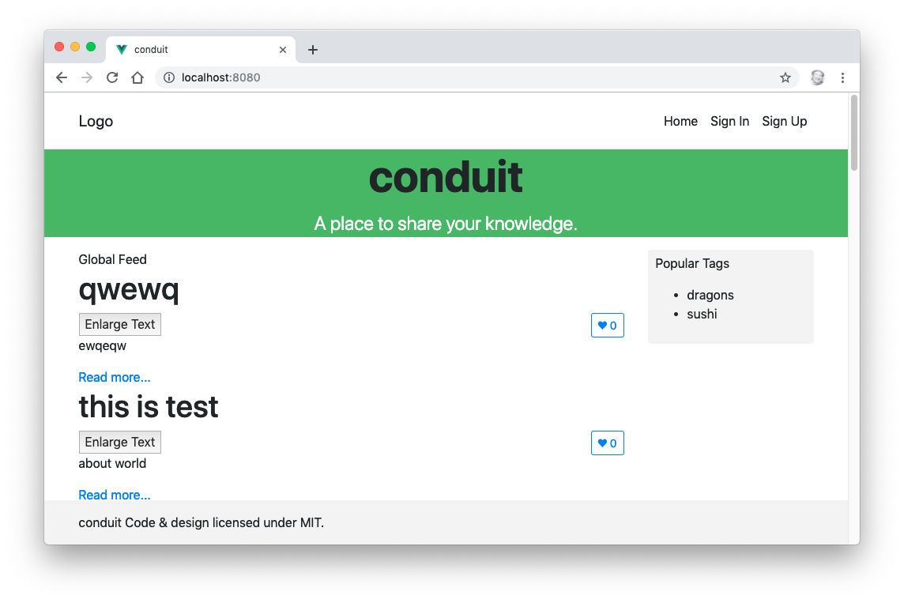
Component Lifecycle
LAB 16
20 min
Load articles from the real Conduit API when ArticleList mounts.
Create src/common/config.js with API_URL (from import.meta.env.VITE_API_URL)
npm install axios
Create api.service.js with an axios instance and a query() method
Fetch articles in onMounted and assign them to the articles ref
Remove the JSON import; start with ref([])
Professional Vue.js Development
154
Notes:
TIMING: 20 minutes.
LAB TIPS:
- The API base URL is https://api.realworld.show/api. Make sure it's reachable from your classroom network before class. If it isn't, point VITE_API_URL at an alternative instance in .env.local.
- Vite only exposes environment variables that start with VITE_, on import.meta.env. process.env doesn't exist in the browser.
- Initialize articles as an empty array, not an object, or the "No articles are here" check breaks.
COMMON PROBLEMS:
- Network errors or CORS errors in the console: check the API URL and the network. Open the Network tab and look at the failed request.
- The ArticleList test now fails because it makes a real network request. That's expected; we fix it properly in Lab 23 with mocks.
DEBRIEF: Show the request in the Network tab, and the articles ref filling in Vue DevTools.

Slide 155
Vue and Forms
DAY 2
Text inputs, checkboxes, radio buttons, selects and modifiers
Professional Vue.js Development
155
Notes:
TIMING: About 15 minutes of demos, then Lab 17 (which can spill into the start of Day 3).
SAY: Forms are where two-way binding shines. We'll look at how v-model handles each type of input, then use one to filter the article list.

Slide 156
Input Bindings
<input v-model="yourAnswer">
<textarea v-model="yourAnswer"></textarea>
<input type="checkbox" id="agree" v-model="checked">
<input type="radio" id="first" value="First" v-model="picked">
<select v-model="selected">
<option disabled value="">Please select one</option>
<option>A</option>
<option>B</option>
<option>C</option>
</select>
Professional Vue.js Development
156
Notes:
SAY: One directive, every input type. The value type depends on the input:
- text and textarea: a string.
- a single checkbox: a boolean.
- several checkboxes bound to the same array: an array of the checked values.
- radio buttons: the value of the selected one.
- select: the selected option's value (or an array, with multiple).
TIP: For a select, a disabled first option with value="" gives a "please select" prompt. Without it, iOS won't fire a change event for the first option.
DEMO: demos/input-bindings/index.html shows two text inputs combined by a computed property. The next four slides each have their own demo.

Slide 157
2-way Binding Pros and Cons
2-way binding makes development easier
2-way binding can make data flow harder to follow and test
v-model is a little bit magic (which could be a pro or a con)
<input v-model="searchText">
…does the same thing as:
<input
:value="searchText"
@input="searchText = $event.target.value">
Professional Vue.js Development
157
Notes:
KEY POINT: v-model is syntactic sugar. It's one-way binding (:value) plus an event listener that updates the state. There's no special two-way channel. Understanding this makes v-model on components (Day 3) easy to understand.
SAY: The "con" is mostly about large apps: if many places can change a value through v-model, it's harder to trace where a change came from. That's one reason stores like Pinia centralize changes in actions.

Slide 158
Creating a Form with Checkboxes
DEMO
Files: demos/forms/checkboxes.html
A single checkbox bound to a boolean
Several checkboxes bound to one array
true-value / false-value for custom values
<input type="checkbox" value="Vue" v-model="frameworks">
<input type="checkbox" value="React" v-model="frameworks">
Professional Vue.js Development
158
Notes:
DEMO: Open demos/forms/checkboxes.html in the browser (no build step).
1. Toggle the "I agree" checkbox; the boolean shows true/false below.
2. Check several frameworks; the array updates in order of checking.
3. Toggle the newsletter box, which uses true-value="yes" and false-value="no".
4. Open the file and show the three refs and the template.
ASK: Why does the frameworks array keep the order you clicked, rather than the order on the page? (v-model pushes and removes values as boxes are checked and unchecked.)

Slide 159
Creating a Form with Radio Buttons
DEMO
Files: demos/forms/radio.html
Radio buttons in a group share one v-model
The ref holds the value of the selected button
Use :value to select numbers or objects
<input type="radio" value="small" v-model="size">
<input type="radio" value="large" v-model="size">
Professional Vue.js Development
159
Notes:
DEMO: Open demos/forms/radio.html.
1. Pick a size; the selected value appears below.
2. Pick a shipping option. These use :value with objects, so the ref holds the whole object, and the computed total updates with its price.
SAY: With v-model you don't need a name attribute to group radio buttons. They're grouped by sharing the same v-model. (Adding name is still fine for accessibility and for native form submission.)

Slide 160
Creating a Form with a Select Element
DEMO
Files: demos/forms/select.html
Single select: the ref holds the chosen option's value
multiple: the ref holds an array
Generate options with v-for; bind objects with :value
<select v-model="country">
<option disabled value="">Choose…</option>
<option v-for="c in countries" :key="c.code" :value="c.code">
{{ c.name }}
</option>
</select>
Professional Vue.js Development
160
Notes:
DEMO: Open demos/forms/select.html.
1. Choose a country from the single select; its code is shown.
2. Ctrl/Cmd-click several toppings in the multiple select; the array updates.
3. Point out that the options are generated with v-for from an array, the usual case with real data.
WATCH FOR: If the bound value doesn't match any option's value, the select renders blank. That's why the "Choose…" option with value="" matches the initial ref('').

Slide 161
Input Modifiers
DEMO
Files: demos/forms/modifiers.html
.lazy — sync on change instead of every input
.number — cast the value to a number
.trim — strip leading and trailing whitespace
<input v-model.lazy="message">
<input v-model.number="age">
<input v-model.trim="username">
Professional Vue.js Development
161
Notes:
DEMO: Open demos/forms/modifiers.html.
1. Type in the .lazy input: the output doesn't change until you press Tab or click away.
2. Type a number into the plain input and the .number input. The page shows typeof for each: "string" vs "number". Then show age + 1 for each: "201" vs 21.
IF ASKED: Vue automatically applies .number to inputs with type="number", which is why the demo uses text inputs to show the difference.
3. Type spaces around a name in the .trim input; the brackets in the output show they're gone.
KEY POINT: Lab 17's note mentions that an earlier version of the lab used v-model.number on a text search, which is wrong: .number tries to cast every keystroke to a number. Use modifiers only when they match the data.

Slide 162
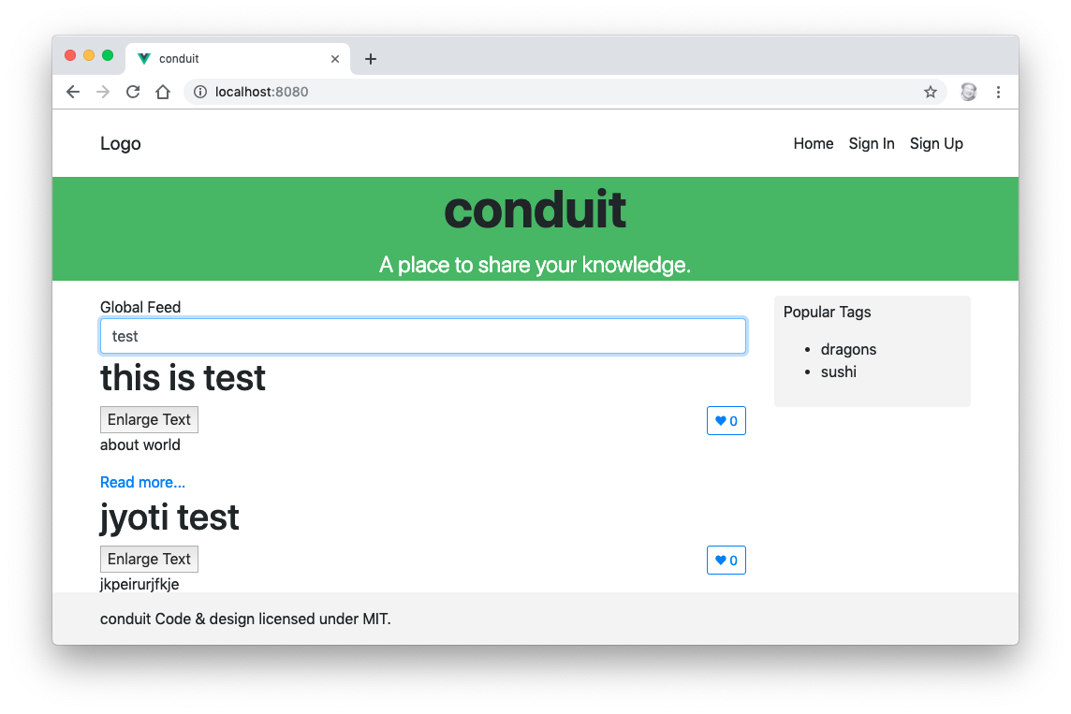
Forms
LAB 17
15 min
Filter the article list as the user types.
Add an input bound to a searchDetails ref with v-model
Create a filterIt computed property
Loop over filterIt instead of articles
Challenges: make it case-insensitive; search the description too
Professional Vue.js Development
162
Notes:
TIMING: 15 minutes. It's fine to let this finish at the start of Day 3.
SAY: This combines the forms demos with the computed-property demo from this morning: v-model feeds a ref; a computed property filters the list.
LAB TIPS:
- Don't use v-model.number here; we're filtering text.
- Case-insensitive: lowercase both sides with toLowerCase().
COMMON PROBLEMS:
- The list doesn't filter: v-for still loops over articles instead of filterIt.
- Errors when articles haven't loaded: the computed runs while articles is still []. That's fine; filter on an empty array returns [].
DEBRIEF: End of Day 2. Tomorrow starts with Review 2 (quiz/day2.txt), then components in depth.

Slide 163
Vue Components
DAY 3
Props, naming, registration, v-model, slots and async components
Professional Vue.js Development
163
Notes:
TIMING: Day 3 starts with Review 2 (Labs 11-17, quiz/day2.txt) from 8:30 to 9:00. Then 30 minutes on components, and Lab 18.
SAY: You've been writing components since Day 1. Now let's look at them properly: how data flows into them, how to customize their content with slots, and how to load them on demand.

Slide 164
What are Vue Components?
A reusable piece of UI with its own state, template and styles
Written as a single-file component: a .vue file with <script setup>, <template> and <style>
State is declared with ref() and reactive(), so each instance gets its own copy
That's what the data() function guaranteed in the Options API
A component may have more than one root element (a fragment)
Components form a tree: data flows down as props, events flow up
Professional Vue.js Development
164
Notes:
SAY: A component is to UI what a function is to code: a named, reusable unit with inputs (props), outputs (events), and private internals (state).
KEY POINT: Each <ArticlePreview> on the page is a separate instance with its own favorited ref. Clicking favorite on one doesn't affect the others. In the Options API, that's why data had to be a function returning a fresh object.

Slide 165
Creating a Component
<!-- TodoItem.vue -->
<script setup>
defineProps({
todo: { type: Object, required: true },
})
</script>
<template>
<li>{{ todo.text }}</li>
</template>
The file name is the component name: TodoItem.vue is used as <TodoItem />
Vue 2 wrote Vue.component('todo-item', { ... })
Professional Vue.js Development
165
Notes:
SAY: This is a complete component: it takes a todo object as a prop and renders its text in an li.
SAY: To use it: import TodoItem from './TodoItem.vue', then <TodoItem :todo="item" />.
KEY POINT: There's no registration step and no name declaration. With <script setup>, the file name is the name, and importing it registers it.

Slide 166
Organizing and Reusing Components
Apps are usually organized as a tree of nested components.
Professional Vue.js Development
166
Notes:
SAY: On the left, a page layout: header, sidebar, main content with repeated items. On the right, the same thing as a component tree.
DO: Map it onto Conduit on the whiteboard: App at the root; TheHeader, HomeContent, TheFooter beneath it; HomeContent contains GlobalFeed and the tags sidebar; GlobalFeed contains ArticleList; ArticleList contains many ArticlePreview.
KEY POINT: Where state lives in this tree determines who can see it. State lives in the closest common ancestor of the components that need it, and is passed down as props. When that ancestor is far away, it's time for a store.

Slide 167
Naming Components
PascalCase — the recommended default
Matches the file name, and the editor can resolve it
Distinguishes your components from native HTML elements
kebab-case — <todo-item>
Required when templates are written directly in the HTML page (in-DOM templates), because HTML tag names are case-insensitive
Use multi-word names (TodoItem, not Todo) to avoid clashing with current and future HTML elements
Professional Vue.js Development
167
Notes:
SAY: In .vue files, use PascalCase: <TodoItem />. It's obvious at a glance that it's a component, not an HTML element.
SAY: When you use Vue from a CDN with the template in the HTML page, the browser parses the HTML first and lowercases tag names, so you must write <todo-item></todo-item>. Vue matches it to TodoItem automatically.
KEY POINT: Multi-word names are enforced by ESLint's vue/multi-word-component-names rule. That's why our components are TheHeader and HomeContent, and why Lab 22 renames Login.vue to LoginPage.vue.

Slide 168
Local Components
The usual case: import the component where you use it.
<script setup>
import PopupWindow from './components/PopupWindow.vue'
</script>
<template>
<PopupWindow />
</template>
The import is the registration. There's no components option.
Professional Vue.js Development
168
Notes:
SAY: With <script setup>, local registration is just an import. The compiler sees that PopupWindow is used in the template and wires it up.
SAY: In the Options API you had to import the component and then list it in components: { PopupWindow }. Forgetting the second step was a common bug.

Slide 169
Global Components
// main.js
import { createApp } from 'vue'
import App from './App.vue'
import PopupWindow from './components/PopupWindow.vue'
const app = createApp(App)
app.component('PopupWindow', PopupWindow)
app.mount('#app')
Registered on the app, not on a global Vue
Usable in every component's template without an import
Professional Vue.js Development
169
Notes:
SAY: app.component registers a component for every template in this app. A second app on the same page doesn't see it.
SAY: Plugins often register global components this way. The router registers <RouterLink> and <RouterView> globally, which is why they work in templates even without an import.

Slide 170
Global vs. Local
Prefer local registration.
A reader can see where every component comes from
Unused components can be tree-shaken out of the bundle
The editor can jump to the definition and type-check props
Register globally only for components used on nearly every screen — an icon, or a base button.
Professional Vue.js Development
170
Notes:
SAY: Global registration is convenient, but it hides dependencies. When you read a template that uses <DataTable>, you can't tell where it came from, and the bundler can't remove it even if nothing uses it.
KEY POINT: In this course, every component is imported locally.

Slide 171
Props
Declare props with the defineProps compiler macro.
const props = defineProps({
todo: { type: Object, required: true },
size: { type: String, default: 'medium' },
})
In the template, write todo directly; in script, use props.todo
Props are read-only — emit an event to ask the parent for a change
type, required, default and validator produce dev-time warnings
Professional Vue.js Development
171
Notes:
SAY: Props are a component's inputs. The object form lets you declare a type, whether it's required, a default, and a custom validator. Vue checks these in development and warns in the console when they're violated.
KEY POINT: One-way data flow. When the parent's value changes, the child's prop updates. But the child must never assign to a prop. If you need a local, editable copy, initialize a ref from it: const draft = ref(props.todo.text).
SAY: Defaults for objects and arrays must be factory functions: default: () => []. Otherwise every instance would share one array.
IF ASKED: With TypeScript, you can write defineProps<{ todo: Todo; size?: string }>() instead, as in the compiler-macros demo.

Slide 172
Passing Data
Pass data from parent to child components using props
Pass props using attributes:
<!-- a static string -->
<TodoItem todo="wash the car" />
<!-- any JavaScript value: use v-bind -->
<TodoItem :todo="item" :priority="2" :done="false" />
A component can have as many props as you need
Any value can be passed to any prop
Professional Vue.js Development
172
Notes:
KEY POINT: The colon matters. Without it, the value is always a string. priority="2" passes the string "2"; :priority="2" passes the number 2. :done="false" passes the boolean false, while done="false" passes the string "false", which is truthy!
SAY: Prop names: declare in camelCase (articleTitle) and pass in either camelCase or kebab-case (:article-title). Vue converts between them.

Slide 173
Using Props
Parent
<TodoItem :todo="item" size="large" />
Child: TodoItem.vue
<script setup>
defineProps(['todo', 'size'])
</script>
<template>
<li :class="size">{{ todo.text }}</li>
</template>
Professional Vue.js Development
173
Notes:
SAY: The array form of defineProps just lists names, with no types. It's fine for quick prototypes; the object form (slide 171) is better for anything you'll keep, because you get validation and documentation.
SAY: Follow the data: the parent's item flows into the child's todo prop, and the child renders it. If the parent changes item.text, the child re-renders.

Slide 174
Fragments: Multiple Root Elements
Vue 2 required a single root element. Vue 3 doesn't.
<template>
<h1>{{ title }}</h1>
<div v-html="content"></div>
</template>
With more than one root, Vue can't decide where to put inherited attributes (class, style, listeners)
Bind $attrs explicitly if the parent passes them:
<div v-bind="$attrs" v-html="content"></div>
Professional Vue.js Development
174
Notes:
SAY: In Vue 2 you'd wrap this in an extra div, which could break CSS layouts like flexbox and grid. Vue 3 allows several root nodes.
SAY: Attributes the parent passes that aren't declared as props ("fallthrough attributes", like class or id) normally go on the root element. With several roots, Vue doesn't guess; it warns until you bind $attrs where you want them.
TIP: defineOptions({ inheritAttrs: false }) turns off automatic fallthrough entirely, so you can place $attrs yourself even in a single-root component.

Slide 175
Using v-model on Components
v-model works on components as it does on inputs:
<CustomInput v-model="searchText" />
…does the same thing as:
<CustomInput
:model-value="searchText"
@update:model-value="(v) => (searchText = v)" />
Vue 3 uses the modelValue prop and update:modelValue event (Vue 2 used value and input)
Named models allow several per component: v-model:title, v-model:body
Professional Vue.js Development
175
Notes:
SAY: Just like on inputs, v-model on a component is sugar for a prop plus an event. The child receives modelValue as a prop and emits update:modelValue with the new value; the parent's handler updates its ref.
SAY: The rename from Vue 2's value/input freed up the value prop for ordinary use and made multiple v-models possible: <UserForm v-model:first-name="first" v-model:last-name="last" />.
TRANSITION: Writing the prop and the event by hand is boilerplate. Vue 3.4 added a macro that does it for you.

Slide 176
defineModel
Since Vue 3.4, the whole prop-and-event pair has a shorthand.
<!-- CustomInput.vue -->
<script setup>
const model = defineModel()
</script>
<template>
<input v-model="model">
</template>
model is a writable ref
Writing to it emits update:modelValue for you
Named and typed: defineModel('title', { type: String, required: true })
Professional Vue.js Development
176
Notes:
SAY: defineModel declares the modelValue prop and the update:modelValue event, and gives you a ref that reads the prop and emits the event when you assign to it. The child can treat it like local state, while the parent still owns the value.
DEMO: demos/compiler-macros has defineModel<boolean>() in MacroCounter.vue as isActive.
KEY POINT: The parent code doesn't change at all: still <CustomInput v-model="searchText" />.

Slide 177
Content Distribution with Slots
Slots let a parent pass template content into a component.
<!-- parent -->
<NavigationLink url="/profile">
Your Profile
</NavigationLink>
<!-- NavigationLink.vue -->
<script setup>
defineProps({ url: String })
</script>
<template>
<a :href="url" class="nav-link">
<slot></slot>
</a>
</template>
Professional Vue.js Development
177
Notes:
SAY: Props pass data; slots pass markup. Whatever the parent puts between <NavigationLink> and </NavigationLink> is rendered where the child has <slot>.
SAY: Think of the child as a picture frame and the slot as the hole in the middle. The frame (the link styling, the card border, the modal chrome) is reusable; the picture is supplied by whoever uses it.
KEY POINT: Slot content can be anything: text, HTML, other components. And it's compiled in the parent's scope, so it can use the parent's state.

Slide 178
Cool Things You Can Do With Slots
Slots can contain any template code, including HTML and components
Slot content can use the parent's state (it's compiled in the parent's scope)
Provide default content for when the parent doesn't supply any:
<button class="btn">
<slot>Submit</slot>
</button>
Use named slots when a component needs several insertion points
Professional Vue.js Development
178
Notes:
SAY: Default content is shown only when the parent passes nothing. <SubmitButton /> renders "Submit"; <SubmitButton>Save</SubmitButton> renders "Save".
KEY POINT: Scope rule: slot content sees the parent's data, not the child's. If the child needs to pass data back up to the slot content, that's a scoped slot, coming up on slide 182.

Slide 179
Naming Slots
The parent fills each named slot with a <template v-slot:name>:
<BaseLayout>
<template v-slot:header>
<h1>Header content</h1>
</template>
<p>Main content goes in the default slot.</p>
<template v-slot:footer>
<p>Footer content</p>
</template>
</BaseLayout>
Professional Vue.js Development
179
Notes:
SAY: A layout component with header, main and footer areas. The parent targets the named slots with <template v-slot:header> and <template v-slot:footer>. Anything not inside a named template goes to the default slot.
TRANSITION: Here's the child side.

Slide 180
Using Named Slots
<!-- BaseLayout.vue -->
<template>
<div class="container">
<header>
<slot name="header"></slot>
</header>
<main>
<slot></slot> <!-- the default slot -->
</main>
<footer>
<slot name="footer"></slot>
</footer>
</div>
</template>
Professional Vue.js Development
180
Notes:
SAY: The child marks each insertion point with <slot name="...">. A slot without a name is the default slot.
TIP: To render a wrapper only when a slot was given content, check $slots: <footer v-if="$slots.footer">. In script, useSlots() gives the same object.

Slide 181
Using Slots
DEMO
Files: demos/slots/index.html
A BaseCard component with header, default and footer slots
Default content when a slot is empty
A scoped slot: ItemList passes each item back to the parent
Open the file in a browser; edit the template to experiment
Professional Vue.js Development
181
Notes:
DEMO: Open demos/slots/index.html in the browser.
1. The first card fills all three slots. The second card supplies only default content, so the header shows its fallback text and the footer is omitted (it's wrapped in v-if="$slots.footer").
2. Scroll to the list. ItemList owns the ul/li markup and the loop, but each item's content comes from the parent through a scoped slot: <template #item="{ item }">. Show that the parent renders done items with a strike-through, a decision the list component doesn't know about.
3. Open the source. Components are defined with template strings so the demo needs no build step. In a Vite project, each would be its own .vue file.
KEY POINT: This is the pattern Lab 18 uses: TagList owns the sidebar box and heading; the parent supplies the tags.

Slide 182
More Fun with Slots
Named slot shorthand: v-slot:header can be written #header
<template #header>
<p>template content here</p>
</template>
Scoped slots: the child passes data to the slot content
<!-- ItemList.vue -->
<li v-for="item in items" :key="item.id">
<slot name="item" :item="item"></slot>
</li>
<!-- parent -->
<ItemList :items="todos">
<template #item="{ item }">{{ item.text }}</template>
</ItemList>
Also: dynamic slot names (#[name]), abbreviated default slot syntax
Professional Vue.js Development
182
Notes:
SAY: # is the slot shorthand, like : for v-bind and @ for v-on.
KEY POINT: Scoped slots flip the scope rule. Normally slot content only sees the parent's data. With a scoped slot, the child passes data as attributes on <slot>, and the parent receives it as an object, usually destructured: #item="{ item }".
SAY: This is how reusable list, table and data-fetching components work: the child handles the logic (looping, sorting, fetching); the parent decides what each item looks like.
SAY: When a component only has a default scoped slot, you can put v-slot directly on the component tag: <ItemList v-slot="{ item }">.

Slide 183
Slots
LAB 18
20 min
Load popular tags from the API and display them, and each article's tags, with slots.
Create TagItem and TagList (with a default slot and fallback text)
Load tags from /tags (same base URL as articles)
Add a named tags slot to ArticlePreview; fill it with #tags
Make clicking a tag filter the article list
Professional Vue.js Development
183
Notes:
TIMING: About 20 minutes (more with the challenges).
LAB TIPS:
- TagList owns the layout (the box, heading and ul) but not the content: the parent supplies TagItems through the default slot.
- For filtering, TagItem emits a select event, HomeContent stores selectedTag, and passes it down as a prop through GlobalFeed to ArticleList, where filterIt checks it.
COMMON PROBLEMS:
- Tags don't render: the API response is { tags: [...] }, so assign data.tags.
- Clicking does nothing: the event isn't declared with defineEmits, or the parent listens with the wrong name.
DEBRIEF: Ask: selectedTag had to be passed down through GlobalFeed, which doesn't use it. What's that called? (Prop drilling.) Keep that in mind; Pinia solves it this afternoon.

Slide 184
Loading Components Asynchronously
Wrap a dynamic import with defineAsyncComponent:
import { defineAsyncComponent } from 'vue'
const AsyncModal = defineAsyncComponent(() =>
import('./components/Modal.vue')
)
Vite gives the component its own chunk, downloaded on first use
Routes get this for free from a lazy route component
Options for a loading component, an error component, delay and timeout
<Suspense> can show a fallback while async components load (still marked experimental)
Professional Vue.js Development
184
Notes:
SAY: A regular import puts the component in the main bundle, so it's downloaded when the app loads. A dynamic import() tells the bundler to split it into a separate file, fetched only the first time the component renders.
SAY: Good candidates: big components that aren't always shown, like modals, charts, rich-text editors and admin panels.
DEMO (optional): Run npm run build and point out the extra chunk in dist/assets.
KEY POINT: You'll use the same import() pattern for routes on slide 215, where it's the default.

Slide 185
Composables
DAY 3
Reusing stateful logic with plain functions
Professional Vue.js Development
185
Notes:
TIMING: 9:50-10:05 lecture, then Lab 19.
SAY: Composables are the Composition API's answer to code reuse. If you understand that a composable is just a function that uses ref, computed and lifecycle hooks, you understand composables.

Slide 186
Composable Basics
A composable is a function that uses the Composition API to encapsulate and reuse stateful logic
By convention it's named use… and lives in src/composables
It's called synchronously from <script setup>, so it can use lifecycle hooks and watchers on the caller's behalf
const { x, y } = useMouse() // reactive mouse position
Professional Vue.js Development
186
Notes:
SAY: Stateless helpers, like a function that formats a date, are just utility functions. A composable is different because it holds reactive state and possibly side effects, and every component that calls it gets its own copy.
SAY: useMouse is the classic example: it creates x and y refs, adds a mousemove listener in onMounted, removes it in onUnmounted, and returns the refs. Any component can now track the mouse in one line, and none of them can forget the cleanup.
IF ASKED: Is it like a React hook? Very similar idea, without the rules: no dependency arrays, no stale closures, and setup only runs once, so a composable's code doesn't re-run on every render.

Slide 187
Why Composables Replace Mixins
A mixin merged its options into the component silently:
You couldn't tell where an inherited property came from
Two mixins declaring the same name collided, and a merge strategy picked the winner
A mixin couldn't take arguments
A composable takes its inputs as parameters and returns its outputs, so both ends are visible at the call site.
Mixins still work in Vue 3, but the docs describe them as legacy.
Professional Vue.js Development
187
Notes:
SAY: If you've maintained a Vue 2 app with several mixins, you've probably seen a template use a property like isLoading and had to search every mixin to find which one defined it.
SAY: With a composable, the origin is explicit: const { isLoading } = useArticles(). You can rename on destructure to avoid collisions: const { isLoading: tagsLoading } = useTags().

Slide 188
Writing a Composable
// src/composables/useArticleFilter.js
import { computed, ref } from 'vue'
export function useArticleFilter(articles) {
const searchDetails = ref('')
const filterIt = computed(() =>
articles.value.filter((a) =>
a.title.includes(searchDetails.value)
)
)
return { searchDetails, filterIt }
}
Professional Vue.js Development
188
Notes:
SAY: This is the filter from Lab 17, moved out of ArticleList into its own file. It takes the list of articles as a ref, creates its own search ref, and returns both the search ref and the filtered list.
KEY POINT: articles arrives as a ref, and the computed reads articles.value, so the filter stays reactive when the caller's articles change (for example, when the API responds).
SAY: This is exactly what you'll build in Lab 19.

Slide 189
Using a Composable
<script setup>
import { ref } from 'vue'
import { useArticleFilter } from '@/composables/useArticleFilter'
const articles = ref([])
const { searchDetails, filterIt } = useArticleFilter(articles)
</script>
<template>
<input v-model="searchDetails">
<ArticlePreview v-for="a in filterIt" :key="a.slug" :article="a" />
</template>
Called twice, you get two independent filters — something a mixin could never do.
Professional Vue.js Development
189
Notes:
SAY: The component calls the composable once in setup, destructures the result, and uses the refs in its template exactly as if it had declared them itself.
KEY POINT: Destructuring is safe here because the composable returns a plain object of refs. That's the convention: return refs, not a reactive object.
ASK: How would you filter the tags list with the same logic? (Call useArticleFilter(tags) a second time. That's the Lab 19 challenge, though you'd likely generalize the name and the property it filters on.)

Slide 190
Composable Conventions
Name it use… so readers know it may register hooks
Call it synchronously from setup, never in a callback or after await
Accept refs or getters as arguments so callers can pass live state; toValue() normalizes them
Return plain refs, so the caller can destructure freely
Clean up after yourself in onUnmounted
Professional Vue.js Development
190
Notes:
SAY: These five rules make composables predictable.
- The use prefix is a signal, like React's.
- Synchronous: hooks register against the current component, which only exists during setup.
- Flexible inputs: toValue(x) returns x.value if x is a ref, calls x if it's a function, or returns x as is. So callers can pass a ref, a getter like () => props.id, or a plain value.
- Plain refs out: return { data, error, loading }, not reactive({ ... }).
- Clean up: anything the composable starts, it stops.

Slide 191
Community Composables
VueUse — a large collection of ready-made composables
useLocalStorage, useFetch, useMediaQuery, useDebounceFn, useIntersectionObserver, …
Worth checking before writing your own
vueuse.org
import { useLocalStorage } from '@vueuse/core'
const theme = useLocalStorage('theme', 'light') // a ref, persisted
Professional Vue.js Development
191
Notes:
SAY: VueUse has over 200 composables, tree-shakeable, so you only ship what you import. It's maintained by Vue core team members.
SAY: useLocalStorage returns a ref that reads its initial value from localStorage and writes back on every change. One line replaces a watcher, a JSON parse, a JSON stringify, and error handling.
TIP: VueUse's source code is a great place to learn how to write composables well. Each function's docs page links to its source.

Slide 192
Composables
LAB 19
25 min
Extract the article filter into a reusable composable.
Create src/composables/useArticleFilter.js
Move searchDetails and filterIt into it
Call it from ArticleList: const { searchDetails, filterIt } = useArticleFilter(articles)
Confirm the filter still works
Challenge: reuse it to filter the tags
Professional Vue.js Development
192
Notes:
TIMING: 25 minutes, before the morning break.
LAB TIPS:
- Pass the articles ref itself, not articles.value. Passing the value gives the composable a static array.
- If students kept the tag filter from Lab 18, they'll need to merge that logic in, or pass the selected tag into the composable as a second argument (a ref or getter).
COMMON PROBLEMS:
- The filter stops updating after the API loads: articles.value was passed instead of the ref.
- "articles.value is undefined": guard with (articles.value ?? []).

Slide 193
Using Pinia
DAY 3
Vue's official state management library
Professional Vue.js Development
193
Notes:
TIMING: 10:45-11:15 lecture, then Lab 20 (about 75 minutes total, spanning lunch).
SAY: After the break: shared state. This is where we fix the prop drilling from Lab 18, and set up the store that authentication and the API will use this afternoon.

Slide 194
Why a Store?
DAY 3
Professional Vue.js Development
194
Notes:
ASK: Before the next slide: in Lab 18, how did the selected tag get from HomeContent to ArticleList? (Through GlobalFeed, which didn't use it.) What would happen if the header also needed to show the selected tag? (We'd lift the state up to App and pass it down two branches.)

Slide 195
The Problem
Props flow down; events flow up
That works until two distant components need the same state:
Passing it through every intermediate component ("prop drilling")
Or keeping two copies that drift out of sync
A store gives that state one owner, outside the component tree
Any component can read it, and changes go through clearly named actions
Professional Vue.js Development
195
Notes:
SAY: Think about the logged-in user in Conduit. The header needs it (to show the username), the home page needs it (to show "Your Feed"), the article page needs it (to show edit buttons), and the settings page edits it. They're in completely different branches of the component tree.
SAY: You could keep the user in App and pass it down everywhere, with events coming back up. Or every component could fetch its own copy. Both get messy fast.
KEY POINT: A store is a single source of truth that lives outside the component tree. Components subscribe to the parts they need. Changes go through the store's actions, so there's one place to look when something changes unexpectedly.
IF ASKED: Couldn't I just use a reactive object exported from a module? For small apps, yes, and it works. Pinia adds DevTools integration, server-side rendering safety, plugins and conventions.

Slide 196
Pinia
Vue's official state management library
A store is a composable: you call useSomeStore() to get it
state, getters and actions — no mutations, no dispatch, no commit
Type-safe, and each store is its own module by construction
Replaced Vuex, which is now in maintenance mode
Professional Vue.js Development
196
Notes:
SAY: Pinia (pronounced "peen-ya", after the Spanish for pineapple) was created by Eduardo San Martin Morote of the Vue core team as an experiment in what Vuex 5 might look like. It was simpler, so it became the official recommendation.
SAY: The three concepts map onto things you already know: state is like ref, getters are like computed, actions are like functions. A store is essentially a composable whose state is shared by every component that calls it.
NOTE: The previous version of this slide used a numbered list; it's bullets now since there's no sequence.

Slide 197
Pinia vs. Vuex
Vuex | Pinia
state | state
getters | getters
mutations | — (actions assign directly)
actions + dispatch('name') | actions, called as functions
commit('NAME', payload) | this.value = payload
modules + namespacing | one file per store
mapState / mapGetters | storeToRefs
Professional Vue.js Development
197
Notes:
SAY: For anyone migrating from Vuex, this is the cheat sheet. The concepts carry over almost one for one; the ceremony goes away.
- No mutations: actions change state directly.
- No dispatch and commit with string names: you call store.fetchArticles() like any method, so your editor can autocomplete it and find usages.
- No modules: each store is already separate, and stores can use each other.
- mapState and mapGetters were Options API helpers. In the Composition API, storeToRefs does that job.

Slide 198
Installing Pinia
npm install pinia
// main.js
import { createApp } from 'vue'
import { createPinia } from 'pinia'
import App from './App.vue'
const app = createApp(App)
app.use(createPinia())
app.mount('#app')
Install Pinia before the router, so navigation guards can reach the stores.
Professional Vue.js Development
198
Notes:
SAY: createPinia() creates the root store container; app.use() installs it. Unlike Vuex, the Pinia instance holds no state of its own. Each store registers itself the first time a component calls it.
KEY POINT: Order matters slightly: Pinia before the router, so router navigation guards (like "redirect to login if not authenticated") can call useAuthStore().
SAY: If you choose Pinia in create-vue, this is set up for you, along with a sample counter store.

Slide 199
Defining a Store
// src/stores/counter.js
import { defineStore } from 'pinia'
export const useCounterStore = defineStore('counter', {
state: () => ({ count: 0 }),
getters: {
double: (state) => state.count * 2,
},
actions: {
increment() {
this.count++
},
},
})
'counter' is the store's unique id, shown in the DevTools
Professional Vue.js Development
199
Notes:
SAY: This is an "option store". It looks a lot like an Options API component: state is a function returning the initial state, getters are like computed properties, actions are like methods and use this to reach the store.
SAY: defineStore returns a function, by convention named use...Store. Calling it inside a component returns the store instance, the same one every time.

Slide 200
Setup Stores
A store can also be written like <script setup>:
export const useCounterStore = defineStore('counter', () => {
const count = ref(0) // state
const double = computed(() => count.value * 2) // getter
function increment() { // action
count.value++
}
return { count, double, increment }
})
Same store, different syntax
Setup stores compose more easily; option stores map directly onto a Vuex module you're porting
Professional Vue.js Development
200
Notes:
SAY: Instead of an options object, pass a function. Inside it, refs become state, computeds become getters, and functions become actions. Return everything you want to expose.
KEY POINT: In a setup store you must return all state. Pinia can't track state you don't return, and DevTools won't show it.
SAY: Setup stores can use composables and watchers inside them, which option stores can't. Lab 20 uses an option store because the original Vuex code maps onto it directly.

Slide 201
State
state is a function that returns a fresh object
Read and write it directly on the store:
const counter = useCounterStore()
counter.count++
counter.$patch({ count: 10 }) // several changes at once
counter.$reset() // back to the initial state
$reset() is built in for option stores; setup stores define their own
Professional Vue.js Development
201
Notes:
SAY: You can modify state directly from a component: counter.count++. That's allowed, and the DevTools still record it.
SAY: $patch applies several changes as one entry in the DevTools timeline. It also accepts a function: counter.$patch((state) => { state.items.push(item); state.hasChanged = true }).
KEY POINT: Even though direct mutation is allowed, most teams put meaningful changes in actions, so business rules live in one place.

Slide 202
Getters
Computed properties for a store
Receive state as their first argument
Cached, like any computed property
getters: {
doneTodos: (state) => state.todos.filter((t) => t.done),
doneCount() {
return this.doneTodos.length
},
},
Use this (and a regular function) to reach other getters
Professional Vue.js Development
202
Notes:
SAY: Arrow function getters receive state. To use another getter, write a regular function and use this. (Arrow functions don't have their own this.)
SAY: Getters are read like properties: store.doneCount, not store.doneCount().
IF ASKED: Getters with arguments? Return a function: getById: (state) => (id) => state.todos.find((t) => t.id === id). Note that the returned function isn't cached.

Slide 203
Using a Store in a Component
<script setup>
import { useCounterStore } from '@/stores/counter'
const counter = useCounterStore()
</script>
<template>
<p>{{ counter.count }} / {{ counter.double }}</p>
<button @click="counter.increment()">+1</button>
</template>
Professional Vue.js Development
203
Notes:
SAY: Call the use function in setup, keep the store in a variable, and access its state, getters and actions as properties. Any component that calls useCounterStore() gets the same instance, so they all see the same count.
KEY POINT: Don't call useCounterStore() outside setup or a function that runs after Pinia is installed, such as at the top level of a module that's imported before app.use(pinia).

Slide 204
storeToRefs
A store is reactive, so destructuring it copies the values out and breaks reactivity.
import { storeToRefs } from 'pinia'
const { count, double } = counter // ✗ not reactive
const { count, double } = storeToRefs(counter) // ✓ refs
const { increment } = counter // ✓ actions
storeToRefs replaces mapState and mapGetters.
Professional Vue.js Development
204
Notes:
SAY: This is the destructuring trap from slide 131 again. The store is a reactive object, so pulling properties off it gives you plain values that never update.
SAY: storeToRefs wraps each state property and getter in a ref linked to the store. Actions aren't included (they're not state), but they're plain functions you can destructure directly.
DEMO (optional): In a component, destructure count without storeToRefs, show it doesn't update when you click increment, then fix it.

Slide 205
Actions
An action is just a method on the store
It can be async, and it changes state through this
actions: {
async fetchArticles(params) {
this.isLoading = true
try {
const { data } = await ArticlesService.query(params.type)
this.articles = data.articles
} finally {
this.isLoading = false
}
},
},
Professional Vue.js Development
205
Notes:
SAY: Actions are where business logic and API calls go. Components call store.fetchArticles({ type: 'all' }) and don't need to know how the data is fetched or where it's stored.
KEY POINT: The finally block guarantees isLoading is cleared even if the request fails. The Vuex version of Conduit didn't do that, so a failed request left the spinner on forever.
SAY: Actions return whatever you return, including promises, so a component can await store.fetchArticles() if it needs to know when it's done.

Slide 206
No Mutations
Vuex separated synchronous mutations from asynchronous actions so the devtools could record every state change
Pinia tracks changes through the reactivity system instead, so that separation is unnecessary
The result: no mutation types, no commit, no string constants — one less indirection between the component and the state
$subscribe and $onAction are there if you need to observe changes (logging, persistence)
Professional Vue.js Development
206
Notes:
SAY: In Vuex, the rule was: only mutations can change state, and they must be synchronous, so DevTools could snapshot state after each one. Async work went in actions, which committed mutations. Every change needed a constant, a mutation and an action.
SAY: Pinia gets the same DevTools visibility from Vue's reactivity system, so the extra layer was dropped.
SAY: $subscribe(callback) runs after every state change, like a watcher on the whole store. $onAction(callback) runs around every action call, with hooks for success and error. Both are handy for logging and analytics.

Slide 207
Multiple Stores
Every store is a separate module by construction.
src/stores/
auth.js → useAuthStore
home.js → useHomeStore
A store can use another store — just call its use… function inside an action or getter
actions: {
async fetchFeed() {
const auth = useAuthStore()
if (!auth.isAuthenticated) return
// ...
},
},
Vuex needed modules, namespacing, and 'module/action' strings.
Professional Vue.js Development
207
Notes:
SAY: Split stores by domain: one for authentication, one for the home feed, one for the article being edited. Each is small and focused.
SAY: Stores call each other by calling the use function inside actions or getters, the same way components do.
WATCH FOR: Avoid two stores that both read each other's state in their setup function; that creates a circular dependency. Inside actions and getters it's fine.

Slide 208
Pinia and the DevTools
Vue DevTools shows every registered store
Inspect and edit state live
A timeline of actions, with arguments and results
Time-travel: jump back to an earlier state
Stores appear as soon as they're first used
Professional Vue.js Development
208
Notes:
DEMO: If you have a Pinia project open (for example, after Lab 20), open Vue DevTools > Pinia. Select the home store, edit isLoading by hand, and watch the page react. Then open the Timeline, trigger an action, and show its arguments and duration.
SAY: This is one of the strongest reasons to put shared state in Pinia rather than a homemade reactive object.

Slide 209
Persisting Store State
Pinia is extended with plugins.
// main.js
const pinia = createPinia()
pinia.use(({ store }) => {
store.$subscribe((_mutation, state) => {
localStorage.setItem(store.$id, JSON.stringify(state))
})
})
A plugin runs for every store when it's created
pinia-plugin-persistedstate packages this up, with options for which stores and paths to persist
Professional Vue.js Development
209
Notes:
SAY: A Pinia plugin is a function called once for each store. It can add properties, wrap actions or, as here, subscribe to changes. This one saves every store to localStorage under its id whenever its state changes.
SAY: To restore on load, the plugin would also read from localStorage and $patch the store. pinia-plugin-persistedstate does both and is the usual choice.
WATCH FOR: Don't persist sensitive data (tokens are a judgment call) or huge lists to localStorage. It's synchronous, limited to about 5 MB, and readable by any script on the page.

Slide 210
Testing a Store
A store is a plain function — no component needed.
import { beforeEach, expect, it } from 'vitest'
import { createPinia, setActivePinia } from 'pinia'
import { useCounterStore } from '@/stores/counter'
beforeEach(() => setActivePinia(createPinia()))
it('increments', () => {
const counter = useCounterStore()
counter.increment()
expect(counter.count).toBe(1)
})
@pinia/testing adds createTestingPinia(), which stubs actions for component tests.
Professional Vue.js Development
210
Notes:
SAY: setActivePinia(createPinia()) before each test gives every test a fresh, empty set of stores, so state from one test can't leak into the next.
SAY: Then you just call the store's use function and test it like any object: call actions, check state and getters.
SAY: When testing components that use a store, createTestingPinia() from @pinia/testing replaces every action with a vi.fn() spy, so you can check that the component called the right action without running it.
TRANSITION: Lab 23 uses this setup.

Slide 211
Implementing Pinia
LAB 20
75 min
Move the article list into a Pinia store and load it with an action.
npm install pinia; install it in main.js
Add ArticlesService to api.service.js
Create stores/home.js: state, plus fetchArticles, setTags and updateArticleInList actions
In ArticleList: useHomeStore() + storeToRefs(); call fetchArticles in onMounted
Watch the store in the DevTools Pinia tab
Professional Vue.js Development
211
Notes:
TIMING: About 75 minutes: 45 before lunch, 30 after.
SAY: This is the biggest refactor of the course. The app should look exactly the same at the end; the difference is where the data lives.
LAB TIPS:
- Compare with the Vuex version described in the lab: no constants file, no mutations, no dispatch.
- The finally block in fetchArticles clears isLoading even on errors.
- Remove the local articles ref from ArticleList; the store owns it now. The useArticleFilter composable still works, because storeToRefs gives you a ref.
COMMON PROBLEMS:
- "getActivePinia was called with no active Pinia": the store is used before app.use(createPinia()), or in a test without setActivePinia.
- Articles never update: destructured without storeToRefs.
- Existing tests now fail because components need Pinia. That's expected; we fix the tests in Lab 23.
DEBRIEF: Open the Pinia DevTools tab and edit articles directly. Then ask: which components could now read the articles without props? (Any of them.)

Slide 212
Single-Page Applications
DAY 3
Routing with Vue Router
Professional Vue.js Development
212
Notes:
TIMING: 1:30-1:45 lecture, then Lab 21 (about 30 minutes, split by the break).
SAY: So far Conduit has one screen. Real apps have many: home, sign in, sign up, article pages, profiles. In a single-page app those are separate URLs, but the page never reloads. Vue Router makes that work.

Slide 213
Creating an SPA with Vue Router
Map URLs to components, and tell Vue Router where to render them
Clicking a link changes the URL with the History API — no page reload
The back and forward buttons, bookmarks and deep links all work
Route components can be lazy-loaded, so each page gets its own chunk
Vue Router 4+ is the version for Vue 3
Professional Vue.js Development
213
Notes:
SAY: Without a router, a single-page app has one URL, so the back button leaves the app and you can't bookmark or share a particular screen.
SAY: Vue Router watches the URL. When it changes, the router finds the matching route and renders that route's component inside <RouterView>. RouterLink renders an <a> that changes the URL without reloading.
KEY POINT: Lazy loading is a choice you make per route, by using a function that calls import() instead of a static import. It's the recommended default for every route except perhaps the home page.
NOTE: The previous wording said every route component is loaded lazily. That's only true if you write the route that way.

Slide 214
Vue Router: the Template
<script setup>
import { RouterLink, RouterView } from 'vue-router'
</script>
<template>
<nav>
<RouterLink :to="{ name: 'home' }">Home</RouterLink>
<RouterLink :to="{ name: 'login' }">Sign in</RouterLink>
</nav>
<RouterView />
</template>
RouterLink renders an <a> and adds an active class when its route matches
RouterView renders the component for the current route
Professional Vue.js Development
214
Notes:
SAY: RouterLink with :to accepts a path string ('/login') or a route location object. Named routes ({ name: 'login' }) are better: if the URL changes later, links don't break.
SAY: RouterView is the placeholder. Everything outside it (here, the nav) stays on screen as the route changes.
KEY POINT: RouterLink applies router-link-active when its route matches (including parent routes) and router-link-exact-active on an exact match. Use these classes to highlight the current nav item.
SAY: app.use(router) registers these two components globally, so the import is optional. Importing them lets your editor resolve and type-check them.

Slide 215
Vue Router: the JavaScript
// src/router/index.js
import { createRouter, createWebHistory } from 'vue-router'
export default createRouter({
history: createWebHistory(import.meta.env.BASE_URL),
routes: [
{ name: 'home', path: '/',
component: () => import('@/components/HomeContent.vue') },
{ name: 'login', path: '/login',
component: () => import('@/components/LoginPage.vue') },
],
})
Install it in main.js with app.use(router)
Vue Router 3 wrote new Router({ mode: 'history', routes })
Professional Vue.js Development
215
Notes:
SAY: createRouter takes a history mode and a routes array. createWebHistory gives clean URLs like /login. (createWebHashHistory gives /#/login, which works on any static host without server configuration.)
SAY: Each route has a path, a component, and optionally a name. Writing the component as () => import(...) makes it lazy-loaded.
WATCH FOR: With web history, refreshing the browser on /login asks the server for /login. Vite's dev server handles that, but production servers need a fallback rule that serves index.html for unknown paths.
SAY: In <script setup> there's no this.$router or this.$route. Use useRouter() to navigate (router.push({ name: 'home' })) and useRoute() to read params and query.
NOTE: Component names updated to match Conduit (HomeContent, LoginPage).

Slide 216
Routing
LAB 21
30 min
Add Vue Router with home and sign-in routes.
npm install vue-router; create src/router/index.js
Add a lazy-loaded home route; install the router after Pinia
Replace <HomeContent /> in App.vue with <RouterView />
Turn the header links into <RouterLink>s
Add a login route and a LoginPage component
Challenge: the Sign Up page
Professional Vue.js Development
216
Notes:
TIMING: About 30 minutes, split around the 2:00 break.
LAB TIPS:
- Remember the .vue extension inside import().
- After swapping in <RouterView />, the app should look exactly as before. That's the checkpoint.
COMMON PROBLEMS:
- Blank page and "Failed to resolve component: RouterView": the router wasn't installed with app.use(router).
- A 404 on refresh in production: needs the server fallback (not an issue on the Vite dev server).
- Active link styling not working: use exact-active-class if you need an exact match.

Slide 217
AJAX with Pinia
LAB 22
45 min
Add sign up, log in and authentication state with an auth store.
Copy jwt.service.js, api.service.js and stores/auth.js from labs/lab22
Read through the auth store: state, login, register, checkAuth
Add LoginPage and SignUpPage; navigate with useRouter()
Use isAuthenticated (via storeToRefs) in HomeContent
Challenges: a logout button; checkAuth() on startup
Professional Vue.js Development
217
Notes:
TIMING: About 45 minutes.
SAY: This lab connects everything: forms (v-model), a store with async actions, the router, and a real API with authentication.
LAB TIPS:
- Save the copied components as LoginPage.vue and SignUpPage.vue (multi-word names for ESLint), and make sure the routes point at them.
- In <script setup> there's no this.$router or this.$store: use useRouter() and useAuthStore().
- The login flow: the form calls authStore.login(), which posts to the API, saves the JWT token, sets the user, and the component then calls router.push({ name: 'home' }).
COMMON PROBLEMS:
- Registration fails with 422: the API rejects duplicate usernames or emails. Display authStore.errors.
- Filters like {{ v | error }} in old examples: filters were removed in Vue 3.
DEBRIEF: Register and log in, then open the Pinia tab and show user and isAuthenticated. Reload the page: are you still logged in? (Only if checkAuth runs on startup, which is the challenge.)

Slide 218
Testing
DAY 3
TDD, Vitest and Vue Test Utils
Professional Vue.js Development
218
Notes:
TIMING: 3:30-3:50 lecture, then Lab 23. Move quickly through the TDD theory if time is short; the Vitest and Vue Test Utils slides (229-248) matter most for the lab.

Slide 219
Test-Driven Development
DAY 3
Objectives
Learn the TDD steps
Write assertions
Create tests with Vitest
Test components with Vue Test Utils
Professional Vue.js Development
219
Notes:
SAY: In this section we'll talk about test-driven development and automated testing. Automated tests:
1. check that the code does what it's supposed to do,
2. are grouped into suites you can run with one command,
3. run automatically, on every save and in CI.
KEY POINT: The key with test-driven development is working in very small increments.

Slide 220
Goal of TDD
Clean code that works. — Kent Beck
Works: every behavior is pinned down by a test
Clean: you can refactor fearlessly, because the tests tell you if you broke something
Professional Vue.js Development
220
Notes:
SAY: Kent Beck's phrase sums up TDD. "That works" comes from writing a test first for each behavior. "Clean" comes from the refactor step: once tests pass, you improve the design with a safety net.
ASK: How many of you write tests before code? After? Not at all? No judgment; the honest answers help you set the tone.

Slide 221
The TDD Cycle
Red — write a little test that doesn't work
Green — make the test pass as quickly as possible
Don't worry about doing it right
Refactor — eliminate the duplication created in making the test pass
Tests stay green the whole time
Professional Vue.js Development
221
Notes:
SAY: The cycle is short: minutes, not hours. Write one failing test. Make it pass with the simplest code you can. Clean up. Repeat.
KEY POINT: Seeing the test fail first is important. It proves the test can fail, so when it passes you know your code did it, not a bug in the test.

Slide 222
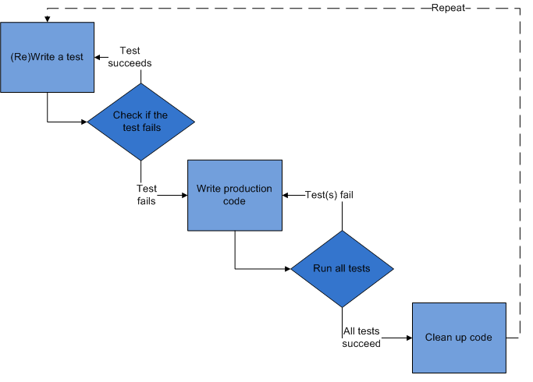
TDD Steps
Write a test
Check that the test fails
Write code
Run tests — pass!
Refactor
Repeat
Professional Vue.js Development
222
Notes:
SAY: Here's the cycle as a flowchart. Notice the loop back from "run all tests" to "write production code" when a test fails, and the loop from "clean up code" all the way back to the start.
TIP: Vitest's watch mode makes the cycle fast: save the file and the result appears in under a second.

Slide 223
Red
Write the story
Invent the interface you wish you had
Characteristics of good tests:
Each test is independent of the others
Any behavior is specified in only one test
No unnecessary assertions
Test only one unit of code at a time
Avoid unnecessary preconditions
Professional Vue.js Development
223
Notes:
SAY: In the red step you're designing, not just testing. Writing the test first forces you to decide what the function or component should be called, what it takes and what it returns, from the caller's point of view.
SAY: Good tests are independent (run in any order), focused (one behavior each), and minimal (no setup they don't need). When a test fails, you should know exactly what broke from its name.

Slide 224
Green
Get the test to pass as quickly as possible. Three strategies:
Fake it — do something, no matter how crude, to make the test pass (even return a constant)
Obvious implementation — if the clean solution is obvious, type it in
…but don't try too hard
Triangulation — only generalize when you have two or more examples
When the second example demands a more general solution, then and only then generalize
Professional Vue.js Development
224
Notes:
SAY: "Fake it" sounds like cheating, but it's useful: return 'Hello, World!' to pass the first test. The second test, for a different name, forces you to write the real implementation. That's triangulation.
KEY POINT: The goal of green is speed. Getting back to a passing state quickly means you're never far from working code.

Slide 225
Refactor
Make it right
Remove duplication
Improve the test
Repeat
Add ideas that aren't immediately needed to a to-do list, not the code
Professional Vue.js Development
225
Notes:
SAY: Now that the tests are green, improve the code: better names, removed duplication, extracted functions. Run the tests after every change.
SAY: The to-do list is a discipline trick: when you think of another case ("what about an empty name?"), write it down as the next test rather than coding it now.

Slide 226
Assertions
An assertion is an expression that checks a value and fails the test if it's wrong
Assertion styles:
expect(buttonText).toBe('Go!') // Vitest / Jest
expect(body).to.be.an('array') // Chai
assert.deepEqual(obj1, obj2) // node:assert
Vitest's expect includes Chai's, with a Jest-compatible API on top
Professional Vue.js Development
226
Notes:
SAY: Different libraries, same idea: compare an actual value with an expected value. In this course we use Vitest's expect with Jest-style matchers like toBe and toEqual.
SAY: Vitest also supports Chai's chainable style (expect(x).to.equal(y)), which helps if you're porting Mocha tests.

Slide 227
JavaScript Testing Frameworks
Vitest — Vite-native; shares your Vite config and transforms
Jest — long the default; needs its own transform setup for Vite projects
Mocha + Chai — runner and assertion library, chosen separately
node:test — built into Node.js since version 18
Playwright / Cypress — end-to-end tests in a real browser
Professional Vue.js Development
227
Notes:
SAY: Unit test runners (Vitest, Jest, Mocha, node:test) run your functions and components in Node, usually with a simulated DOM. End-to-end tools drive a real browser against your running app.
KEY POINT: For a Vite project, Vitest is the natural choice: it reads vite.config.js, so the @ alias, the Vue plugin and environment variables work in tests exactly as in the app, with no separate Babel or Jest config.

Slide 228
JS Exception Handling
function hello(name) {
return 'Hello, ' + name
}
const result = hello('World')
const expected = 'Hello, World!'
try {
if (result !== expected) {
throw new Error(`Expected ${expected} but got ${result}`)
}
} catch (err) {
console.log(err.message)
}
Professional Vue.js Development
228
Notes:
SAY: Before frameworks, here's an assertion by hand: compare, throw an error if it's wrong, catch and report. That's all a test framework does at its core, plus naming, grouping, running and reporting.
DEMO: demos/testing/trythrowcatch.js. Run `node trythrowcatch.js`. It fails ("Expected Hello, World! but got Hello, World"), because hello() is missing the exclamation mark. Fix hello(), run again, and it passes. That's red, then green.
SAY: You could write an assert() helper to tidy this up. Or use a library that already exists, which is the next section.

Slide 229
Vitest Overview
DAY 3
Objectives
Learn about Vitest
Write unit tests with Vitest
Understand the rendering modes: mount vs. shallowMount
Mock modules, functions and timers
Professional Vue.js Development
229
Notes:
SAY: Now the tools we'll use in Lab 23: Vitest to run tests, and Vue Test Utils to mount components inside them.
NOTE: The old notes here described Jasmine, which this course no longer uses.

Slide 230
Vitest
The test runner built for Vite
Reuses your vite.config.js — aliases, plugins and .vue handling all work in tests with no extra configuration
Runs files named *.spec.js or *.test.js
Simulates a browser environment with jsdom or happy-dom
Jest-compatible API: describe, it, expect, vi.fn()
Watch mode re-runs only the tests affected by your last save
Professional Vue.js Development
230
Notes:
SAY: Vitest was created by the Vite team. Because it uses the same transform pipeline as your app, it's fast to start and never drifts out of sync with your build config.
SAY: jsdom is a JavaScript implementation of the DOM. It lets components mount and render in Node without a browser. It's fast, but it's not a real browser: no layout, no real CSS. That's why we'll mention browser testing at the end.
TIP: `npx vitest --ui` opens a browser-based dashboard of your tests.

Slide 231
How Vitest Works
Suites (describe) group your tests
Specs (it / test) contain expectations
import { describe, expect, it } from 'vitest'
describe('A suite is just a function', () => {
it('and so is a spec', () => {
expect(true).toBe(true)
})
})
Set globals: true in the test config to skip the import
Professional Vue.js Development
231
Notes:
SAY: A test file is just JavaScript. describe and it are functions that register tests; Vitest finds the files, runs them, and reports.
SAY: The Conduit config has globals: true, so describe, it and expect are available without importing them. Importing them explicitly is clearer and works either way.

Slide 232
Test Suites
Created with the describe function
Contain one or more specs (and can nest other suites)
Two parameters:
a text description
a function
describe('hello', () => {
// specs go here
})
Setup and teardown: beforeEach, afterEach, beforeAll, afterAll
Professional Vue.js Development
232
Notes:
SAY: Suites group related tests, usually one per function or component, and give the report structure.
SAY: beforeEach runs before every spec in the suite. It's where you create fresh test data, mount a component, or create a fresh Pinia, so specs don't affect each other.

Slide 233
Specs
Created with the it or test function — they're the same thing
Contain one or more expectations (assertions)
describe('hello', () => {
it('concatenates Hello and a name', () => {
expect(hello('World')).toBe('Hello, World!')
})
})
Name specs so that a failure reads like a bug report
Professional Vue.js Development
233
Notes:
SAY: it reads naturally with the suite name: "hello concatenates Hello and a name". test reads better for some teams. Pick one and be consistent.
TIP: it.only runs just that spec, and it.skip skips it. Handy while working, but don't commit them (ESLint plugins can flag them).

Slide 234
Expectations
Also called assertions
Made with the expect function:
takes the actual value
chained to a matcher
which takes the expected value
expect(actual).toEqual(expected)
Professional Vue.js Development
234
Notes:
SAY: Read it out loud: "expect actual to equal expected". If it doesn't, Vitest throws, the spec fails, and the report shows a diff between the two values.

Slide 235
Matchers
expect(fn).toThrow(error)
expect(value).toBe(other) // Object.is (identity)
expect(value).toEqual(other) // deep equality
expect(value).toBeDefined()
expect(value).toBeTruthy() // or .toBeFalsy()
expect(number).toBeGreaterThan(n) // or .toBeLessThan(n)
expect(value).toBeNull() // or .toBeUndefined()
expect(array).toContain(member)
expect(string).toMatch(/pattern/)
await expect(promise).resolves.toBe(value)
Add .not to negate any matcher: expect(x).not.toBe(0)
Professional Vue.js Development
235
Notes:
KEY POINT: The one people get wrong: toBe vs toEqual. toBe checks identity, so two different objects with the same contents are not toBe each other. Use toEqual for objects and arrays.
SAY: For async code, either await the value and assert, or use .resolves / .rejects on the promise. Don't forget the await, or the test finishes before the assertion runs.

Slide 236
TDD vs. BDD
Test-Driven Development
Focused on being useful for programmers
Tests describe results
Terse names
Behavior-Driven Development
Focused on documentation, readable by non-programmers
Tests describe features and behavior
More verbose names ("should …")
Professional Vue.js Development
236
Notes:
SAY: The difference between TDD and BDD is subtle, and mostly in language. TDD is designed for programmers to test software, while BDD helps design and document it in terms the business understands.
SAY: Neither is better. The choice depends on your team, your framework and who reads the tests. The next two slides show the same test both ways.

Slide 237
TDD Example
describe('Counter', () => {
test('tick increases count to 1', () => {
const counter = new Counter()
counter.tick()
expect(counter.count).toBe(1)
})
})
Professional Vue.js Development
237
Notes:
SAY: Arrange, act, assert: create the counter, call tick, check the result. The blank lines separate the three phases, a habit worth copying.

Slide 238
BDD Example
describe('Counter', () => {
it('should increase count by 1 after calling tick', () => {
const counter = new Counter()
const expected = counter.count + 1
counter.tick()
expect(counter.count).toBe(expected)
})
})
Professional Vue.js Development
238
Notes:
SAY: Same test. The name describes behavior in a sentence, and the expectation is expressed relative to the starting state rather than a magic number.

Slide 239
Mocking
Replace real dependencies with controllable fakes:
vi.fn() — a mock function that records how it was called
vi.mock() — replace a whole module
vi.spyOn() — wrap an existing method, keeping the original
vi.useFakeTimers() — control setTimeout and setInterval
vi.stubGlobal() — replace a global such as fetch
Professional Vue.js Development
239
Notes:
SAY: Unit tests should be fast and deterministic. Real network calls, real timers and real dates make tests slow and flaky, so we replace them with fakes we control.
KEY POINT: You'll use vi.mock in Lab 23 to stop HomeContent from calling the real /tags API.

Slide 240
Mock Function
import { expect, it, vi } from 'vitest'
it('records calls', () => {
const mockCallback = vi.fn()
;[0, 1].forEach(mockCallback)
// The mock function was called twice
expect(mockCallback).toHaveBeenCalledTimes(2)
// First call: (value 0, index 0, the array)
expect(mockCallback).toHaveBeenNthCalledWith(1, 0, 0, [0, 1])
})
Professional Vue.js Development
240
Notes:
SAY: vi.fn() creates a function that does nothing but record every call: how many times, with which arguments, what it returned.
SAY: forEach calls its callback with three arguments: value, index and the array. So the first call is (0, 0, [0, 1]).
SAY: You can also give the mock behavior: vi.fn().mockReturnValue(42), or .mockResolvedValue(data) for an async function.
NOTE: The leading semicolon guards against automatic semicolon insertion when a line starts with [. Without semicolons on the previous line, it could be parsed as an index into the line before.

Slide 241
Mocking a Module
Replace a module your component imports, so the test never hits the network:
vi.mock('@/common/api.service', () => ({
default: {
query: vi.fn().mockResolvedValue({ data: { tags: [] } }),
},
}))
vi.mock is hoisted above the imports, so it applies even though it's written after them
Professional Vue.js Development
241
Notes:
SAY: vi.mock takes the module path and a factory function that returns the fake module. Any file that imports @/common/api.service during this test gets the fake instead.
KEY POINT: Hoisting: Vitest moves vi.mock calls to the top of the file before running it. That's why it works even though imports come first in the source. It also means the factory can't use variables defined in the test file (use vi.hoisted() if you need to).
SAY: This is exactly what Lab 23 needs: HomeContent queries /tags when it mounts.

Slide 242
Resetting Mocks
Mocks remember every call, so state leaks between tests.
vi.clearAllMocks() // forget recorded calls
vi.resetAllMocks() // also drop the implementations
vi.restoreAllMocks() // undo every spyOn
Or set clearMocks, mockReset or restoreMocks: true in the Vitest config
Professional Vue.js Development
242
Notes:
SAY: If test A calls a mock twice, test B sees those calls too unless you clear the mock between tests. Put the reset in an afterEach, or turn on the config option so it happens automatically.

Slide 243
Fake Timers
vi.useFakeTimers()
const spy = vi.fn()
setTimeout(spy, 5000)
vi.advanceTimersByTime(5000) // no real waiting
expect(spy).toHaveBeenCalled()
vi.useRealTimers()
Professional Vue.js Development
243
Notes:
SAY: Testing a 5-second timeout shouldn't take 5 seconds. Fake timers replace setTimeout and setInterval with versions you advance manually.
SAY: Useful for debounced search inputs, polling, toasts that disappear, and the lifecycle timer example from Day 2.
TIP: vi.setSystemTime(new Date('2026-01-01')) fakes the current date too.

Slide 244
Snapshot Testing
Renders a component (or any value)
Writes a snapshot file on the first run
Compares later runs against it, and fails if the output differs
Update deliberately with vitest -u, and review the diff
Best for output that should rarely change. A poor substitute for an assertion about behavior.
Professional Vue.js Development
244
Notes:
SAY: Snapshots catch unintended changes to rendered output with almost no effort. The risk is that people update snapshots without reading the diff, which makes the test meaningless.
TIP: Keep snapshots small (one component, not a whole page), and review snapshot changes in code review like any other code.

Slide 245
Sample Snapshot Test
import { mount } from '@vue/test-utils'
it('renders content correctly', () => {
const wrapper = mount(TheHeader, {
global: { plugins: [pinia, router] },
})
expect(wrapper.html()).toMatchSnapshot()
})
The first run creates __snapshots__/TheHeader.spec.js.snap
Professional Vue.js Development
245
Notes:
SAY: wrapper.html() returns the rendered HTML as a string; toMatchSnapshot() compares it with the stored snapshot.
SAY: toMatchInlineSnapshot() writes the snapshot into the test file itself, which is easier to review for small outputs.

Slide 246
Vue Test Utils
The official unit-testing utility library for Vue
Version 2 is the one built for Vue 3
Changes from version 1:
propsData is now props
createLocalVue is gone — use global.plugins
stubs, mocks and provide moved under global
setValue() and trigger() return a promise; await them
Professional Vue.js Development
246
Notes:
SAY: Vue Test Utils mounts a component in the test environment and gives you a wrapper with methods to find elements (find, findAll, findComponent), interact (trigger, setValue) and inspect (text, html, emitted, props).
KEY POINT: await wrapper.find('button').trigger('click') waits for Vue to re-render, so assertions after it see the updated DOM.
SAY: The migration notes matter if students have Vue 2 tests: createLocalVue existed to avoid polluting the global Vue. Vue 3 apps are isolated, so plugins are passed per mount.

Slide 247
mount
Creates a wrapper containing the mounted and rendered component, including all of its children.
const wrapper = mount(TheHeader, {
props: { title: 'Conduit' },
global: { plugins: [router] },
})
expect(wrapper.text()).toContain('Conduit')
Professional Vue.js Development
247
Notes:
SAY: mount renders the real component tree. That gives you confidence that the pieces work together, but it also means every child runs its setup, makes its API calls, and needs its plugins.

Slide 248
shallowMount
Mounts the component with its child components stubbed out.
Useful when a child would fetch data or need its own plugins
const wrapper = shallowMount(HomeContent, {
global: { plugins: [pinia, router] },
})
Children render as <global-feed-stub> placeholders
Professional Vue.js Development
248
Notes:
SAY: shallowMount replaces every child component with a stub that renders nothing (just a placeholder tag), so you test the component in isolation.
SAY: The trade-off: tests are faster and more focused, but they won't catch problems in how the parent and children work together. Many teams use mount by default and stub specific children with global.stubs.
TRANSITION: Lab 23 uses shallowMount with Pinia and a test router.

Slide 249
Testing with Vitest
LAB 23
25 min
Fix the HomeContent tests now that it depends on the router, Pinia and the API.
Run npm run test and read the failure
Create a test router with createRouter and createWebHistory
Create a fresh Pinia in beforeEach
shallowMount with global: { plugins: [pinia, router] }
vi.mock('@/common/api.service') so /tags isn't really fetched
Challenge: test the auth store directly
Professional Vue.js Development
249
Notes:
TIMING: About 25 minutes.
SAY: HomeContent now depends on a store and the router, and it calls the API when it mounts. A bare mount() has none of those, so the test fails. That's the normal state of affairs as an app grows, and this lab shows the standard fixes.
LAB TIPS:
- Read the error message first: it names the injection that couldn't be resolved (Pinia or the router).
- A fresh Pinia per test keeps store state from leaking between tests.
- vi.mock must return the same shape as the real module: a default export with a query method that resolves to { data: { tags: [] } }.
COMMON PROBLEMS:
- Router warnings about no match for the current location: add a catch-all route to the test router, or ignore the warning.
- Tests pass but log network errors: the mock path doesn't exactly match the import path used by the component.

Slide 250
Testing in a Real Browser
DAY 3
Professional Vue.js Development
250
Notes:
SAY: A quick look at testing beyond jsdom. This is a short, mostly informational section.

Slide 251
Browser and End-to-End Testing
jsdom is a fast approximation of a browser, not a browser
Vitest browser mode runs the same tests in a real browser, driven by Playwright or WebdriverIO
Playwright and Cypress drive the whole application end to end
create-vue can set up end-to-end testing for you
Karma, which earlier versions of this course covered, was deprecated in 2023.
Professional Vue.js Development
251
Notes:
SAY: jsdom doesn't do layout, so it can't tell you whether an element is actually visible, whether CSS hides it, or whether it scrolls correctly. For those, run tests in a real browser.
SAY: Vitest browser mode keeps the same test syntax but runs it in Chromium, Firefox or WebKit. End-to-end tools like Playwright test the deployed app the way a user would: open a URL, click, type, check what appears.
KEY POINT: A typical split is many fast unit tests (Vitest and jsdom), some component tests in browser mode, and a few end-to-end tests for critical journeys like sign in and checkout.
NOTE: The old notes here described how Karma worked. Karma is deprecated; the slide now points to its replacements.

Slide 252
Transitions and Animations
DAY 3
<Transition>, <TransitionGroup>, CSS classes and JavaScript hooks
Professional Vue.js Development
252
Notes:
TIMING: Time permitting at the end of Day 3, together with Lab 24. If you're short on time, show the demo (demos/transitions/index.html) and skip the lab.
SAY: Animation makes interfaces easier to follow: an item sliding out tells the user where it went. Vue has animation built in, with no extra library needed.

Slide 253
<Transition>
A built-in wrapper component
Creates enter and leave transitions for the element or component inside it
Triggered by:
conditional rendering (v-if)
conditional display (v-show)
dynamic components (<component :is>)
changing the key of the child
<TransitionGroup> does the same for a list rendered with v-for
Professional Vue.js Development
253
Notes:
SAY: <Transition> wraps a single element or component. When that child is inserted or removed, Vue adds CSS classes at the right moments so your CSS transitions or animations can run, and delays removal from the DOM until the leave animation finishes.
SAY: Changing the key of the child forces Vue to treat it as a new element, which is a neat trick for animating content swaps (for example, :key="currentImage").

Slide 254
How <Transition> Works
When the wrapped element is inserted or removed, Vue:
Checks whether it has CSS transitions or animations; if so, adds and removes the transition classes at the right times
Calls any JavaScript hooks you've provided
If neither, inserts or removes it on the next frame
<button @click="show = !show">Toggle</button>
<Transition name="fade">
<p v-if="show">hello</p>
</Transition>
Professional Vue.js Development
254
Notes:
DEMO: demos/transitions/index.html. Open it in the browser.
1. Click Toggle: the paragraph fades and slides. Show the CSS in the file.
2. Slow it down: change 0.3s to 2s and reload, then inspect the <p> in DevTools Elements while it animates. Students can watch fade-enter-from, fade-enter-active and fade-enter-to appear and disappear on the element.
3. Scroll to the list demo (<TransitionGroup>), add and remove items.
SAY: The name attribute is the prefix for the CSS classes: name="fade" means .fade-enter-active and so on. Without a name, the prefix is v-.

Slide 255
The Transition Classes
Vue applies these classes, prefixed with the transition's name, in order:
v-enter-from — the starting state, applied before insertion
v-enter-active — applied for the whole entering phase (put transition here)
v-enter-to — the end state of the enter transition
v-leave-from — the starting state of the leave transition
v-leave-active — applied for the whole leaving phase
v-leave-to — the end state, applied until the animation finishes
Vue 2 called the first and fourth v-enter and v-leave. That rename is the most common reason an old example stops animating.
Professional Vue.js Development
255
Notes:
SAY: Think of it as three snapshots per direction. -from is where it starts, -to is where it ends, and -active is on for the whole time and holds the transition property (duration and easing).
KEY POINT: You usually only need to style four selectors: the two -active classes (with the transition) and enter-from plus leave-to (with the hidden state: opacity 0, moved a bit). The visible state is just the element's normal styling.

Slide 256
Defining the CSS
.fade-enter-active,
.fade-leave-active {
transition: all 0.3s ease;
}
.fade-enter-from,
.fade-leave-to {
transform: translateX(10px);
opacity: 0;
}
Professional Vue.js Development
256
Notes:
SAY: That's all the CSS needed for a fade-and-slide. Entering, the element starts invisible and 10px to the right, and transitions to its normal state. Leaving, it transitions from normal to invisible and shifted.
TIP: Animate transform and opacity where you can. The browser can animate them without recalculating layout, so they stay smooth even on slow devices.

Slide 257
JavaScript Hooks
<Transition
@before-enter="beforeEnter"
@enter="enter"
@after-enter="afterEnter"
@enter-cancelled="enterCancelled"
@before-leave="beforeLeave"
@leave="leave"
@after-leave="afterLeave"
@leave-cancelled="leaveCancelled"
:css="false"
>
<p v-if="show">hello</p>
</Transition>
Professional Vue.js Development
257
Notes:
SAY: <Transition> emits events at each stage. You can use them alongside CSS, for example to log or to start something after an element has appeared, or instead of CSS, to drive the animation with a JavaScript library like GSAP or the Web Animations API.
SAY: :css="false" tells Vue not to look for CSS transitions at all, which avoids interference and saves a little work.

Slide 258
Using the JavaScript Hooks
Declare the handlers in <script setup>:
function beforeEnter(el) {
el.style.opacity = 0
}
function enter(el, done) {
el.animate([{ opacity: 0 }, { opacity: 1 }], { duration: 300 })
.onfinish = done // tell Vue the animation is over
}
With :css="false", enter and leave must call done()
Professional Vue.js Development
258
Notes:
SAY: Each hook receives the element. enter and leave also receive a done callback. Vue waits for done() before finishing the transition, which for leave means before removing the element from the DOM.
SAY: This example uses the browser's built-in Web Animations API, el.animate(), so no library is needed.
WATCH FOR: Forgetting done() with :css="false". Enter finishes immediately, and leave never removes the element.

Slide 259
Custom Transition Classes
Override the generated class names to plug in a CSS animation library:
enter-from-class
enter-active-class
enter-to-class
leave-from-class
leave-active-class
leave-to-class
Vue 2 named the first and fourth enter-class and leave-class.
Professional Vue.js Development
259
Notes:
SAY: Libraries like Animate.css define their own class names. These props tell Vue to apply the library's classes instead of generated ones like fade-enter-active.

Slide 260
Custom Transition Classes Example
<link
rel="stylesheet"
href="https://cdn.jsdelivr.net/npm/animate.css@4.1.1">
<Transition
enter-active-class="animate__animated animate__tada"
leave-active-class="animate__animated animate__bounceOutRight"
>
<p v-if="show">hello</p>
</Transition>
Professional Vue.js Development
260
Notes:
SAY: Animate.css provides ready-made keyframe animations. animate__animated sets up the animation; animate__tada and animate__bounceOutRight pick which one. Vue adds those classes during enter and leave instead of its own.
DEMO: The transitions demo has an Animate.css example at the bottom.

Slide 261
Transitions and Animations
LAB 24
20 min · optional
Remove articles from the feed with an animated transition.
Add a Remove From Feed icon (maybe a trash can) to each article
When clicked, remove the article from the feed
Wrap the list in <TransitionGroup> and animate articles as they leave
Challenge: add a -move class so the remaining articles slide up
Professional Vue.js Development
261
Notes:
TIMING: Optional; only if time permits at the end of Day 3. Wrap up with Review 3 (quiz/day3.txt), questions and evaluations by 4:30.
LAB TIPS:
- Every child of <TransitionGroup> needs a stable, unique key. Use article.slug, not the index, or the animation attaches to the wrong element.
- Removing an article: keep a visibleArticles computed, or remove it from the store's array with an action.
- The move challenge: .article-move { transition: transform 0.3s } plus position: absolute on .article-leave-active, so the leaving item is taken out of the layout flow.
DEBRIEF: That's the end of the course labs. Recap the app: components, props and events, computed and watchers, lifecycle, forms, slots, composables, Pinia, routing, an authenticated API, tests, and animation.

Slide 262
ES2015 (ES6) and Beyond
APPENDIX · JAVASCRIPT REVIEW
Objectives
Learn what's new
Use arrow functions and block-scoped variables
Create generator functions
Use classes and modules
See how modern code is transpiled
Professional Vue.js Development
262
Notes:
SAY: This appendix is a JavaScript refresher. Use it as needed throughout the course, based on the class's experience. The most useful topics for Vue are: let/const, arrow functions, destructuring, spread, template literals, modules (slides 41-44), and promises/async (slides 301-307).
TIP: Runnable versions of most examples are in demos/js-review. Run any of them with `node <file>`.

Slide 263
Variable Scoping with const and let
const creates a binding that can't be reassigned
The value isn't frozen: an object assigned to a const can still be changed
let creates a block-scoped variable
var is scoped to the whole enclosing function
Redeclaring a let in the same scope is a syntax error
Both are in a temporal dead zone until declared
Using one before its declaration throws a ReferenceError
Default to const; use let when you need to reassign. Avoid var.
Professional Vue.js Development
263
Notes:
SAY: Unlike var, const and let are block-scoped: they exist only inside the nearest curly braces.
SAY: const means the variable can't be pointed at something else. It doesn't make the value immutable: const user = { name: 'Ada' }; user.name = 'Grace' is fine. Object.freeze() is the way to make an object read-only.
KEY POINT: This is why Vue code declares refs with const: const count = ref(0). You change count.value, never count itself.
NOTE: The old slide said let has "no hoisting". Technically let and const are hoisted, but stay uninitialized until their declaration runs, which is called the temporal dead zone.
DEMO: demos/js-review/let-const.js

Slide 264
let vs. var
var
let
var a = 5
var b = 10
if (a === 5) {
var a = 4
var b = 1
}
console.log(a) // 4
console.log(b) // 1
let a = 5
let b = 10
if (a === 5) {
let a = 4
let b = 1
}
console.log(a) // 5
console.log(b) // 10
Professional Vue.js Development
264
Notes:
SAY: With var, the variables inside the if block are the same variables as outside, so the assignments overwrite them. With let, the block creates new variables that disappear when the block ends.
ASK: Which behavior would you expect if you'd never seen JavaScript? (The let behavior. That's why it was added.)
DEMO: demos/js-review/let-const.js

Slide 265
Block-scoped Functions
ES5 (IIFEs)
ES6 (blocks)
(function () {
function foo() { return 1 }
(function () {
function foo() { return 2 }
foo() // 2
})()
foo() // 1
})()
{
function foo() { return 1 }
{
function foo() { return 2 }
foo() // 2
}
foo() // 1
}
Professional Vue.js Development
265
Notes:
SAY: Before ES6, the only way to create a private scope was a function, so we used immediately invoked function expressions (IIFEs). In ES6, a plain block creates a scope, and in strict mode (which includes all modules) function declarations are scoped to their block.
SAY: Modules made IIFEs mostly unnecessary: every module already has its own scope.

Slide 266
Arrow Functions
Also called "fat arrow" functions: a more concise syntax for writing functions.
Function expression (ES5)
Arrow function
const increment = function (v) {
return v + 1
}
const increment = (v) => v + 1
// a block body needs return
const inc2 = (v) => {
return v + 1
}
Professional Vue.js Development
266
Notes:
KEY POINT: With a single expression after the arrow, the value is returned automatically. With curly braces, it's a block body and you need return.
WATCH FOR: The original slide had `increment = (v) => {v+1}`, which is a very common bug: the braces make it a block body, so it returns undefined. Point this out; students will make this mistake in computed properties.
SAY: To return an object literal from a concise arrow, wrap it in parentheses: () => ({ count: 0 }). You'll see this in Pinia's state function.
DEMO: demos/js-review/arrow-functions.js

Slide 267
Arrow Function Parameters
Surround parameter names with parentheses:
(param1, param2, param3) => { statements }
Parentheses are optional when there's exactly one parameter:
singleParam => { statements }
No parameters: empty parentheses are required
() => { statements }
Professional Vue.js Development
267
Notes:
SAY: Prettier, which the Conduit project uses, adds parentheses around single parameters by default, so you'll see (v) => in this course's code.

Slide 268
Arrow Functions and this
Arrow functions don't have their own this: they use the this of the surrounding code.
ES6
ES5
this.nums.forEach((v) => {
if (v % 5 === 0) {
this.fives.push(v)
}
})
var self = this
this.nums.forEach(function (v) {
if (v % 5 === 0) {
self.fives.push(v)
}
})
Professional Vue.js Development
268
Notes:
SAY: In ES5, a callback function got its own this (usually undefined or window), so you had to save the outer this in a variable like self or that. Arrow functions inherit this from where they're defined, which is what you almost always want for callbacks.
SAY: Arrow functions are always anonymous; to name one, assign it to a variable.
KEY POINT: The flip side: don't use an arrow function where you need a dynamic this, like an object method or a Pinia getter that uses this to reach other getters (slide 202).
DEMO: demos/jsdemo.js includes a Counter example comparing a regular inner function and an arrow function.

Slide 269
Default Parameter Handling
ES6
ES5
function myFunc(x, y = 0, z = 13) {
return x + y + z
}
myFunc(4) // 17
function myFunc(x, y, z) {
if (y === undefined) y = 0
if (z === undefined) z = 13
return x + y + z
}
Professional Vue.js Development
269
Notes:
SAY: Defaults apply when the argument is missing or explicitly undefined, but not when it's null.
SAY: You'll see defaults constantly in modern code, for example fetchArticles(params = {}) in the Pinia store in Lab 20.
DEMO: demos/js-review/parameters.js

Slide 270
Rest Parameter
Gathers the remaining arguments into a single array parameter.
function myFunc(x, y, ...a) {
return (x + y) * a.length
}
console.log(myFunc(1, 2, 'hello', true, 7)) // 9
Only the last parameter can be a rest parameter
a is a real array (unlike the old arguments object)
Professional Vue.js Development
270
Notes:
SAY: x is 1, y is 2, and a collects everything else: ['hello', true, 7]. So (1 + 2) * 3 = 9.
DEMO: demos/js-review/parameters.js (replaces the old jsbin.com link).

Slide 271
Spread Operator
Spreads the elements of an iterable (like an array or string) into array literals, function arguments, or object literals.
const params = ['hello', true, 7]
const other = [1, 2, ...params] // [1, 2, 'hello', true, 7]
myFunc(1, 2, ...params) // myFunc(1, 2, 'hello', true, 7)
const chars = [...'foo'] // ['f', 'o', 'o']
// copy an object, overriding one property
const copy = { ...user, name: 'Ada' }
Professional Vue.js Development
271
Notes:
SAY: Spread looks like rest, but does the opposite: rest gathers values into an array; spread expands an array into values.
KEY POINT: Object spread (ES2018) is everywhere in Vue and Pinia code: making a shallow copy of an object with one property changed. Lab 20's updateArticleInList action uses { ...article, favoritesCount: data.favoritesCount }.
DEMO: demos/js-review/spread.js
NOTE: The original slide called MyFunc with a capital M, which would throw a ReferenceError. Fixed.

Slide 272
Template Literals
String interpolation with backticks:
const customer = { name: 'Penny' }
const order = { price: 4, product: 'parts', quantity: 6 }
const message = `Hi, ${customer.name}. Thank you for your order
of ${order.quantity} ${order.product} at $${order.price}.`
Any expression can go inside ${ }
Template literals can span multiple lines
Professional Vue.js Development
272
Notes:
SAY: Template literals are enclosed by backticks (the key above Tab on most keyboards) instead of quotes. Inside, ${expression} inserts the value of any expression.
WATCH FOR: The most common error in Lab 08 is typing single quotes instead of backticks around a template literal. The ${} then appears literally in the output.
DEMO: demos/js-review/template-literals.js

Slide 273
Template Literals: Tags and Raw Strings
A tag function receives the string parts and the values separately, and can read the raw text without escape processing.
function tag(strings, ...values) {
console.log(strings.raw[0])
// "string text line 1 \n string text line 2"
}
tag`string text line 1 \n string text line 2`
String.raw`C:\new\folder` // "C:\new\folder" — backslashes kept
Professional Vue.js Development
273
Notes:
SAY: A tagged template calls a function with the literal parts of the string (strings) and the interpolated values (values). strings.raw has the text exactly as typed, without interpreting backslash escapes like \n.
SAY: You won't write many tag functions, but you'll use them: libraries for GraphQL queries, CSS-in-JS and HTML templating use tags. String.raw is the built-in one.
DEMO: demos/js-review/template-literals.js

Slide 274
Enhanced Object Properties
Property shorthand: a shorter syntax for properties whose name matches a variable.
ES5
ES6
const obj = { x: x, y: y }
const obj = { x, y }
Professional Vue.js Development
274
Notes:
SAY: When the property name and the variable name are the same, you can write the name once.
ASK: In { x, y }, does x refer to the name or the value? (Both: the property is named x and gets the value of the variable x.) How could you check? (console.log(obj) after setting x = 1.)
KEY POINT: You've seen this all week: return { searchDetails, filterIt } in a composable, and return { count, double, increment } in a setup store.

Slide 275
Computed Property Names
Use an expression as a property name in an object literal:
const obj = {
customer: 'Nigel',
['order' + getOrderNum()]: 10,
}
// { customer: 'Nigel', order42: 10 }
Common with dynamic keys: { [field]: value }
Professional Vue.js Development
275
Notes:
SAY: Square brackets around a property name mean "evaluate this expression and use the result as the name".
SAY: A typical use: a generic form handler that updates whichever field changed: form.value = { ...form.value, [field]: value }.
DEMO: demos/js-review/objects.js

Slide 276
Method Notation in Object Literals
ES6
ES5
const obj = {
foo(a, b) {
// ...
},
bar(x, y) {
// ...
},
}
var obj = {
foo: function (a, b) {
// ...
},
bar: function (x, y) {
// ...
},
}
Professional Vue.js Development
276
Notes:
SAY: Method shorthand is how you write actions and getters in a Pinia option store, and methods in the Options API: increment() { this.count++ }.
KEY POINT: Unlike arrow functions, shorthand methods get their own this, which is the object they're called on.

Slide 277
Array Destructuring
Unpack array elements into variables during assignment:
const list = [1, 2, 3]
const [a, , b] = list // a = 1, b = 3 (skip the middle)
;[b, a] = [a, b] // swap without a temporary variable
const [first, ...rest] = list // first = 1, rest = [2, 3]
Professional Vue.js Development
277
Notes:
SAY: The position on the left matches the position on the right. An empty slot skips a value. A rest element collects what's left.
SAY: You've seen array destructuring in v-for: (article, index) in articles is the same idea, and in Lab 18's watch callbacks.
NOTE: The leading semicolon before the swap prevents it being joined to the previous line, since there are no semicolons. jsbin link replaced with a local file.
DEMO: demos/js-review/destructuring.js

Slide 278
Object Destructuring
Unpack object properties into variables during assignment:
const { a, b, c } = { a: 1, b: 2, c: 3 }
console.log(a, b, c) // 1 2 3
const { title, author: { username } } = article // nested
const { data } = await ApiService.query('tags') // from a response
const { count = 0 } = options // with a default
Professional Vue.js Development
278
Notes:
KEY POINT: This is the single most common piece of ES6 syntax in Vue code: const { data } = await axios.get(...), const { searchDetails, filterIt } = useArticleFilter(articles), const { articles } = storeToRefs(store).
WATCH FOR: Remember the reactivity trap from slide 131: destructuring a reactive object copies the values. That's not a destructuring problem; it's what destructuring always does. Refs survive because the variable holds the ref object itself.
DEMO: demos/js-review/destructuring.js

Slide 279
Symbol Primitive
A unique and immutable primitive value
Can be used as an object property key that won't collide with any other
const sym1 = Symbol()
const sym2 = Symbol('foo')
const sym3 = Symbol('foo')
sym2 === sym3 // false — every Symbol() is unique
Well-known symbols customize built-in behavior, e.g. Symbol.iterator
Professional Vue.js Development
279
Notes:
SAY: Each call to Symbol() creates a new, unique value. The string is only a description for debugging; it doesn't make two symbols equal.
SAY: Where you'll see them in Vue: provide/inject keys are often symbols, so two libraries can't accidentally use the same key: export const ApiKey = Symbol('api').
DEMO: demos/js-review/iterators.js

Slide 280
User-defined Iterators
To be iterable, an object (or its prototype chain) must have a method with the key Symbol.iterator
const myIterable = {
*[Symbol.iterator]() {
yield 1
yield 2
yield 3
},
}
;[...myIterable] // [1, 2, 3]
Iterables work with for...of, spread and destructuring
Professional Vue.js Development
280
Notes:
SAY: Arrays, strings, Maps and Sets are built-in iterables. You can make your own object iterable by giving it a Symbol.iterator method that returns an iterator. The easiest way is a generator method, the * syntax, which we'll see in a moment.
DEMO: demos/js-review/iterators.js

Slide 281
The for...of Statement
Iterate over all the values of an iterable object:
const fibonacci = {
[Symbol.iterator]() {
let pre = 0, cur = 1
return {
next() {
;[pre, cur] = [cur, pre + cur]
return { done: false, value: cur }
},
}
},
}
for (const n of fibonacci) {
if (n > 1000) break
console.log(n)
}
Professional Vue.js Development
281
Notes:
SAY: This iterator never ends (done is always false); the loop stops it with break. That's fine, because iterators are lazy: each value is computed only when the loop asks for it.
KEY POINT: for...of gives values; for...in gives keys (property names). Use for...of with arrays.
DEMO: demos/js-review/iterators.js (replaces the old jsbin link).

Slide 282
Creating and Consuming Generator Functions
A generator is a special kind of function that works as a factory for iterators.
function* idMaker() {
let index = 0
while (true) {
yield index++
}
}
const gen = idMaker()
console.log(gen.next().value) // 0
console.log(gen.next().value) // 1
Professional Vue.js Development
282
Notes:
SAY: function* declares a generator. Calling it doesn't run the body; it returns an iterator. Each call to next() runs the body until the next yield, returns that value, and pauses there.
SAY: Generators are why the infinite while (true) loop is safe here: it only advances when asked.
DEMO: demos/js-review/generators.js

Slide 283
Class Definition
ES6 introduced OOP-style classes
Syntax on top of JavaScript's prototype-based inheritance
Created with a class declaration or a class expression
Can have a constructor, methods, getters and setters, static members, and (ES2022) fields and #private fields
Professional Vue.js Development
283
Notes:
SAY: Classes are syntax over prototypes, the same mechanism JavaScript always had, but much easier to read.
SAY: In Vue's Composition API you rarely write classes; functions and composables do that job. You'll still use classes from libraries, and errors (class MyError extends Error).

Slide 284
Class Declaration
class Square {
constructor(height, width) {
this.height = height
this.width = width
}
get area() {
return this.height * this.width
}
}
const sq = new Square(3, 3)
console.log(sq.area) // 9
Professional Vue.js Development
284
Notes:
SAY: constructor runs when you call new Square(...). Methods and getters defined in the class body are shared through the prototype.
SAY: Unlike function declarations, class declarations aren't hoisted for use: you must declare the class before you use it.
DEMO: demos/js-review/classes.js

Slide 285
Class Expressions
Unnamed
Named
const Square = class {
constructor(height, width) {
this.height = height
this.width = width
}
}
const Square = class Rectangle {
constructor(height, width) {
this.height = height
this.width = width
}
}
// the name Rectangle is only
// visible inside the class body
Professional Vue.js Development
285
Notes:
SAY: A class expression assigns a class to a variable, just like a function expression. A named class expression has a name that's only in scope inside the class body, useful for recursion or clearer stack traces.
NOTE: The original "named" example was actually a class declaration. Fixed.

Slide 286
Class Inheritance
class Rectangle extends Shape {
constructor(id, x, y, width, height) {
super(id, x, y)
this.width = width
this.height = height
}
}
class Circle extends Shape {
constructor(id, x, y, radius) {
super(id, x, y)
this.radius = radius
}
}
Call super() before using this in a subclass constructor
Professional Vue.js Development
286
Notes:
SAY: extends sets up the prototype chain; super() calls the parent constructor. In a subclass constructor, using this before super() throws a ReferenceError.
SAY: super.method() calls the parent's version of a method you've overridden.
DEMO: demos/js-review/classes.js

Slide 287
Beyond ES2015
ES2016 (ES7)
Exponentiation operator: 2 ** 10
Array.prototype.includes()
ES2017 (ES8)
async / await
Object.entries(), Object.values()
ES2018+ — object spread, optional chaining, ??, top-level await… (see slide 8)
ES.Next — the name for whatever is coming next
Professional Vue.js Development
287
Notes:
SAY: After ES2015, releases became yearly and smaller. Slide 8 lists the highlights through ES2025.
SAY: New features go through the TC39 proposal process, stages 0 to 4. Stage 4 means it's in the next yearly release. "ES.Next" refers to features that are finished but not yet in a numbered edition.

Slide 288
Advanced JavaScript Topics
APPENDIX · JAVASCRIPT REVIEW
Strict mode, this, map, and promises
Professional Vue.js Development
288
Notes:
SAY: The second half of the JavaScript review: how this works, array methods, and asynchronous code with promises and async/await. The promises section is the most important for Vue work, since every API call uses it.
TIP: The examples on the this slides are collected in demos/jsdemo.js. Run it with `node jsdemo.js` or step through it in the browser.

Slide 289
"use strict"
Introduced with ES5
Opts in to a restricted, safer variant of JavaScript
Turns silent mistakes into errors (assigning to an undeclared variable)
this is undefined in plain function calls, not window
To invoke, put 'use strict' before any other statements in a script or function
function myStrictFunction() {
'use strict'
// ...
}
Implied in ES modules and classes, so it's redundant in modern code
Professional Vue.js Development
289
Notes:
SAY: Strict mode fixes several early design mistakes. The biggest: in sloppy mode, x = 5 without a declaration silently creates a global. In strict mode it throws.
KEY POINT: Every .vue file, every Vite module and every class is automatically strict. You'll never need to type 'use strict' in this course, but it explains behavior like this being undefined in a detached function call.

Slide 290
Understanding this
this lets a function be reused with different context objects
It answers: which object is this function working on right now?
Its value is set by how the function is called, not where it's defined
…except in arrow functions, which use the surrounding this
Professional Vue.js Development
290
Notes:
SAY: In most languages, this always means "the instance this method belongs to". In JavaScript, a regular function's this is decided at call time. The same function can have a different this every time it's called.
KEY POINT: One of the reasons the Composition API is easier: <script setup> code doesn't use this at all.

Slide 291
The 4 Rules of this
Implicit binding — obj.method(): this is obj
Explicit binding — fn.call(obj), fn.apply(obj), fn.bind(obj)
new binding — new Fn(): this is the new object
Default (window) binding — a plain call fn(): window in sloppy mode, undefined in strict mode
Arrow functions ignore all four and use the enclosing this.
Professional Vue.js Development
291
Notes:
SAY: To find this, look at the call site and check the rules in this order: was it called with new? With call, apply or bind? As a method of an object? If none of those, it's the default binding.
TRANSITION: Each rule gets a slide with an example.

Slide 292
What is this?
Ask: how was the function invoked?
We don't know what this is until the function is called
const logName = function () {
console.log(this.name)
}
author.logName = logName
author.logName() // this === author
logName() // this === undefined (strict) or window
Professional Vue.js Development
292
Notes:
SAY: Same function, two calls, two different values of this. That's the key insight: this belongs to the call, not to the function.

Slide 293
Implicit Binding
this refers to the object to the left of the dot.
const author = {
name: 'Chris',
homeTown: 'Detroit',
logName: function () {
console.log(this.name)
},
}
author.logName() // 'Chris'
Professional Vue.js Development
293
Notes:
SAY: author is to the left of the dot when logName is called, so this.name is the same as author.name.
WATCH FOR: Implicit binding is lost when you pass the method somewhere else: setTimeout(author.logName, 100) logs undefined, because setTimeout calls it as a plain function. That's the most common this bug.
NOTE: The original example ended with "});", which is a syntax error. Fixed.

Slide 294
Explicit Binding
.call, .apply and .bind set this explicitly.
const logName = function () {
console.log(this.name)
}
const author = {
name: 'Chris',
homeTown: 'Detroit',
}
logName.call(author) // 'Chris'
Professional Vue.js Development
294
Notes:
SAY: With explicit binding, the function doesn't have to be a property of the object at all. call's first argument becomes this.
NOTE: The original example had mismatched quotes ('Detroit"). Fixed.

Slide 295
Explicit Binding with .call
Calls a function with a given this value and arguments given individually.
const logName = function (lang1) {
console.log(this.fname + ' ' + this.lname + ' ' + lang1)
}
const author = { fname: 'Chris', lname: 'Minnick' }
const languages = ['JavaScript', 'HTML', 'CSS']
logName.call(author, languages[0]) // 'Chris Minnick JavaScript'
Professional Vue.js Development
295
Notes:
SAY: The first parameter of call is the context. Here, logName runs in the context of author. After that come the function's normal arguments, here the first element of the array.
SAY: Inside, the arguments are available as usual, and author's properties are available through this.

Slide 296
Explicit Binding with .apply
Calls a function with a given this value and arguments given as an array.
const logName = function (food1, food2, food3) {
console.log(this.fname + ' ' + this.lname)
console.log(food1, food2, food3)
}
const author = { fname: 'Chris', lname: 'Minnick' }
const favoriteFoods = ['Tacos', 'Soup', 'Sushi']
logName.apply(author, favoriteFoods)
Today, logName.call(author, ...favoriteFoods) does the same thing
Professional Vue.js Development
296
Notes:
SAY: apply works like call, but takes the arguments as an array, which is expanded into the three parameters.
SAY: Memory trick: Apply takes an Array; Call takes Commas.
SAY: Since ES2015, spread makes apply mostly unnecessary.

Slide 297
Explicit Binding with .bind
Works like .call, but returns a new function instead of calling it immediately.
const logName = function (food) {
console.log(
`${this.fname} ${this.lname}'s favorite food was ${food}`
)
}
const person = { fname: 'George', lname: 'Washington' }
const logMe = logName.bind(person, 'Tacos')
logMe() // "George Washington's favorite food was Tacos"
Professional Vue.js Development
297
Notes:
SAY: bind creates a copy of the function with this permanently set (and optionally some arguments pre-filled). Call it later, from anywhere, and this stays bound.
SAY: This was the standard fix for the setTimeout problem from slide 293: setTimeout(author.logName.bind(author), 100). Today an arrow function does the same: setTimeout(() => author.logName(), 100).
DEMO: demos/js-review/this-binding.js (replaces the old jsbin link).

Slide 298
new Binding
When a function is called with new, this is bound to the new object being created.
const City = function (lat, long, state, pop) {
this.lat = lat
this.long = long
this.state = state
this.pop = pop
}
const sacramento = new City(38.58, -121.49, 'CA', 480000)
console.log(sacramento.state) // 'CA'
Professional Vue.js Development
298
Notes:
SAY: new creates an empty object, sets its prototype, calls the function with this pointing at the new object, and returns it. That's what a class constructor does under the hood.
NOTE: Sacramento's longitude is west, so it's negative. Fixed in the example.

Slide 299
Default (window) Binding
When no object is specified or implied, this falls back to the default:
the global object (window) in non-strict scripts
undefined in strict mode, modules and classes
const logName = function () {
console.log(this.name)
}
// in a classic, non-module <script>:
window.name = 'Harry'
logName() // 'Harry'
// in a module or strict code:
logName() // TypeError: Cannot read properties of undefined
Professional Vue.js Development
299
Notes:
SAY: A plain call with no object gets the default binding. In old, sloppy-mode scripts that's window, so this.name reads window.name. In strict code it's undefined, and reading a property of it throws.
KEY POINT: The TypeError is a good thing: it surfaces the bug immediately instead of silently reading a global.
NOTE: The original example passed author as an argument (which has no effect on this) and set window.author rather than window.name, so it didn't print "Harry". Fixed.
DEMO: demos/js-review/this-binding.js. Run it in the browser console to see the window version.

Slide 300
Array.map()
Creates a new array with the result of calling a function on every element
const newArray = arr.map((currentValue, index, array) => {
// return the new element
})
const prices = [10, 20, 30]
const withTax = prices.map((p) => p * 1.1) // [11, 22, 33]
The callback receives the current value, its index, and the array
The original array isn't changed
Professional Vue.js Development
300
Notes:
SAY: map transforms every element and returns a new array of the same length. It never mutates the original.
KEY POINT: Why it matters in Vue: replacing an array is a common way to update state. Lab 20's updateArticleInList action does this.articles = this.articles.map(...) to update one article's favorite count. And in React it's how you render lists (slide 80).
SAY: Its siblings: filter (keep some elements), find (the first match), reduce (combine into one value), and the non-mutating toSorted/toReversed from ES2023.

Slide 301
Promises
APPENDIX · JAVASCRIPT REVIEW
Asynchronous JavaScript, from callbacks to async/await
Professional Vue.js Development
301
Notes:
SAY: Every API call in Conduit is asynchronous: axios returns a promise, and our actions use async/await. This section explains what's happening underneath.

Slide 302
What Are Promises?
An abstraction for asynchronous programming; an alternative to callbacks
A promise represents the eventual result of an async operation
It's always in one of three states:
pending — the initial state
fulfilled — the operation succeeded, with a value
rejected — the operation failed, with a reason (an error)
Once fulfilled or rejected, it's settled and never changes
Professional Vue.js Development
302
Notes:
SAY: A promise is like a receipt from a restaurant counter: you don't have your food yet, but you have something that represents it. You can carry on with other things and react when it's ready, or when they tell you they're out.

Slide 303
Promises vs. Event Listeners
Event listeners are good for things that can happen many times to one object (clicks, keypresses)
A promise can only succeed or fail once
If a promise has already settled, you can still react to it at any time
readJSON(filename).then(onSuccess, onFailure)
Professional Vue.js Development
303
Notes:
SAY: If you add a click listener after the click happened, you missed it. If you call .then() on a promise that already resolved, your callback still runs with the value. That makes promises easy to pass around and combine.

Slide 304
Why Use Promises?
Chain them to transform values or run more async steps in order
Cleaner code: one .catch() handles errors for the whole chain
Avoid the problems of deeply nested callbacks:
"callback hell", the "pyramid of doom", the "Christmas tree"
Combine them: Promise.all, Promise.allSettled, Promise.race, Promise.any
They're the foundation of async / await
Professional Vue.js Development
304
Notes:
SAY: With callbacks, each step that depends on the previous one nests one level deeper, and error handling has to be repeated at every level. Promise chains are flat, and errors fall through to a single catch.
SAY: Promise.all is handy in Vue: load articles and tags in parallel with const [a, t] = await Promise.all([getArticles(), getTags()]).

Slide 305
Callback vs. Promise
DEMO
Files: demos/callback-vs-promise
Callback
import fs from 'node:fs'
fs.readFile('text.txt', (err, file) => {
if (err) console.error(err)
else console.log(file.toString())
})
Promise
import { readFile } from 'node:fs/promises'
readFile('text.txt')
.then((data) => console.log(data.toString()))
.catch(console.error)
Professional Vue.js Development
305
Notes:
DEMO: In demos/callback-vs-promise, run each version:
node callback.js
node promise.js
node async-await.js
Each reads text.txt and prints it. Then rename text.txt (or change the filename in the code) and run them again to show the error path in each style.
SAY: Node's fs module offers both styles: the original callback API, with the error as the first argument, and node:fs/promises, which returns promises.
NOTE: The original slide called a readText() function that didn't exist; it now uses fs/promises.

Slide 306
Creating Promises
Wrap a callback-based API in a Promise:
import fs from 'node:fs'
function readFileAsync(file, encoding) {
return new Promise((resolve, reject) => {
fs.readFile(file, encoding, (err, data) => {
if (err) return reject(err)
resolve(data)
})
})
}
readFileAsync('text.txt', 'utf8').then(console.log, console.error)
In Node, util.promisify() does this for you
Professional Vue.js Development
306
Notes:
SAY: The Promise constructor takes an executor function, which receives resolve and reject. Call resolve with the result when the operation succeeds, or reject with an error when it fails.
SAY: This "promisify" pattern is how promise-based APIs are built on top of older callback APIs. Node ships util.promisify for this, and most modern APIs return promises directly.
DEMO: demos/callback-vs-promise/promisify.js

Slide 307
Async / Await
async functions always return a promise; await pauses until a promise settles.
async function f() {
return 1
}
f().then(console.log) // 1
async function getUser() {
const response = await fetch('/api/user.json')
if (!response.ok) throw new Error(`HTTP ${response.status}`)
return response.json()
}
try {
const user = await getUser()
} catch (err) {
console.error(err)
}
Professional Vue.js Development
307
Notes:
SAY: async/await is syntax over promises. An async function returns a promise of whatever you return. Inside it, await waits for a promise and gives you its value, or throws if it rejects, so you handle errors with ordinary try/catch.
KEY POINT: This is the style used throughout the course: onMounted(async () => { articles.value = await fetchArticles() }) and the async actions in Pinia.
WATCH FOR: fetch only rejects on network failures. A 404 or 500 still resolves, so check response.ok. axios, which Conduit uses, does reject on error status codes.
DEMO: demos/callback-vs-promise/async-await.js

Slide 308
Disclaimer and Copyright
Disclaimer
WatzThis? takes care to ensure the accuracy and quality of this courseware and related courseware files. We cannot guarantee the accuracy of these materials. The courseware and related files are provided without any warranty whatsoever, including but not limited to implied warranties of merchantability or fitness for a particular purpose. Use of screenshots, product names and icons in the courseware are for editorial purposes only. No such use should be construed to imply sponsorship or endorsement of the courseware, nor any affiliation of such entity with WatzThis?.
Third-Party Information
This courseware contains links to third-party web sites that are not under our control and we are not responsible for the content of any linked sites. If you access a third-party web site mentioned in this courseware, then you do so at your own risk. We provide these links only as a convenience, and the inclusion of the link does not imply that we endorse or accept responsibility for the content on those third-party web sites. Information in this courseware may change without notice and does not represent a commitment on the part of the authors and publishers.
Copyright
Copyright 2026, WatzThis?. All rights reserved. Screenshots used for illustrative purposes are the property of the software proprietor. This publication, or any part thereof, may not be reproduced or transmitted in any form by any means, electronic or mechanical, including photocopying, recording, storage in an information retrieval system, or otherwise, without express written permission of WatzThis, 567 Commercial St, Astoria, OR 97103. www.watzthis.com
Help us improve our courseware
Please send your comments and suggestions by email to info@watzthis.com
Professional Vue.js Development
308
Notes:
SAY: Thank you for attending. Please fill out the course evaluation; comments and suggestions also go to info@watzthis.com.

